Slide 1
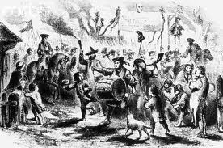
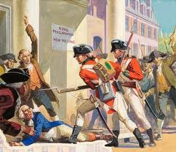
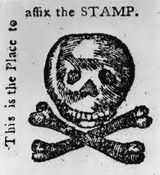
Great Britain Taxes the Colonists
Taxation Without Representation : Gather the Evidence (click on the link below)
Worksheet2: Gathering evidence of the problem

Slide 2
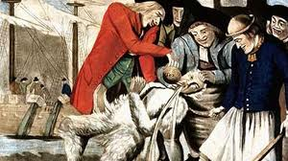
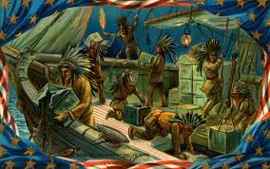
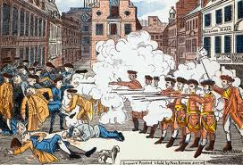
Colonial Protests to Parliamentary Acts and Taxes
Road to the American Revolution

Slide 3
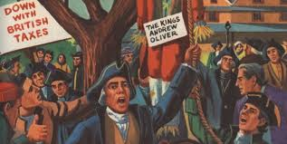
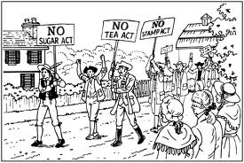
Sugar Act April 5,1764
Provision: revised the duty on sugar, coffee, tea, wine and other imports
Colonial Reaction: several assemblies protest taxation and Revenue.
http://library.thinkquest.org/TQ0312848/suact.htm

Slide 4
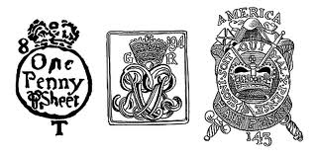
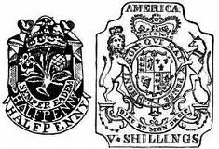
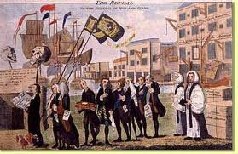
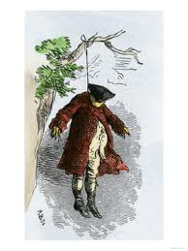
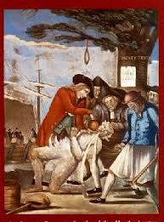
Stamp Act March 22, 1775
Provisions: printed documents such as, deeds, licenses, newspapers etc…) issued only on special stamped paper purchased from stamp distributors.
Colonial Reaction: riots in cities; tax collectors harassed and forced to resign
http://www.socialstudiesforkids.com/wwww/us/stampactdef.htm

Slide 5
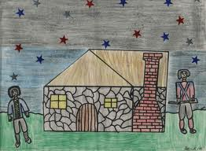
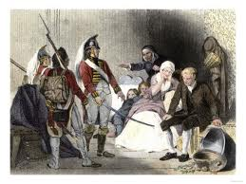
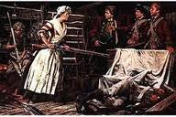
Quartering Act May 1765
Provisions: colonists must supply British troops with food, housing, and guns.
Colonial Reaction: protest assemblies; NY Assembly punished for failure to comply in 1767.
http://www.ushistory.org/declaration/related/quartering.htm

Slide 6
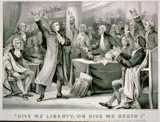
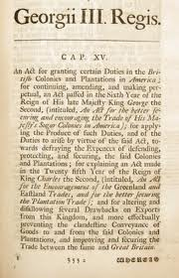
Declaratory Act March 18,1766
Provisions: Parliament declares it’s power to rule (sovereignty) over the colonies “in all cases whatsoever”
Colonial Reaction: Ignored and celebrated the repeal of the Stamp Act.
http://www.stamp-act-history.com/category/declaratory-act/

Slide 7
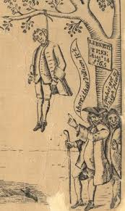
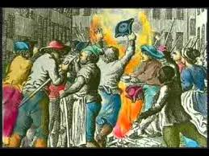
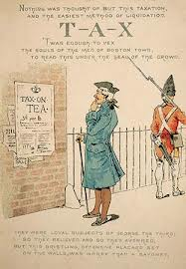
Townshend Acts June/July 1767
Provision: New duties on glass, lead, paper, paints, tea ; customs collections tightened in America.
Colonial Reaction: Nonimportation of British goods; assemblies protest; newspapers attack British policy.
http://www.socialstudiesforkids.com/wwww/us/townshendactsdef.htm

Slide 8
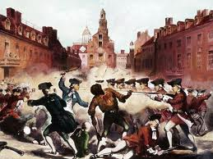
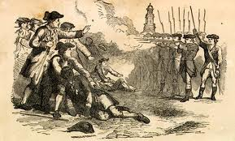
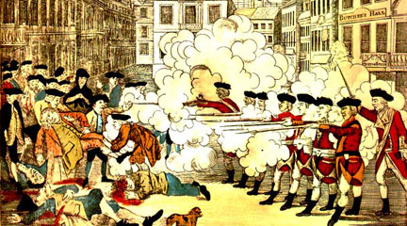
Boston Massacre March 5,1770
Provision: British officers are placed in the streets in Boston.
Colonial Reaction: Colonists throw snowballs, sticks and stones at British officers causing this event.
http://www.americaslibrary.gov/jb/revolut/jb_revolut_boston_1.html

Slide 9
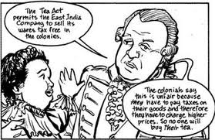
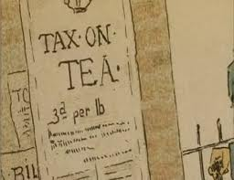
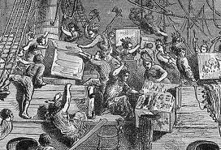
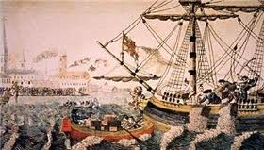
Tea Act May 10,1773
Provisions: Parliament gives the East India Company the right to sell tea directly to Americans: some duties (taxes) reduced.
Colonial Reaction: Protests against favoritism shown to companies who monopolize business; tea destroyed in Boston Harbor on December 16,1773.
http://www.boston-tea-party.org/tea-act.html

Slide 10
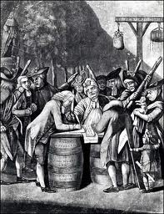
Coercive Intolerable Act March-June 1774
Provisions: Closes the Port of Boston; restructures Massachusetts government; restricts town meeting; troops quartered in Boston; British officials accused of crimes sent to England or Canada for trial.
Colonial Reactions: Boycott of British goods; First Continental Congress convenes(September 1774)
British Parliament adopts the Coercive Acts — History.com This Day in History — 3/28/1774

Slide 11
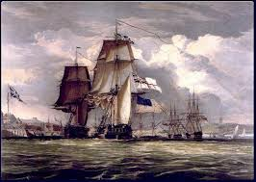
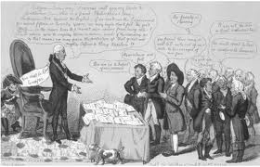
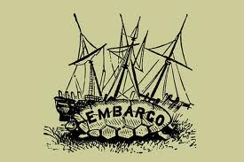
Prohibitory Act December 22,1775
Provisions: Declares British intention to coerce Americans into submission; embargo on American goods; American ships seized.
Colonial Reactions : Drives the Continental Congress closer to decision for independence.
http://en.wikipedia.org/wiki/Prohibitory_Act

Slide 12
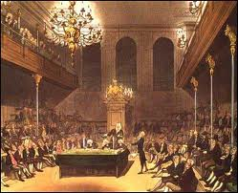
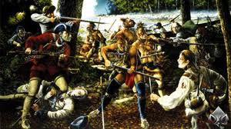
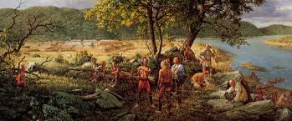
French and Indian War Ends
How does the British Government pay for the French and Indian War?
http://www2.maxwell.syr.edu/plegal/ppa/worksheet3us.html

Slide 13
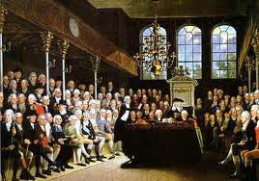
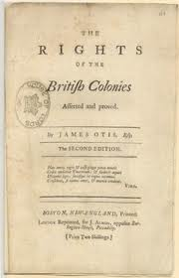
Great Britain taxed the colonists without giving them Represenation in Parliament. Is this a good idea?
Evaluate the policy
http://www2.maxwell.syr.edu/plegal/ppa/worksheet4us.html
http://www.ushistory.org/us/9g.asp

