Slide 1
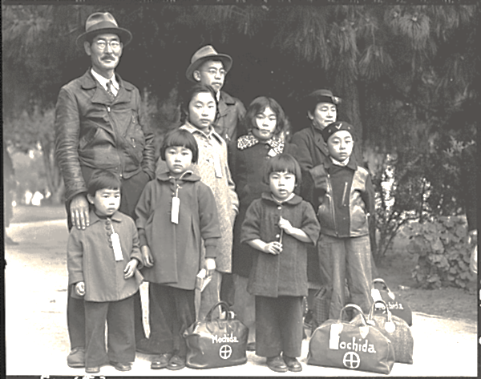
Japanese-American Internment
Kelly Hajdasz
JFK Middle School
Utica City School District
Khajdasz@uticaschools.org

Slide 2
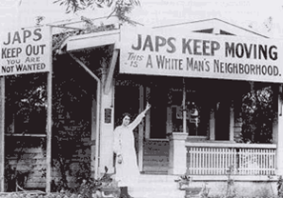
Japanese-American Internment
After the attack on Pearl Harbor, many Americans questioned the loyalty of Japanese Americans, fearing they may act as spies or help Japan invade the U.S.

Slide 3
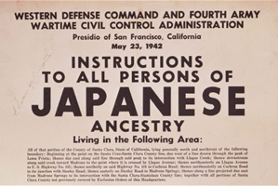
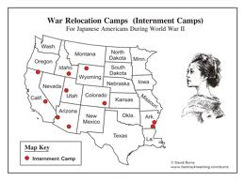
The Wartime Relocation Agency (WRA) forced approximately 120,000 Japanese Americans to relocate to inland camps, living in crowded barracks behind barbed wire.

Slide 4
Identify the Problem
Who was involved?
What happened?
Where did it happen?
When did it happen?
Why did it happen?
How did it happen?

Slide 5
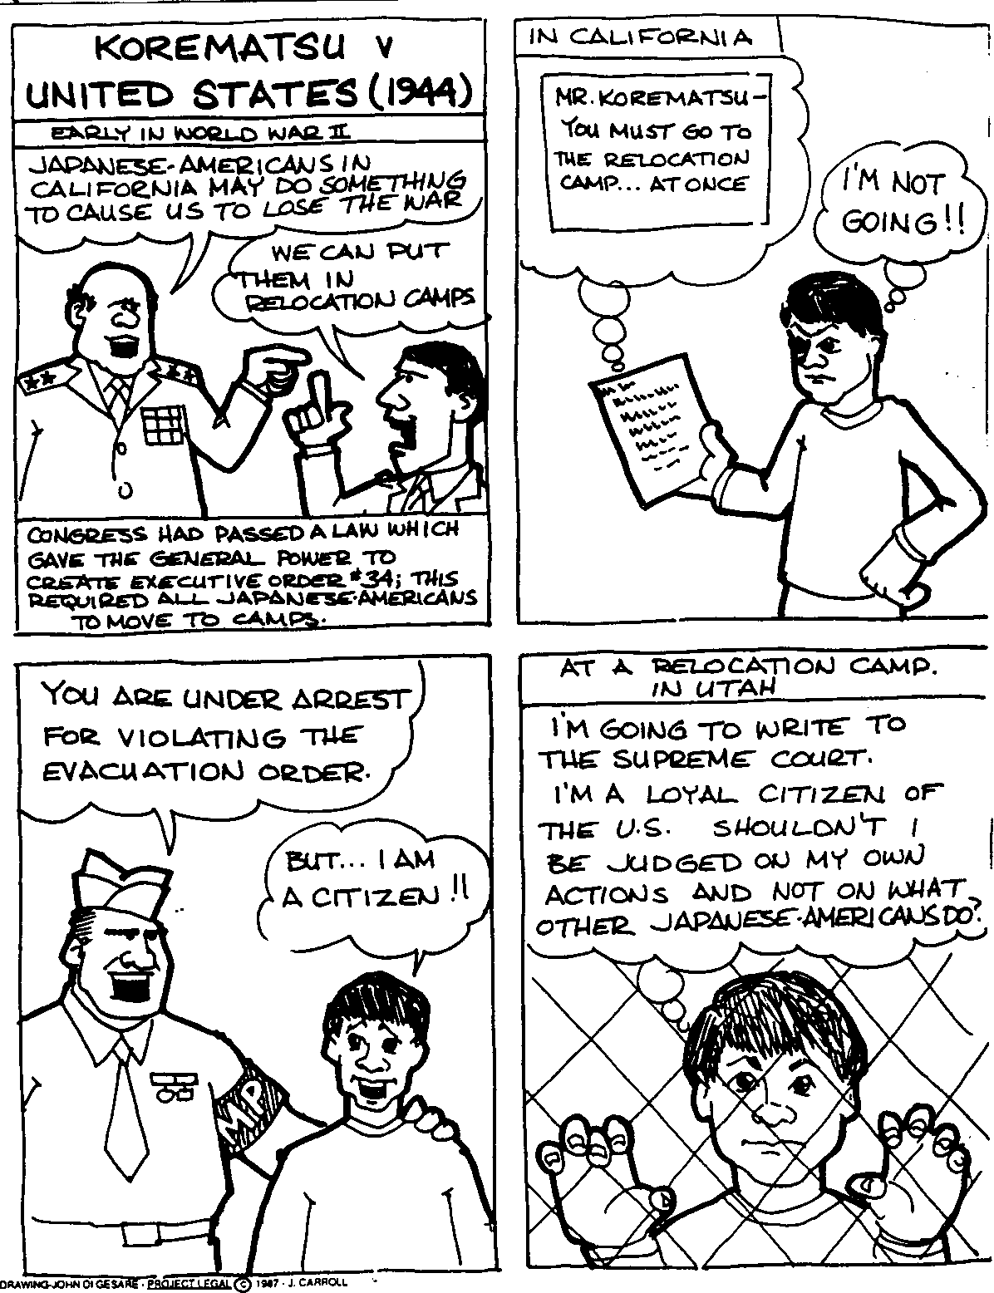
Korematsu v. U.S.
Japanese American Internment (U.S. Govt Film)
Korematsu Information

Slide 6
This Is the Enemy
Prisoner of My Country
Kenji

Slide 7
Gather Evidence
Why was Japanese-American Internment necessary?
Why was Japanese-American Internment unnecessary?

Slide 8
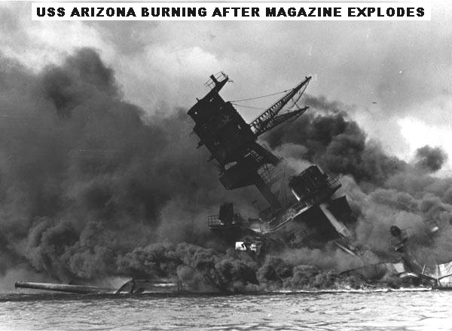
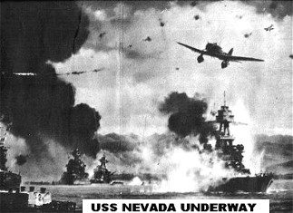
December 7, 1941
CASUALTIES
2,408 KILLED - 1,178 WOUNDED = 3,586 TOTAL
NOTE: Many more were known to have received wounds from shrapnel and other flying debris that didn't receive hospitalization in the already overcrowded medical facilities and no records were kept of their treatment.

Slide 9
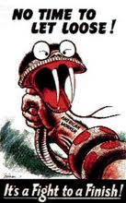
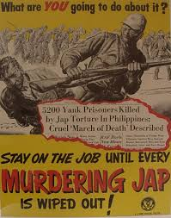
Executive Order 9066

Slide 10
Determine the Causes
Attack on Pearl Harbor
Anti-Japanese Sentiment
Executive Order 9066
For each of the above events, answer the following questions:
Who was involved?
What happened?
Where did it happen?
When did it happen?
Why did it happen?
How did it happen?

Slide 11
Evaluate the Policy
Use the link to evaluate the American relocation policy. Was the government justified in placing Japanese-Americans in internment camps?
Yes No
1.
2.
3.
Explain your position on whether or not the government was justified in placing Japanese-Americans in internment camps.

Slide 12
Resources
Pearl Harbor: The Attack. Photographs. http://www.pearlharborsurvivorsonline.org/. April 30, 2013
Anti-Japanese propaganda posters. Propaganda posters.puredanceensemble.com,
http://www.kidport.com/Reflib/WorldHistory/WorldWarII/WorldWarIIPacificEvents.htm,
http://fortmissoulamuseum.org/WWII/detail.php?id=431 . May 1, 2013
Korematsu v. United States. Cartoon. http://www.streetlaw.org/en/landmark/cases/
korematsu_v_united_states. May 2, 2013
Japanese family. Picture. http: //www.nationalww2museum.org/learn/education/for-students/ww2-history/ww2-by-the-numbers/japanese-american-internment.html.May 5, 2013
Japanese-American Internment. Pictures. http://elliottworldwar2.wikispaces.com/ Japanese-American+internment+camps ,http://mvmsreader.pbworks.com/w/page/
7927229/Farewell%20To%20Manzanar%20B%20Block, http://www.nww2m.com/
2012/02/executive-order-9066-70th-anniversary-japanese-internment-februrary-19/wdc-japanese-internment-announcement/, http://www.fasttrackteaching.com/burns/
Unit_10_WW2/U10_race_issues.html . May1, 2013

Slide 13
Media Sources
This is the Enemy. Video.http://www.youtube.com/watch?feature=player
_detailpage&list=PL64CF32E398486D3C&v=JkaQqzumMGE.May 2, 2013
Manzanar. Music Video. http://www.youtube.com/watch?v=Xon4mjDXB8&playnext
=1&list=PLC6E7984A80F52585 . May 6, 2013
Japanese Relocation. Gov’t propaganda film. http://www.youtube.com/watch?v=
_OiPldKsM5w. May 1, 2013
Pearl Harbor attack scene. Movie. http://www.youtube.com/watch?v=WHU5l788bgs. May 2, 2013
Declaration of War. Speech to Congress.http://www.youtube.com/watch?v
=lK8gYGg0dkE. May 2, 2013
Executive Order 9066. Letter. http://www.archives.gov/historical-docs/todays-doc/?dod-date=219. May 2, 2013
Uchida, Yoshiko. (1995). Prisoner of My Country. The Invisible Thread: p.72-79. New York, NY: Beech Tree Books

