Slide 1
Transportation Revolution:
Erie Canal (1817-1825)
and the National Road (1811-1838)

Slide 2
The American History Public Policy Analyst (AHPPA)
Step 1: Define the Problem
Step 2: Gather the Evidence
Step 3: Determine the Causes
Step 4: Evaluate the Policy

Slide 3
Identify some problems that early American farmers faced?
http://www2.maxwell.syr.edu/plegal/ppa/usppaip2.html

Slide 4
Travel times from NYC to the Mississippi River in 1800 & 1830
Evidence of the Problem

Slide 5
In 1800, travel form New York City to the Mississippi River took six weeks.
Evidence of the Problem

Slide 6
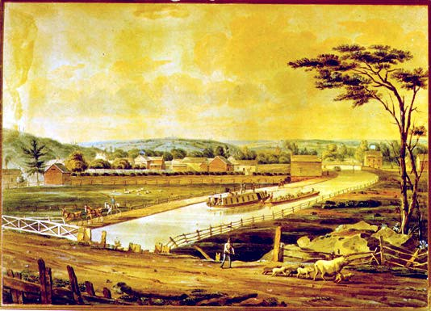
By 1830, travel form New York City to the Mississippi River took three weeks.
Evidence of the Problem

Slide 7
In the early 1800’s, 9 out of 10 Americans were subsistence farmers
Causes of the Problem

Slide 8
Population Density of the U.S. in 1800
Causes of the Problem

Slide 9
The U.S. before 1815
Agricultural exports include: cotton, tobacco, and wheat
9 out of 10 farmers are primarily subsistence farmers
Most local economies are primarily local subsistence/barter economies
Causes of the Problem

Slide 10
1815 was a ‘watershed’ moment
Beginning of Transportation Revolution
New emphasis on road building, as evidenced by National Road (1811-1838)
In 1816, there were 100 miles of canals
By 1840, there were 3,326 miles of canals

Slide 11
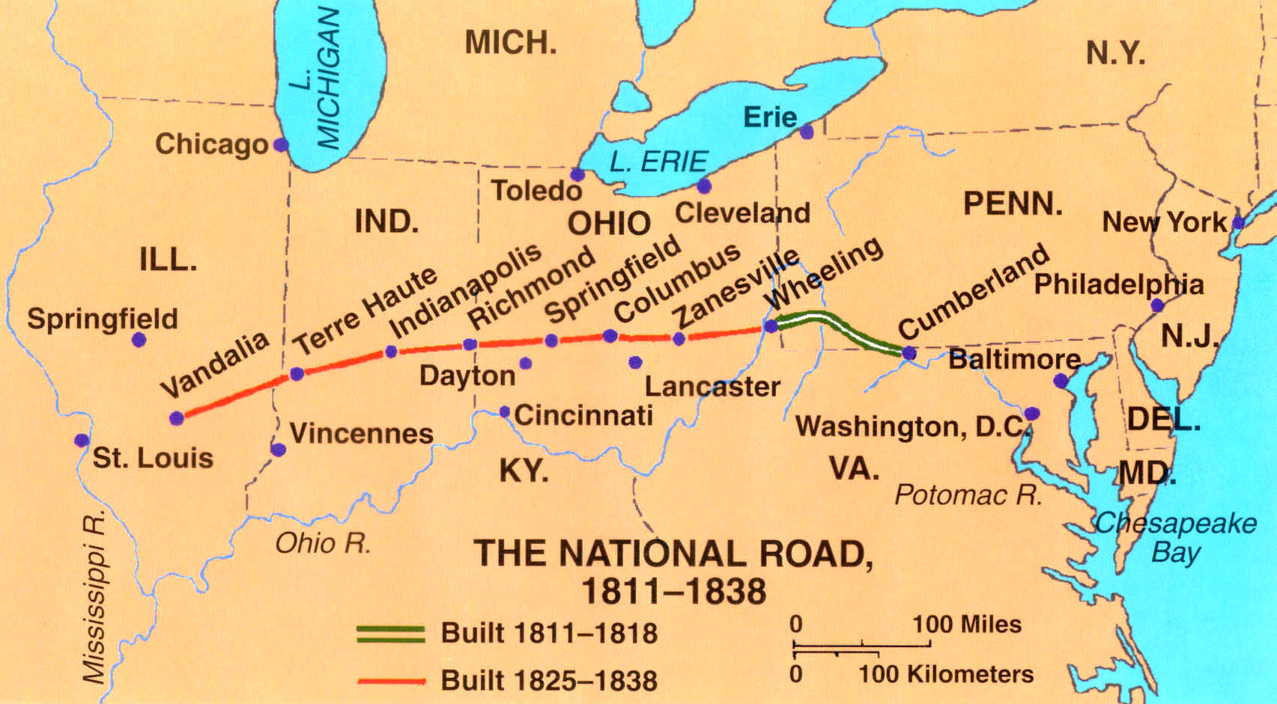
The National Road (1811-1838)

Slide 12
early road construction crew

Slide 13
Erie Canal (1817-1825)
Albany to Buffalo 364 miles
Relatively flat
Highest point is 650 feet above sea level
Marvel of engineering
Cost to transport a ton of goods: in 1816, it cost $9 to transport 30 miles over land, almost the same cost to ship 3,000 miles over the Atlantic Ocean to England.
By 1860 the cost had dropped by almost 95%

Slide 14
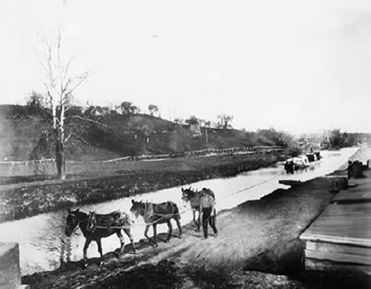

Slide 15
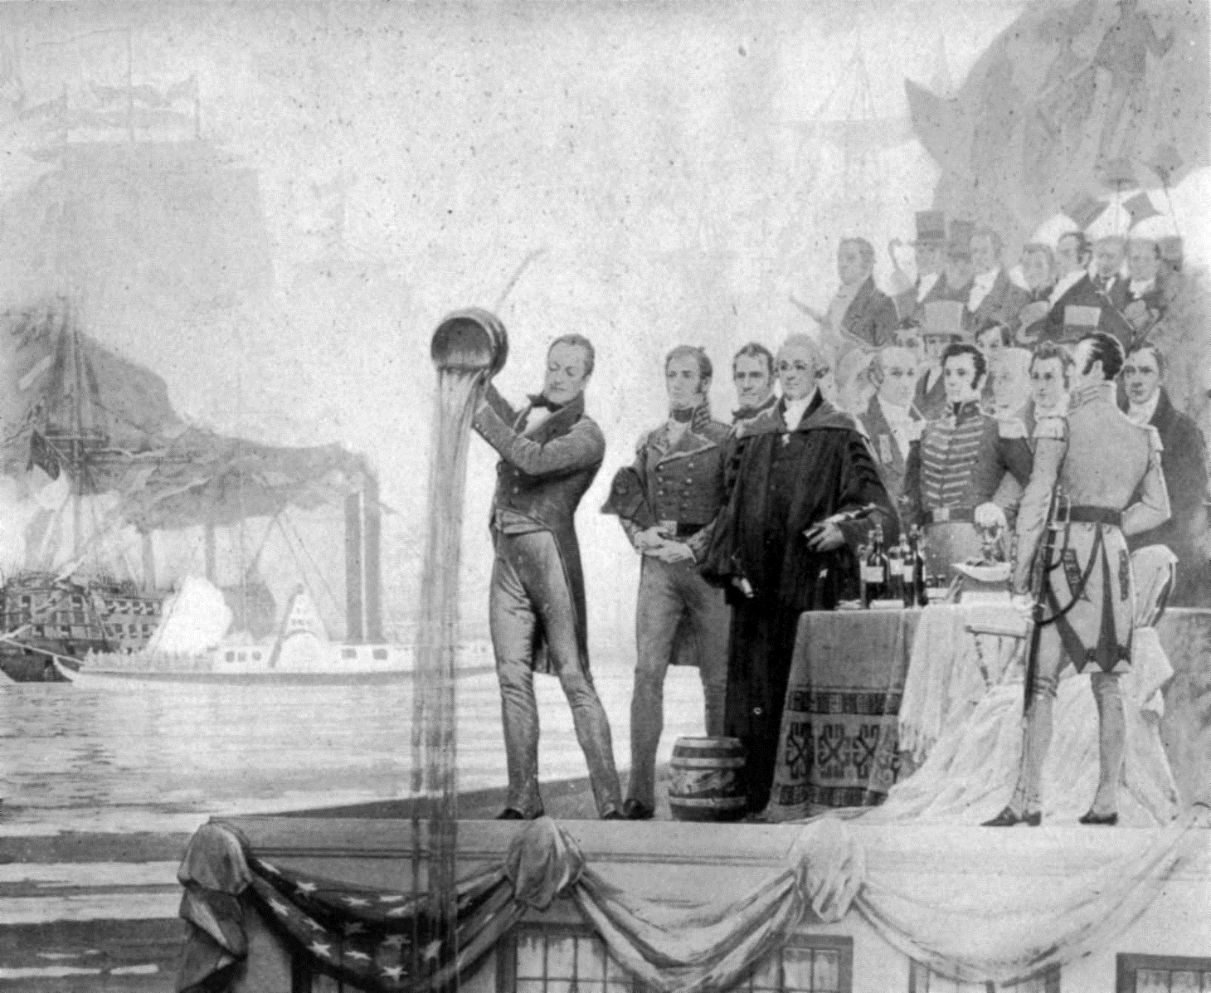
Celebration at the Completion of the Erie Canal

Slide 17
Evaluate the effectiveness of infrastructure improvements.
www2.maxwell.syr.edu/plegal/ppa/usppaep1.html

