Slide 1
World War II
Chapters 24, 25 & 26

Slide 2
From Isolation to War
- Congress further prevented international involvement by passing a series of Neutrality Acts.
- The 1st Neutrality Act prevented the US from providing weapons to nations at war.
- The 2nd act banned loans to nations at war.
- The 3rd act permitted trade of nonmilitary goods with fighting nations, as long as those nations paid cash and transported the cargo themselves. This policy became known as cash and carry.
The Lend-Lease Act
- In December 1940, Britain confessed its inability to pay cash for supplies.
- In response, Roosevelt announced a new plan to provide war supplies to Britain without any payment in return.
- Despite protest from the America First Committee, Congress passed the Lend-Lease Act in March 1941.
- This act authorized the President to aid any nation whose defense he believed was vital to American security.

Slide 3
Pearl Harbor Attacked
The Attack
- On the morning of December 7, 1941, Japanese warplanes attacked the American naval base at Pearl Harbor on the Hawaiian island of Oahu.
- In less than 2 hours, 1000’s of Americans were killed and wounded, and hundreds of American ships and planes were destroyed.
- The attack on Pearl Harbor stunned Americans. Roosevelt declared December 7, 1941 as “a date which will live in infamy.”
- On December 8, Congress passed a war resolution, and Roosevelt signed a declaration of war on Japan.
- On December 11, Germany and Italy declared war on the US. America was once again involved in a world war.

Slide 4
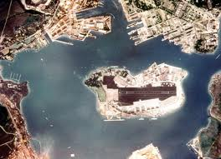
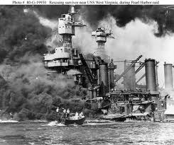
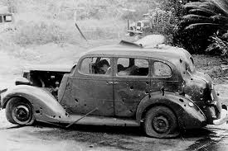
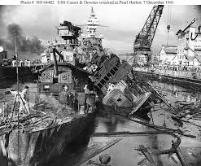
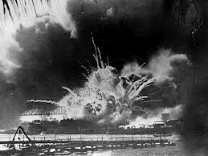
Pearl Harbor Pictures

Slide 5
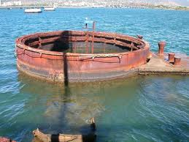
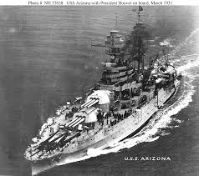
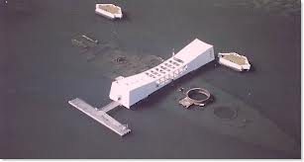
Pearl Harbor Pictures: USS Arizona

Slide 6
Internment of Japanese Americans

Slide 7
Internment of Japanese Americans
American History Public Policy Analyst
Step #1 Identify the Problem:
- As a group you should fill out and print the attached Worksheet #1 that is below….
Worksheet 1

Slide 8
Internment of Japanese Americans
American History Public Policy Analyst
Step #2 Gathering Evidence of the Problem:
Are you sure it is a real problem?
What is your evidence?
Fill out and print attached Worksheet #2 that is below….
Suggestions:
www.google.com www.archives.gov
www.wikipedia.org www.pbs.org/childofcamp/history
www.ushistory.org/us/51e.asp
Worksheet 2

Slide 9
Internment of Japanese Americans
American History Public Policy Analyst
Step #3 What are the causes?
Some things to think about….
- After the bombing of Pearl Harbor many American found themselves wary of Japanese Americans and immigrants.
- Were they or could they be spies for their government or a danger to society?
As a group you should fill out and print Worksheet #3 that is attached below…
Worksheet 3

Slide 10
Internment of Japanese Americans
American History Public Policy Analyst
Step #4 Evaluating the Policy
“With the historian, … knowledge of the past is a key to understanding the present”.
What do you think the famous historian, Kenneth M. Stampp, meant by that statement?
In Step #4, you and your group or class will evaluate it.
Fill out and print attached worksheet #4 that is below…
Worksheet 4

Slide 11
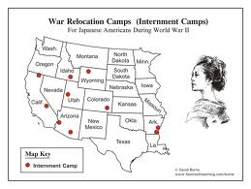
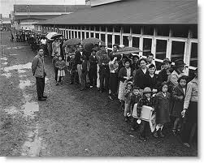
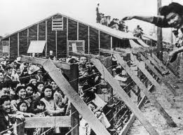
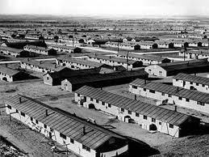
Internment of Japanese Americans

