Slide 1

FlippedTIPS : LTG
Professional Development: DAY TWO
Web-based Presentations
and
Screencasts
Kate E. O’Hara, Ph.D.

Slide 2

Introductions
FlippedTIPS LTG

Slide 3

What is it?
Web 2.0

Slide 4

Technology
Equity and Access

Slide 5
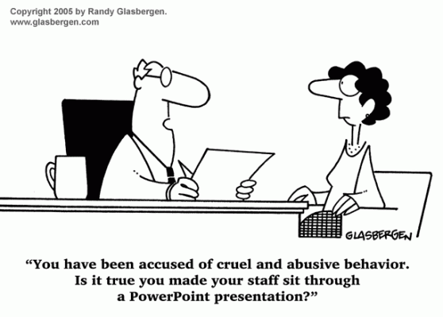
Presentations
Web-based

Slide 6
Web based Presentations
Google Slides
Canva
Prezi
Web-based Presentations

Slide 7

Web based Presentations
Web-based Presentations

Slide 8
Web based Presentations
24/7 access
Free
Create and collaboration
Store online
Share / Publish
.
.
.
.
Web-based Presentations

Slide 9

Google Slides
Presentations

Slide 10

Presentations

Slide 11
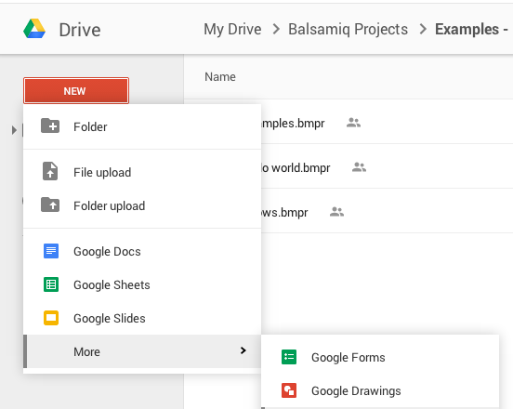
Presentations

Slide 12
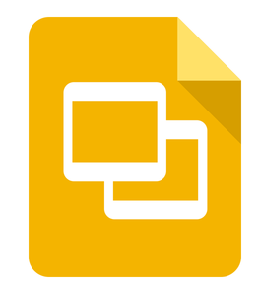
About Google Slides
https://www.google.com/slides/about/
Presentations

Slide 13
Getting started: Google Slides
https://www.youtube.com/watch?v=5Sa9qehBRX0
Presentations

Slide 14

Canva
https://www.canva.com
Presentations

Slide 15
About Canva
https://www.canva.com/create/presentations/
Presentations

Slide 16
Getting Started: Canva
https://support.canva.com/hc/en-us/articles/213256257
Presentations

Slide 17

Prezi
https://prezi.com
Presentations

Slide 18
About Prezi
https://prezi.com/features
Presentations

Slide 19
Getting started: Prezi
https://prezi.com/support
Presentations

Slide 20

presentation tools:

Slide 21
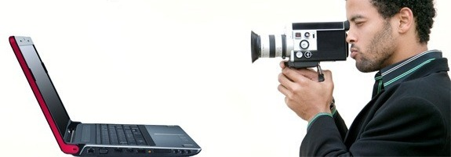
Screencasts

Slide 22
screencast
A screencast is a digital video recording that captures actions taking place on a computer desktop.
Screencasts, which often contain voice-over narration,
are useful for demonstrating how to use specific operating systems, software applications or website features.
Screencast production requires some kind of video-capture software and a microphone. The software, which can be a desktop client or web-based service, captures and synchronizes the video and audio files and compresses the completed movie into a format that can be shared.
Screencast

Slide 23

Screencasting tools:
Jing
https://www.techsmith.com/jing.html
Screencast

Slide 24

Screencasting tools:
Screencast –o– matic
https://screencast-o-matic.com/home
Screencast

Slide 25
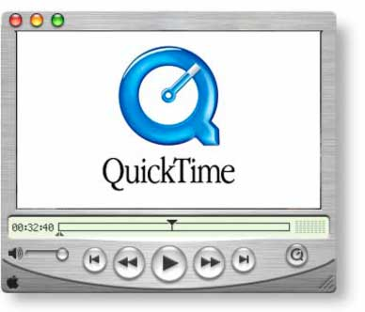
Screencasting tools:
Quick Time Player (Mac, iPhone, iPad, or iPod touch)
Screencast

Slide 26
Screencasting tools:
Quick Time Player
Make sure that you're using Mac OS X Snow Leopard v10.6.3 or later. Download QuickTime Player 7,
then double-click the downloaded file to open it.
Choose File, New Screen Recording (the keyboard shortcut is Control, Command, N).
Press the Record button.
A screen with additional instructions will appear. ...
When you're finished, click on Stop Recording on the Menu Bar.
https://support.apple.com/en-us/HT201066
ShowMe (iPad app / http://www.showme.com)
Screencast

Slide 27

Screencasting tools:
Snagit (Chrome extension expire August 2016)
ClipChamp, Google Cast, Screencastify, Capturecast
(Chrome extension)
HOW DO I GET CHROME EXTENSIONS?

Slide 28

Screencasting tools:

Slide 29


Slide 30



url shorteners

Slide 31
Qr CODES
What are QR codes?
Originally designed in Japan for the automotive industry, marketers adopted the barcodes because of their large storage capacity and ability to translate additional information to consumers beyond what packaging could convey.
If a consumer sees a QR code somewhere, they can take out their mobile device, open up a QR code scanner, and "scan" the barcode to gain access to additional information.
What happens when a student scans your originally designed QR code?

Slide 32
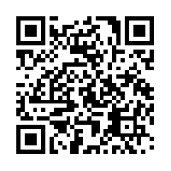
Qr CODES
Quick response (QR) codes are easy to create and have many uses in education.
QR STUFF
http://www.qrstuff.com

Slide 33

Kate E. O’Hara, Ph.D.
kateeohara@cs.com

