Slide 1

Working with
Multilingual Learners in the
Content Classroom
Catherine Box
January, 2023
Presented to NYC DOE ProjectCRITICAL teachers

Slide 2
Agenda
-- Case Study: Who is the Better Language Speaker?
-- Introduction to Pragmatics
+ Defining Pragmatics
+ Speech Acts
-- Takeaways for Classroom Teachers

Slide 3
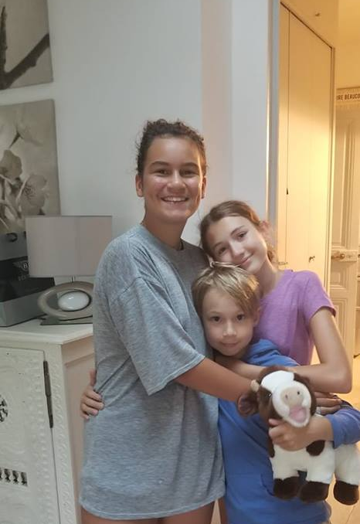
Inspired by Olivia, Océane, and Sam

Slide 4
Océane, 9th grader
Olivia, 9th grader
--French and English spoken at
home; limited French in
community
--Formal study began in 6th grade
--Unwilling to take risks in L2
--High level of receptive
knowledge: understands joking
and sarcasm; follows topic
changes
--Low productive knowledge
--Deep understanding of French and
Francophone cultures
--French spoken at home; no
English in community
--Formal study began in 1st grade
--Willing to take risks in L2
-- Typically developing receptive
knowledge: rarely “gets” joking
and sarcasm; difficulty
following topic changes
-- Typically developing production
--Superficial understanding of
Anglophone culture

Slide 5
What resources does each language learner bring to the classroom?
What kinds of activities would benefit each language learner?
GROUP TASK

Slide 6
Components of Language
Vocabulary
Grammar
Language
Pronunciation
PRAGMATICS

Slide 7

PRAGMATICS IN THE CLASSROOM
--what is pragmatics?
--how can knowledge of pragmatics help in the multilingual classroom?

Slide 8
Pragmatics
Study of language as a tool of social interaction (Wierzbicka, 2003).
-----------------
The study of meaning in context (all that surround
the language).
Study of the relationship between speakers.
More gets communicated than what is said!
Notes:
The way these sentences are used– not what is said but how it is said.
The environment in which it is used– how is it presented, what is the tone, what are the circumstances.

Slide 9
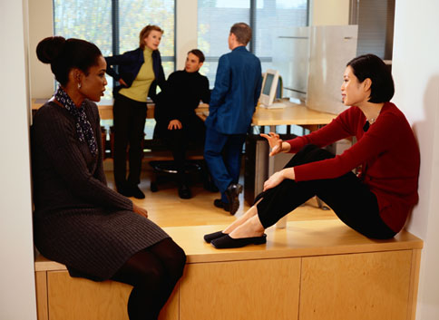
Having communicative competence
means knowing more than grammar and vocabulary. It means knowing how to use language in socially appropriate ways.
Hymes (1966)
Notes:
So what does pragmatics do for language learners? It helps to build their communicative competence, a term coined by a famous anthropologist, Dell Hymes.

Slide 10
Why teach pragmatics?
Assessing our students’ existing pragmatic knowledge and developing our students’ awareness of pragmatics is crucial to developing communicative competence. In other words, our students need to know more than grammar and vocabulary. They need to be able to use the language effectively in and out of class.
Native speakers are less forgiving of pragmatic error than any other kind. (Tannen, 1985)
Teaching pragmatics is not “frosting on the cake” (Beebe, 1995)

Slide 11
What’s the difference?
COLUMN A
That car is red.
I went to the store yesterday.
She is going to get married!
COLUMN B
I promise I’ll buy you a red car.
I’m sorry for what happened at the store yesterday.
I’d like to invite you to my wedding.

Slide 12
Speech Acts
Actions performed by words: by saying the words, you are doing the action.
-- developed by the philosophers Austin (1962) and Searle (1969).
-- Blum-Kulka (1997) argued that speech acts are basic unit of
linguistic communication
Greetings, requests, complaints, compliments, apologies, refusals…
Can you provide any others?

Slide 13
Speech Act Deep Dive
Apologies

Slide 14
Doing Speech Acts: Role Plays
Situation #1:
You are meeting a friend for dinner. Traffic is heavy, and you are running 30 minutes late (your phone is dead, so you can’t text or call). What do you say to your friend when you finally arrive?
Situation #2:
You have scheduled a meeting with an administrator to discuss next year’s schedule. You are running 30 minutes late (your phone is dead, so you can’t text or call). What do you say when you finally arrive?

Slide 15
English Apology Speech Act Set
Express apology (statement of remorse):
“I’m sorry.”
Acknowledge responsibility:
“I should have left earlier.”
Explain situation:
“Traffic was horrible.”
Offer repair:
“Coffee is on me/ I’ve got all afternoon.”
Promise forbearance:
“I’ll be sure to leave earlier next time.”
Notes:
What determines how much of the speech set you perform?

Slide 16
Mini-task: What happens here? Did the man apologize?
https://www.youtube.com/watch?v=0_QfilVbAd4&list=RD0_QfilVbAd4

Slide 17
Why are Speech Acts important?
When spoken/written in English, they usually require politeness, deference, or indirectness. (cf other languages)
They are an integral part of communicative competence, specifically pragmatic competence.
They often come as part of a speech event, of which “native speakers” are not necessarily aware.

Slide 18
What does Pragmatic aware mean for classroom TEACHERS?
Students may have better developed pragmatic competence than linguistic competence (or vice versa).
--students may “sound fluent” but struggle with
academic language.
--students may have strong writing skills, but not be
aware of pragmatic norms.
Being aware of the pragmatic aspects of language sensitizes us beyond simply being “culturally sensitive.”

Slide 19

Thank you!
Catherine Box, Ed.D.
cbox@upenn.edu
Division of Educational Linguistics

