Slide 1
Introducing…
Scaling-Up
Project
CRITICAL

Slide 2
Peanuts Cartoon
What are the three types of people depicted in the following cartoon?

Slide 3
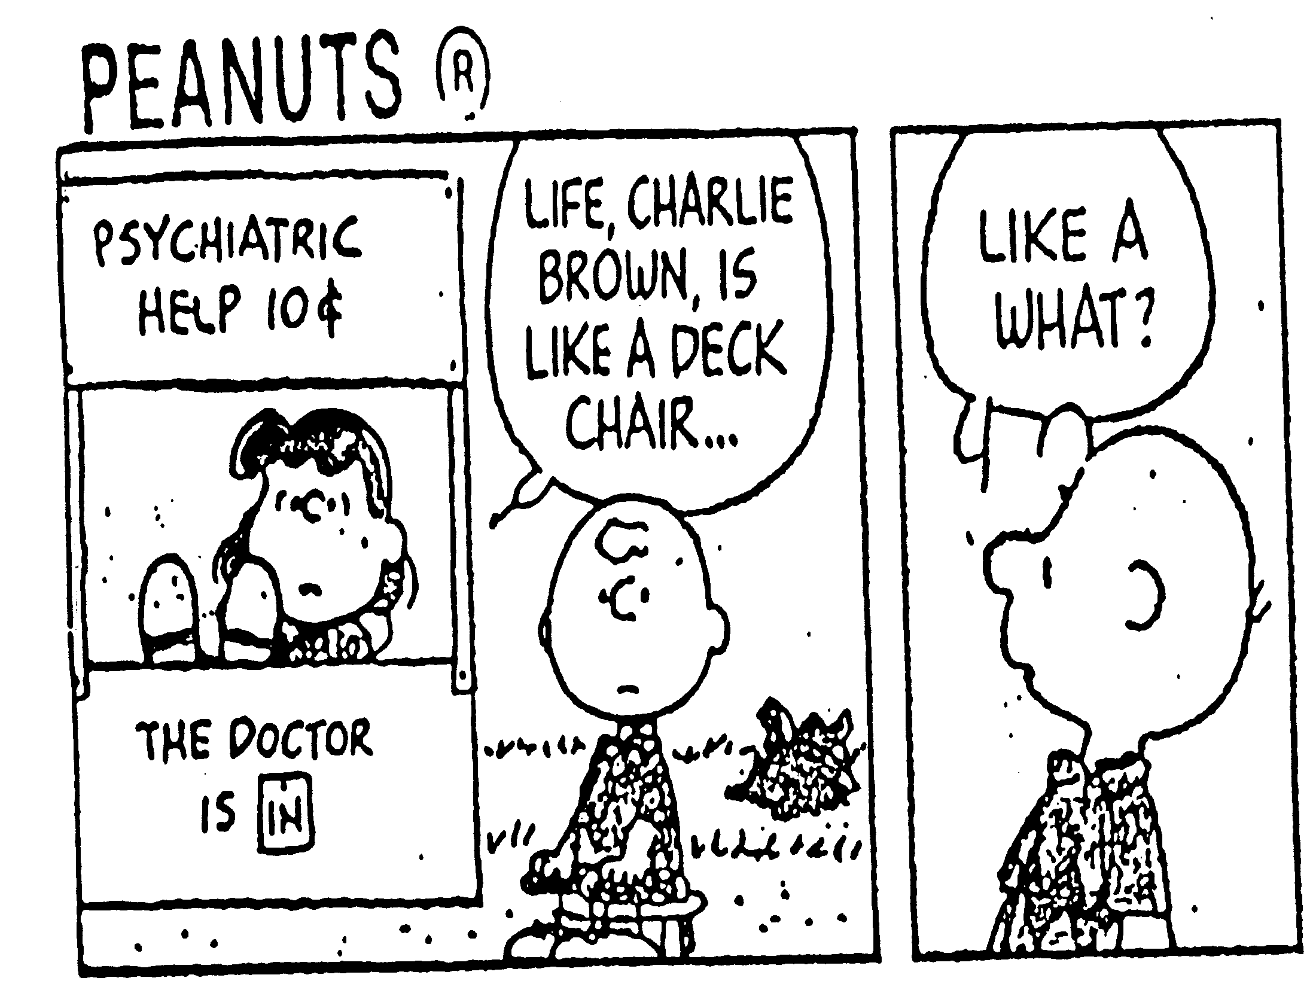

Slide 4
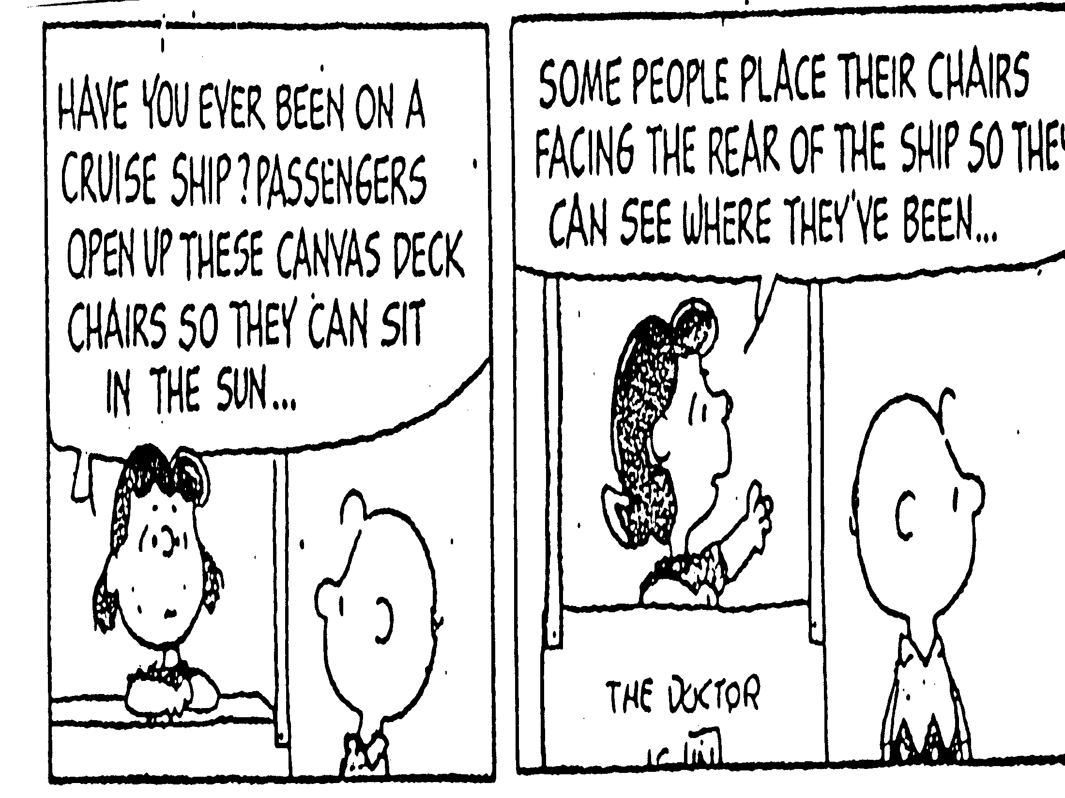

Slide 5
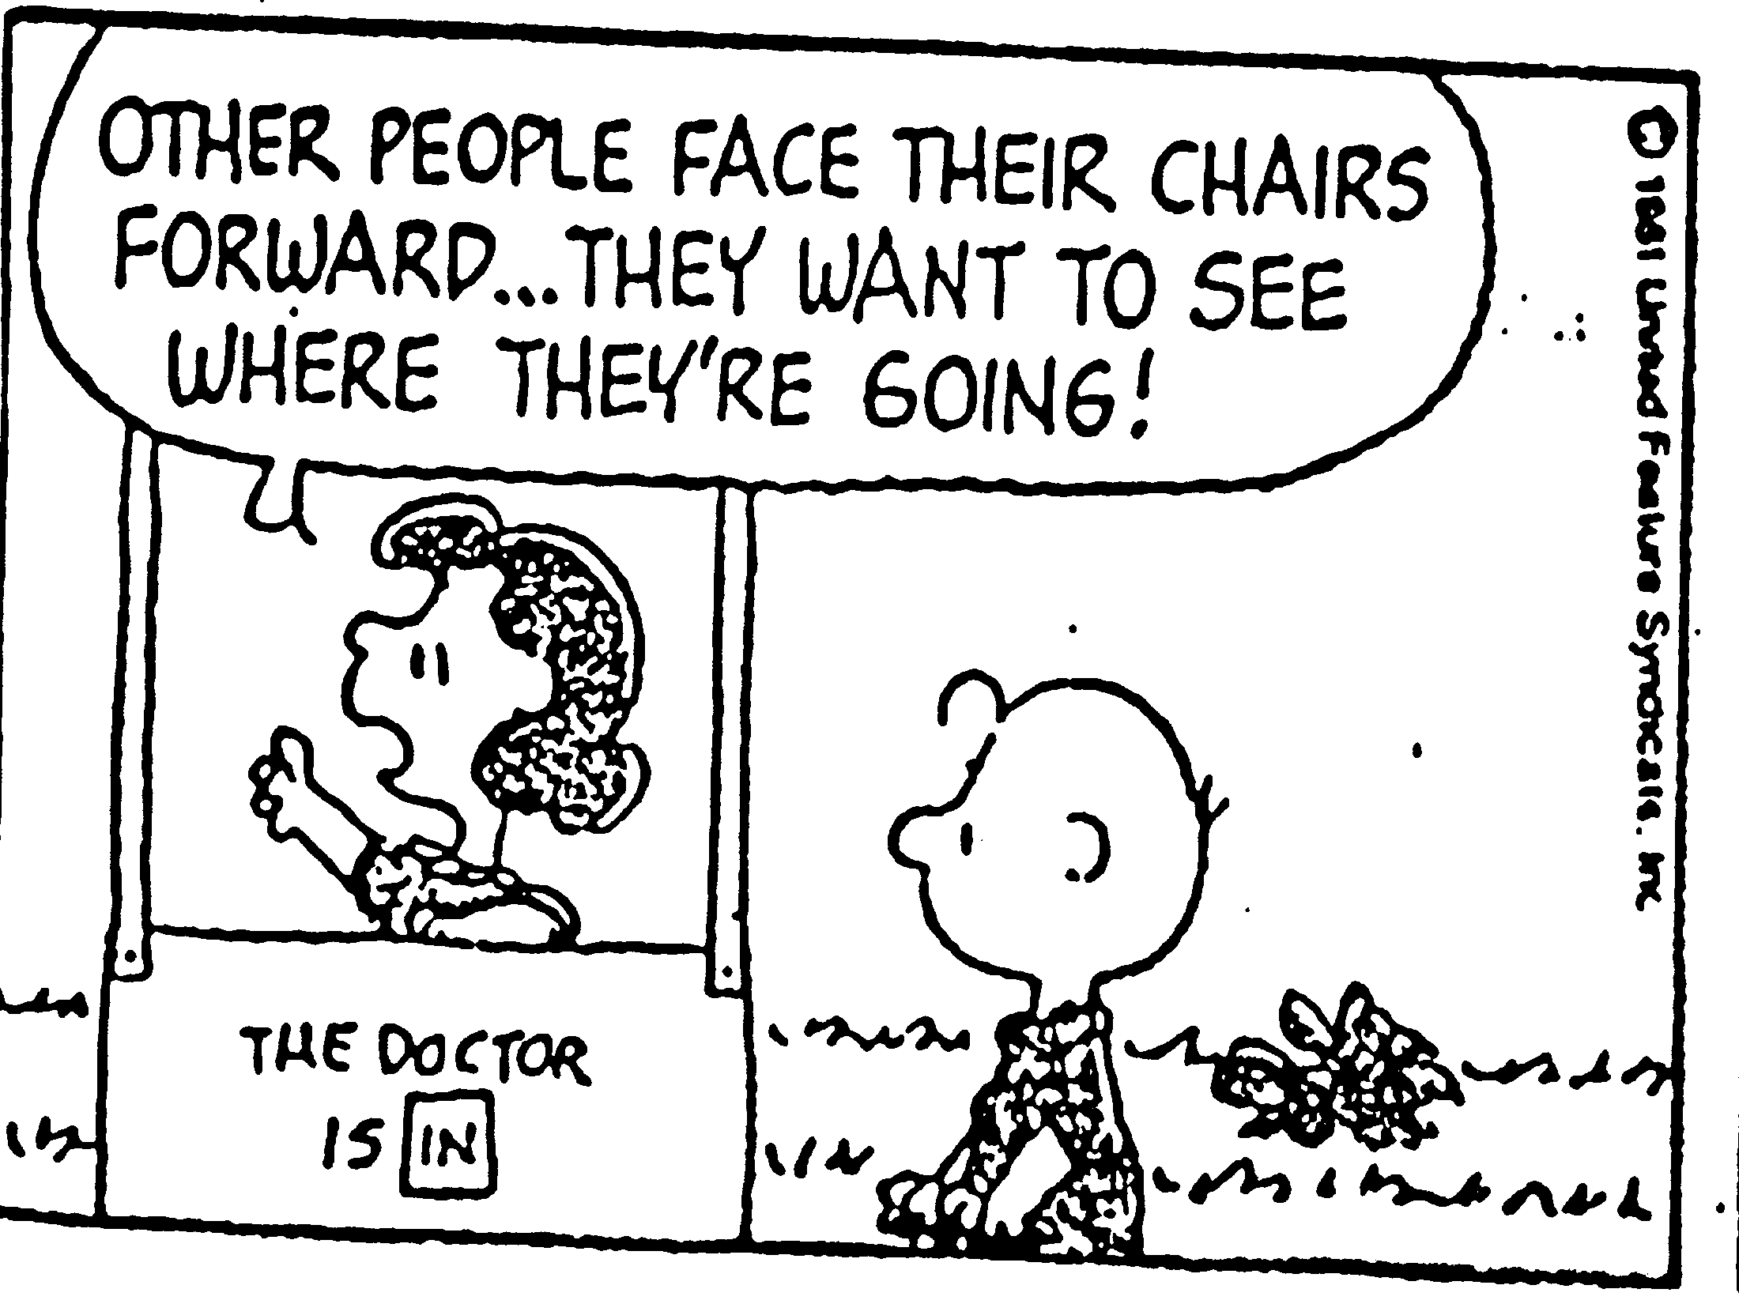

Slide 6
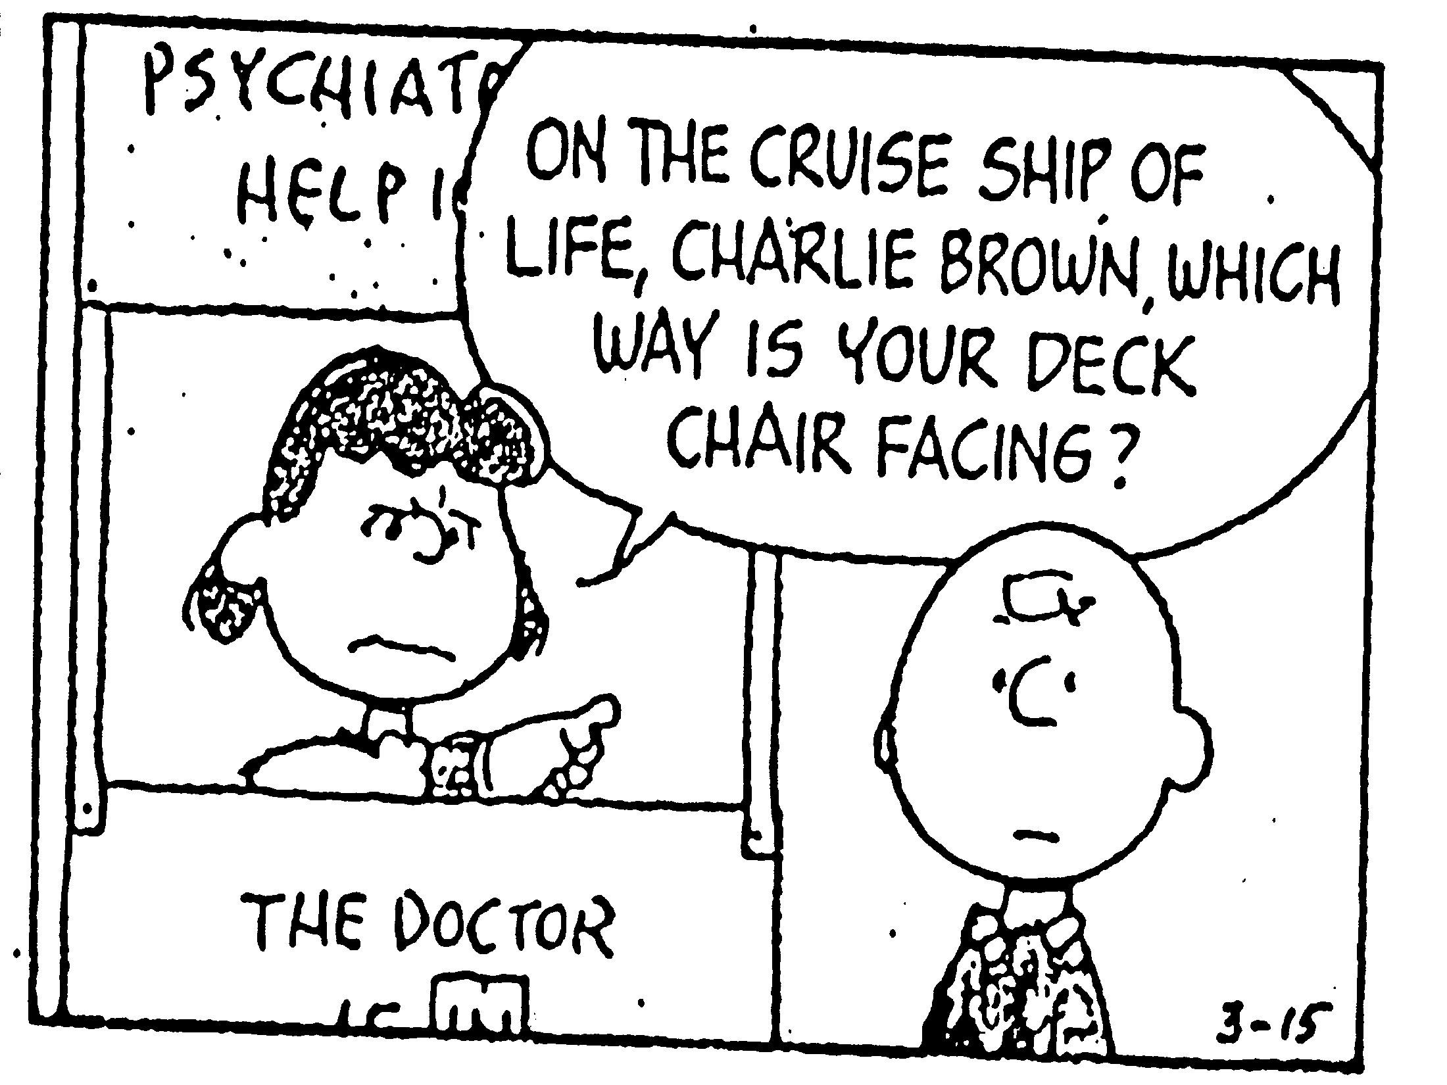

Slide 7
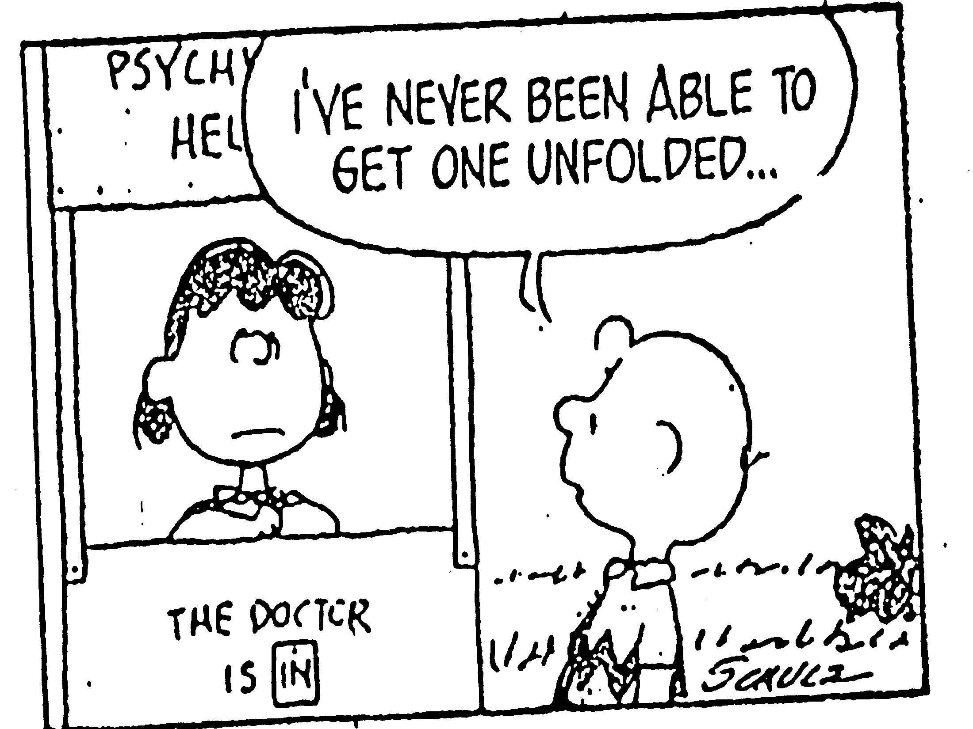

Slide 8
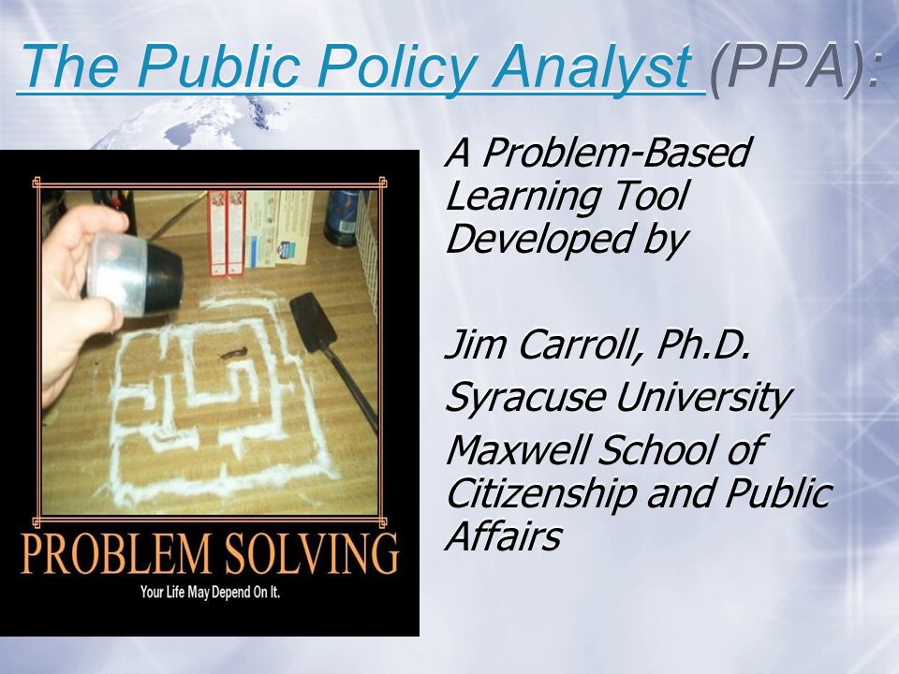
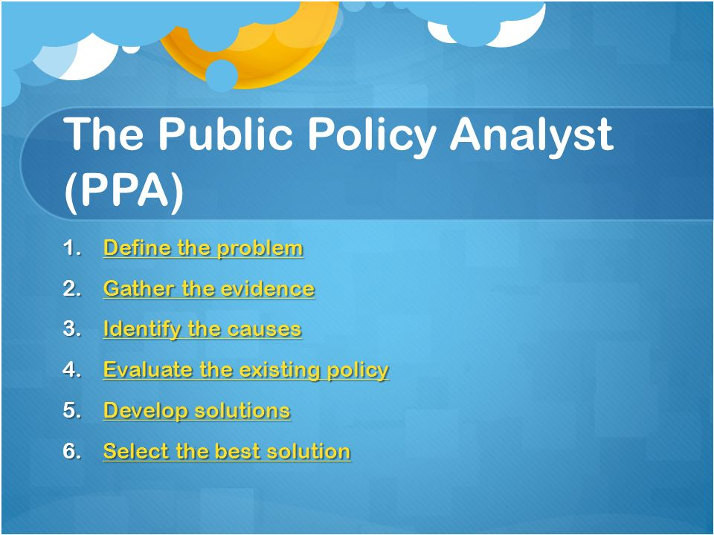
What Will Teachers Be Learning?
and
Joe Montecalvo

Slide 9
What Will Teachers Be Learning?
How to identify social problems to use with the PPA that may be found in…
…your content curriculum or
…your classroom or
…your school or
…your community

Slide 10
What Will Teachers Be Learning?
How to use the six steps of the PPA and…
How to develop WebQuests and PowerPoints or Prezis to teach students the PPA problem solving method

Slide 11
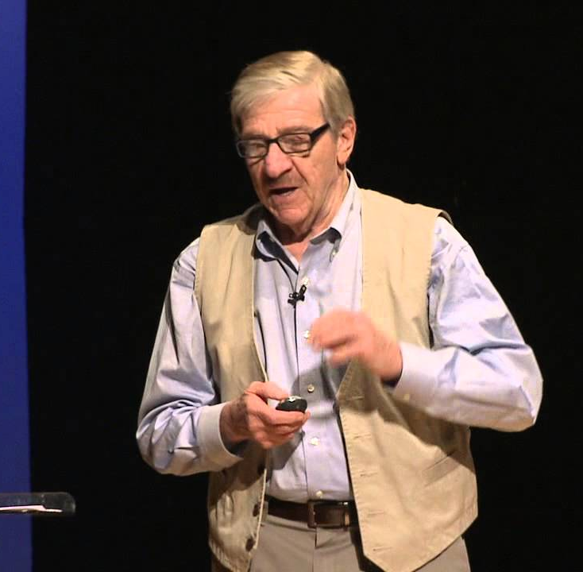
How to Identify Talent Pool Students
The nation’s leading expert in gifted education, Joe Renzulli, will show you how to identify G/T students in your classrooms by using his…

Slide 12

Joe Renzulli of UConn will be here today after lunch to present and again in April!

Slide 13

Once you identify G/T and regular students, you will need to learn how to differentiate your curriculum and teaching
Professor Heather Pinedo-Burns, a G/T expert at TC, Columbia University ,will do presentations on differen- tiated instruction and other strategies for working with G/T and regular students

Slide 14

Do you have any English Learners?
Have you had Professional Development on how to best meet their needs?

Slide 15

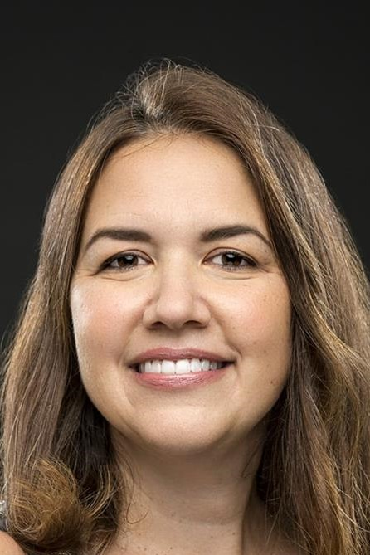
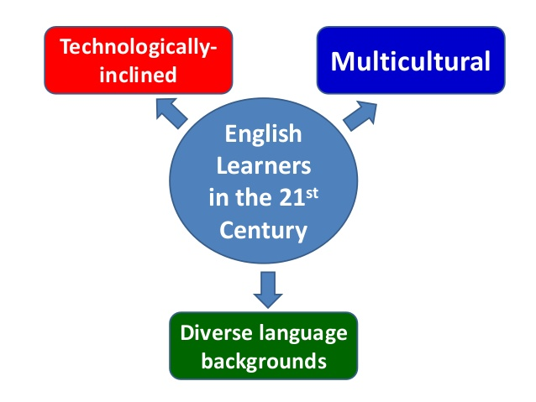
Scaling-Up has a focus on…
Professor Catherine Box of UPenn with conduct 4 workshops on strategies to use with English Learners…

Slide 16
Scaling-Up
Project CRITICAL
A 5-year Gifted Education Grant for CSD 5 based on Syracuse University’s Project LEGAL

Slide 17
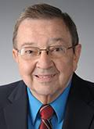
Project LEGAL
Created in 1976 by Director, Jim Carroll, Ph.D.
First, Jim had nine years experience as a social studies teacher in Syracuse, and taught 3 more years as he developed Project LEGAL; then BOCES & SU

Slide 18
Project LEGAL
New York State validation in 1979

Slide 19
Project LEGAL
USED validation in 1982, 1992 & 1996

Slide 20
Project LEGAL’s
Validated Objectives
Significant student growth in problem-solving and critical thinking skills.

Slide 21
Project LEGAL
Has been implemented in 34 states
Hungary, Croatia, and the US Virgin islands

Slide 22
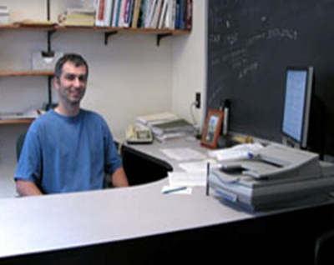
Joe Montecalvo, Asst. Director
In 1993, Jim hired Joe as a one –year grad assistant; Joe learns HTML and LEGAL strategies are revised for the Internet under $7M+ Project TIPS grant for Bronx.

Slide 23
Project CRITICAL Objectives:
CR: Curriculum Restructuring:--Identifying social problems in your curriculum
IT: In-service Training: 5 Release Days & 5 Break Days; 2/20—2/22 & 4/4—4/5
I: Identification of Talent Pool students in regular content classrooms
CA: (teachers using) Computer Applications: Use Jim Carroll and Joe Montecalvo’s Internet application, The Public Policy Analyst, to have students analyze social problems and develop public policy solutions
L: Learning outcomes: (1) problem solving involving public policy issues; (2) state content standards for American history, global history, language arts and science and (3) improved use of technology

Slide 24
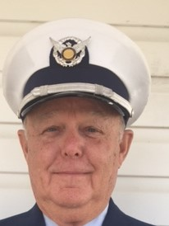
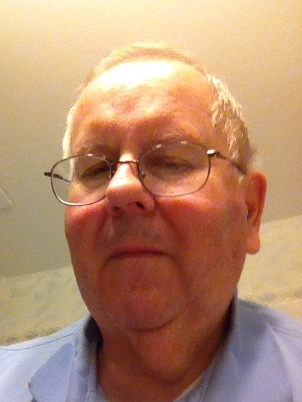
Scaling—Up’s
Staff Developers will make school visits in 2018
Norm Harris
Art Fortin

Slide 25
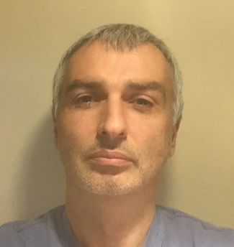

Scaling-Up’s
Technology Specialist
Joe Montecalvo

Slide 26
Scaling-UP Project CRITICAL Builds Upon:
Project
CHARACTER
The Character Public
Policy Analyst
Project
CRITICAL:
Javits Gifted Education
Project TIPS:
The Public
Policy Analyst:
Social Studies,
Science, and
Language Arts

Slide 27
What Are the Benefits
of Scaling-Up
Project CRITICAL?

Slide 28
Benefits: Teachers
Technology integration skills
Training on G/T theorists & curriculum differentiation
Stipends

Slide 29
Benefits: Students
Identifying talented students and meeting their academic needs

Slide 30
Benefits: Students
Technology-proficient
Academic standards
Enhanced Curricula
Employable skills

Slide 31

Scaling-Up staff E-mail
jcarroll@syr.edu
jmonteca@maxwell.syr.edu
mrfortin925@hotmail.com
harris0426@aol.com

Slide 32
Scaling-Up
Project CRITICAL:
Website
http://flippedtips.com/plegal/javits/critical.html

Slide 33
In Closing

Slide 34
Keep you deck chairs facing forward

