Slide 1
Working with Multilingual Learners in the Content Classroom
Catherine Box, Ed.D.
Graduate School of Education at the
University of Pennsylvania
cbox@upenn .edu

Slide 2
PART I: Identity & Discourse

Slide 3
Agenda for Part I
“Big Picture Issues” in ENL
-- who are ENL learners?
-- what is the deficit discourse vs. the asset
discourse of MLLs?
-- what resources do MLLs bring into the classroom?

Slide 4
But First… the Acronyms
The students:
ELL or EL → MLL (but ELL and EL still widely used)
The content area:
ESL → ENL
The certification area:
ESOL
The academic program ENL teachers study:
TESOL
The state regulations regarding ENL students:
CR-154 (Part 154),
CR-154 was recently revised to mandate that most ELs must receive the bulk of their instruction in content classrooms with ENL support, rather than “stand-alone” ENL models (e.g. pull-out, self-contained)
The examinations MLLs take:
NYSITELL (initial entry) and NYSESLAT (yearly until exiting, at which point former MLL/EL(L))

Slide 5
Who are Multilingual Learners?
18.7% of the total student population
and growing rapidly.
160 foreign languages spoken in the home, the
most prevalent of them being
Spanish, Chinese, Bengali, Arabic, and
Russian.
Range from Newcomer to Commanding
in level of English Proficiency; may
carry designation of SIFE. Finally, may carry
designation of “former EL”
Does NOT include students who come to the classroom
already multilingual, if English is one of the languages in
which they are “fluent” or “native.”
http://www.nysed.gov/bilingual-ed/english-language-learnermultilingual-learners-demographicsdata-reports

Slide 6
Possible Interpretations of this information…
18.7% of the total student population and growing rapidly.
Due to their sheer number teachers face more and more challenges concerning how to work with
this population of students in the classroom, for which training has not prepared them.
160 foreign languages in the home, the most prevalent of them being Spanish, Chinese, Bengali, Arabic, and Russian.
ELs arrive at schools speaking languages that many teachers do not know, and thus, are unsure
how best to help them. Also, it is suspicious when students speak to each other in a language
that the teacher does not understand– they might be cheating or bullying each other.
Levels range from Newcomer to Commanding in level of English Proficiency; may carry designation of SIFE.
Students are in need of services to “pass” the NYSESLAT. In the meantime, they tend to score
lower on standardized tests and thus have lower graduation rates. There is a large “achievement
gap” that correlates with EL status. SIFE are in dire need of basic skills that content teachers are
not equipped to facilitate. There is not enough time and not enough resources to make up for the
lost years of US schooling.
*COMMENTS IN RED TAKEN FROM FIELD NOTES OF A WORKSHOP GIVEN TO TEACHERS-IN-TRAINING IN SPRING, 2017.

Slide 7
Deficit Discourse Crumpler et al., 2011; Gutiérrez & Orellana, 2006; Shapiro, 2014)
Differences in race, culture, first
language, and origin are seen as
obstacles to overcome rather
than resources.
Proficiencies in other languages
are ignored, while limited
proficiency in English is
highlighted (e.g. some still use
the term LEP).
Students are often evaluated with
respect to standardized test scores
in ways that may be even more
salient and consequential than
L1 English-speaking peers.

Slide 8
Deficit Discourse in Action: Example from a Gifted Individualized Education Program (G-IEP) *taken from a Gifted Written Report compiled in November 2017. Reproduced here with permission from parents.
“Examples of behaviors of strength include: has excellent reasoning abilities, is proficient at problem finding, asks complex questions, and can easily relate new information to old information.”
“[name of child] employs an advanced vocabulary, prefers advanced level books, and uses language in unusual or novel ways.”
“He requires little repetition or practice in order to show mathematical competency.”
At end of evaluation, there is this blurb:
Include any intervening factors which may mask gifted abilities (such as English as a second language, learning disability, physical impairment, emotional disability, gender or race bias, or socio/cultural deprivation).

Slide 9
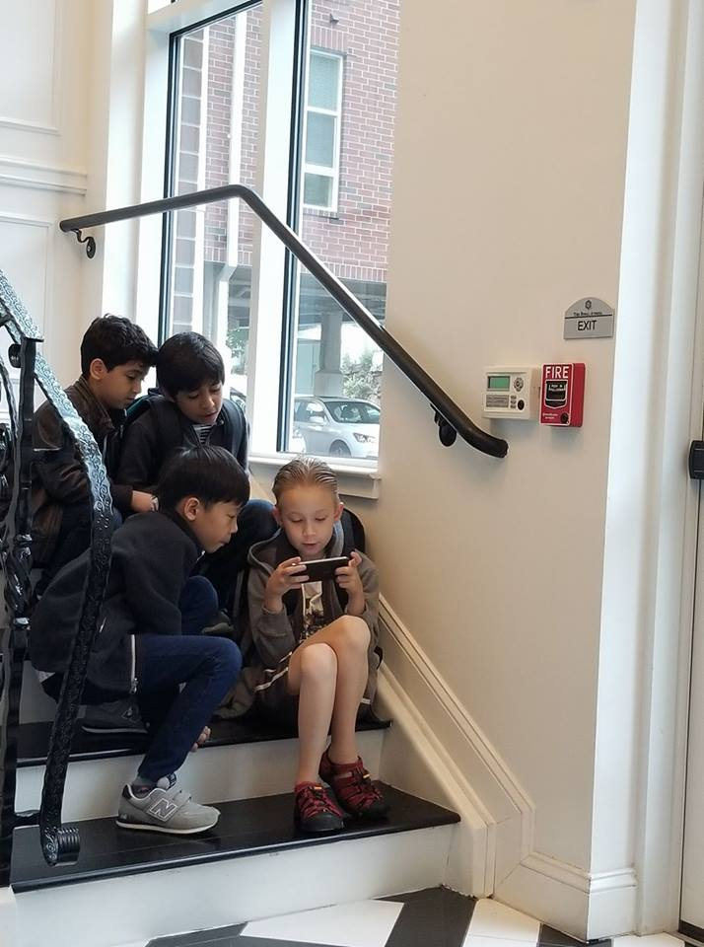
From Deficit to Asset: Let’s flip the script! *taken September 2017, at the public school bus stop near Philadelphia, PA. Seven- and eight-year old multilinguals who speak Korean, Tamil, Arabic, French, English, and Roblox! Reproduced with permission of parents.

Slide 10
Task: For each point, rewrite the interpretation from an asset perspective!
18.7% of the total student population and growing rapidly.
more and more students are arriving in the classroom poised to become
bilingual and biliterate, possessing skills that will be advantageous in a global
economy.
160 foreign languages in the home, the most prevalent of them being Spanish, Chinese, Bengali, Arabic, and Russian.
Levels range from Newcomer to Commanding in level of English Proficiency; may carry designation of SIFE.

Slide 11
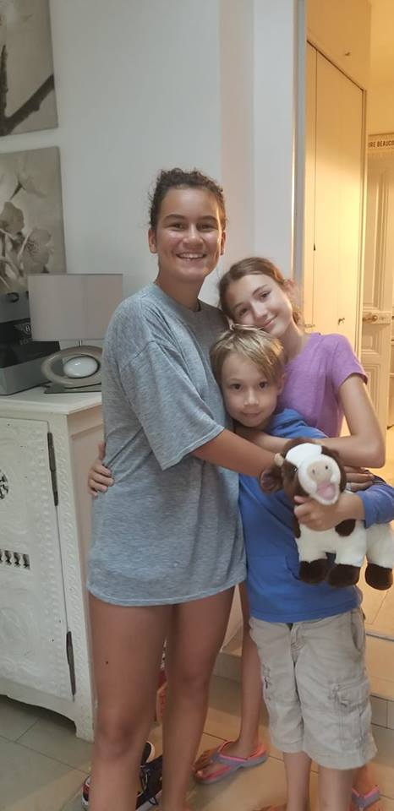
Case Study: Océane and Olivia
Question for discussion:
Who has a better command of her second language?

Slide 12
Océane, rising 8th grader
Olivia, rising 8th grader
--French and English spoken at
home; some French in
community
--Started formally studying French
in 6th grade
--Little motivation
--Poor control of grammar
--Unwilling to take risks in French
--Understands everything
--Deep understanding of French
culture
--French spoken at home; no
English in community
--Started formally studying
English in 1st grade
--Highly motivated
--Excellent control of grammar
--Willing to take risks in English
--Understands somewhat
--Superficial understanding of
American culture

Slide 13
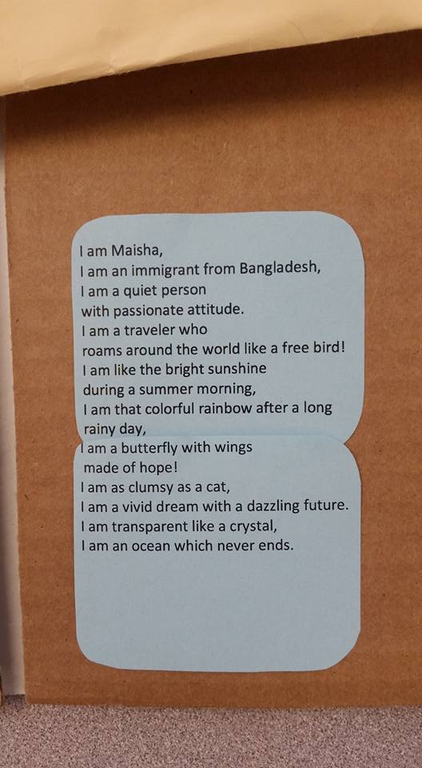
*Photographed with the permission of the author in May 2017 at the Brooklyn International High School.

Slide 14
PART II: Differentiation in the Classroom

Slide 15
Agenda for Part II
Moving from “big picture” to the classroom
-- What are the three ways that content teachers can differentiate for
MLLs in the classroom? (+ the one way that they should not)
How does differentiating for MLLs dovetail and
deviate from differentiating for giftedness in the classroom?
-- What techniques are effective when differentiating for MLLs?
GOAL: Which three techniques will work best in your
classroom?
-- How can these techniques be embedded in activities such that
everyone benefits, including the teacher(s)?

Slide 16
As Heather mentioned, we can differentiate our:
Content
What do you want your students to learn?
Process
How do you want your students to learn?
Product
How will your students demonstrate their knowledge?

Slide 17
 | For Gifted Students | For Multilingual Learners
Content | yes | no
Process | yes | yes
Product | yes | yes

Slide 18
 | For Gifted Students | For Multilingual Learners
Content | yes | no
Process | yes | yes
Product | yes | yes

Slide 19
 | For Gifted Students | For Multilingual Learners
Content | yes | no
Process | yes | yes
Product | yes | yes

Slide 20
Language-focused differentiation provides specific language supports in the classroom designed to help MLLs access content and participate in lesson.
What does language-focused differentiation look like?

Slide 21
Aim for the Challenge Zone! (Gibbons, 2009)
HIGH CHALLENGE
Learning/engagement zone
(Zone of Proximal Development)
Frustration/anxiety
zone
HIGH SUPPORT
LOW SUPPORT
Comfort zone
Boredom zone
LOW CHALLENGE

Slide 22
ESSENTIAL ELEMENTS OF LANGUAGE-FOCUSED SUPPORT
Each support is matched to the language learner’s proficiency level.
Each support is respectful and engaging.
Each support moves toward the same essential understanding.

Slide 23
What can be differentiated for MLLs?
Lesson Plans
Tasks
Schema Activation
Input (teacher language)
Output (student language)
Materials
Assessments
Today and the next 1-2 workshops

Slide 24
Group Task: What do You Need to Succeed?
OBJECTIVE: SUMMARIZE THE TEXT.
TASK: In pairs or triads, prepare a 3-4
sentence summary of the text.
*Keep track of the strategies you, as readers and writers, utilize to complete this task.
*After a few minutes, we will stop and agree upon a particular support that might help you compete your task.

Slide 25
Here bygynneth the Book of the tales of Caunterbury
Whan that aprill with his shoures soote The droghte of march hath perced to the roote, And bathed every veyne in swich licour Of which vertu engendred is the flour; Whan zephirus eek with his sweete breeth
Inspired hath in every holt and heeth Tendre croppes, and the yonge sonne Hath in the ram his halve cours yronne, And smale foweles maken melodye, That slepen al the nyght with open ye (so priketh hem nature in hir corages); Thanne longen folk to goon on pilgrimages,
And palmeres for to seken straunge strondes, To ferne halwes, kowthe in sondry londes; And specially from every shires ende Of engelond to caunterbury they wende, The hooly blisful martir for to seke, That hem hath holpen whan that they were seeke.

Slide 26
Language supports work to meet the various language needs within your class. The supports should provide opportunities for multilingual learners to work at the same level as their peers.

Slide 27
Task Support Checklist (adapted from Peregoy & Boyle, 2017)
SCHEMA ACTIVATION
Prepare students for tasks by activating background knowledge with an asset perspective in mind.
Provide rich contextual information for tasks.
DIFFERENTIATION OF INPUT/OUTPUT
Provide multiple opportunities for students to process information in multiple ways (visuals, dramatization, review, questions, think-pair-shares)
Use abundancy and redundancy strategies when introducing key vocabulary. (repeat often, use in different contexts, write on board, highlight when using it, have students repeat it, give opportunities for students to use it).
Provide multimodal directions/explanations (modeling, gestures, write & say simultaneously).
Ask instruction-clarifying questions (e.g. what do we do first?) before setting students on task.
Ensure participation of all students through providing sentence frames, allowing non-verbal contributions, and group task monitoring.
MATERIALS
Enhance input through bolding key vocabulary in materials.
Provide word banks and glossaries for important terms. Provide brief explanations of grammar points as needed.
Include sentence frames/stems to support students as they engage with written language.

Slide 28
Thank you! Have a great start to your year!
cbox@upenn.edu

