Slide 1

Working with Multilingual Learners in the Content Classroom, Part I
Workshop prepared for ProjectCRITICAL participants
Catherine Box, Ed.D.
cbox@upenn .edu

Slide 2

PART I: Identity & Discourse

Slide 3
Agenda for Part I
“Big Picture Issues” in ENL
-- who are ENL learners?
-- what is the deficit discourse vs. the asset
discourse of MLLs?
-- what specific resources do MLLs bring into the
classroom?

Slide 4
But First… the Acronyms
The students:
ELL or EL → MLL (but ELL and EL still widely used)
The content area:
ENL (English as a New Language)
The certification area:
ESOL PK-12 (English Spoken as an Other Language)
The academic program ENL teachers study:
TESOL (Teaching English Spoken as an Other Language)
The state regulations regarding ENL students:
CR-154
These were revised in 2015, limiting the amount of minutes MLLs could spend in “pull-out” style programs. NYS claims that these revisions have contributed to heightened success in state testing scores and graduation rates.
The examinations MLLs take:
NYSITELL (initial entry) and NYSESLAT (yearly until exiting, at which point former MLL/FELL)

Slide 5
15.3% of the total student population
215 foreign languages spoken in the
home, the most prevalent of them being
Spanish, Chinese, Bengali, Arabic,
Haitian, and Russian.
Range from Newcomer to Commanding
in level of English Proficiency; may
carry designation of SIFE.
Does NOT include students who come to
the classroom already multilingual, if
English is one of the languages in
which they are “fluent” or “native.”
http://nysed_ell_mll_data-report_2018-2019-a.pdf
Who are Multilingual Learners?

Slide 6
Possible Interpretations of this information…
15.3% of the total student population.
Teachers face more and more challenges concerning how to work with this growing
population of students in the classroom, for which training has not prepared them.
215 foreign languages in the home, the most prevalent of them being Spanish, Chinese, Bengali, Haitian, Arabic, and Russian.
ELs arrive at schools speaking languages that many teachers do not know, and thus, are
unsure how best to help them. Also, it is suspicious when students speak to each
other in a language that the teacher does not understand– they might be cheating or
bullying each other.
Levels range from Newcomer to Commanding in level of English Proficiency; may carry designation of SIFE.
Students are in need of services to “pass” the NYSESLAT. In the meantime, they tend to
score lower on standardized tests and thus have lower graduation rates. There is a large
“achievement gap” that correlates with EL status. SIFE are in dire need of basic skills that
content teachers are not equipped to facilitate. There is not enough time and not enough
resources to make up for the lost years of US schooling.
*COMMENTS IN RED TAKEN FROM FIELD NOTES OF A WORKSHOP GIVEN TO TEACHERS-IN-TRAINING.

Slide 7
Deficit Discourse
Crumpler et al., 2011; Gutiérrez & Orellana, 2006; Shapiro, 2014)
Differences in race, culture, first
language, and origin are seen
as obstacles to overcome rather
than resources.
Proficiencies in other languages
are ignored, while limited
proficiency in English is
highlighted (e.g. some still use
the term LEP).
Students are often evaluated with
respect to standardized test
scores in ways that may be even
more salient and consequential
than L1 English-speaking peers.

Slide 8
Deficit Discourse in Action for Gifted Students
*taken from a Gifted Written Report compiled in November 2017. Reproduced here with permission from parents.
“Examples of behaviors of strength include: has excellent reasoning abilities, is proficient at problem finding, asks complex questions, and can easily relate new information to old information.”
“[name of child] employs an advanced vocabulary, prefers advanced level books, and uses language in unusual or novel ways.”
“He requires little repetition or practice in order to show mathematical competency.”
At end of evaluation, there is this blurb:
Include any intervening factors which may mask gifted abilities (such as English as a second language, learning disability, physical impairment, emotional disability, gender or race bias, or socio/cultural deprivation).

Slide 9
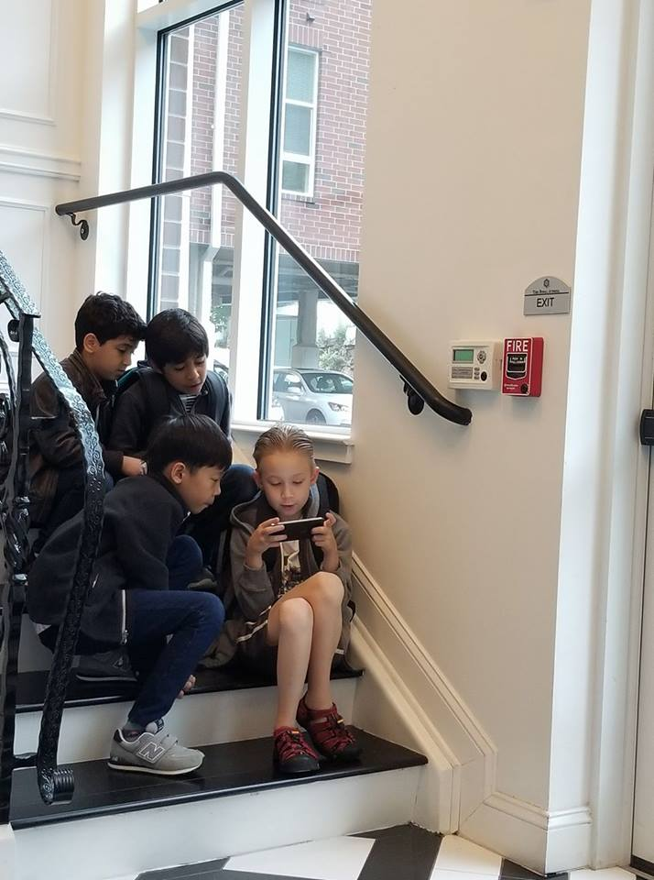
From Deficit to Asset: Let’s flip the script!
*at the public school bus stop near Philadelphia, PA. Seven- and eight-year old multilingualswho speak Korean, Tamil, Arabic, French, English, and Roblox!
Reproduced with permission of parents.

Slide 10
Task: For each point, rewrite the interpretation from an asset perspective!
15.3% of the total student population.
many students are arriving in the classroom poised to become
bilingual and biliterate, possessing skills that will be advantageous in a global
economy.
160 foreign languages in the home, the most prevalent of them being Spanish, Chinese, Bengali, Arabic, and Russian.
Levels range from Newcomer to Commanding in level of English Proficiency; may carry designation of SIFE.

Slide 11
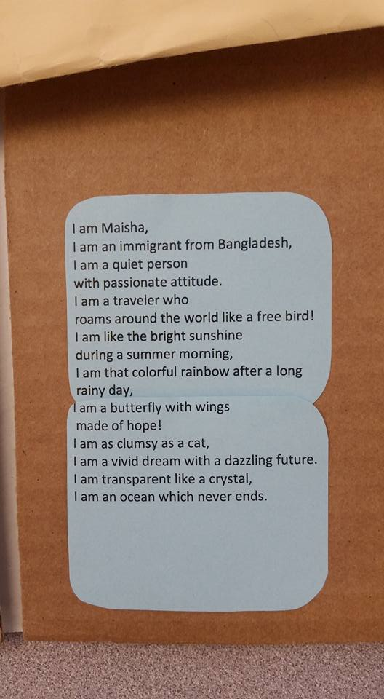
*Photographed with the permission of the author at the Brooklyn International High School.

Slide 12
PART II: Differentiation in the Classroom

Slide 13
Agenda for Part II
Moving from “big picture” to the classroom
-- What are the three ways that content teachers can
differentiate for MLLs in the classroom?
How does differentiating for MLLs dovetail and
deviate from differentiating for giftedness in the
classroom?
-- What techniques are effective when differentiating for MLLs?
-- How can these techniques be embedded in activities such
that everyone benefits, including the teacher(s)?

Slide 14
We can differentiate our:
Content
What do you want your students to learn?
Process
How do you want your students to learn?
Product
How will your students demonstrate their knowledge?

Slide 15
 | For Gifted Students | For Multilingual Learners
Content | yes | caution
Process | yes | yes
Product | yes | yes

Slide 16
 | For Gifted Students | For Multilingual Learners
Content | yes | no
Process | yes | yes
Product | yes | yes

Slide 17
We can differentiate in response to student:
Readiness Skill level
Learning Profile Interests
Personality & more

Slide 18
Language-focused differentiation provides specific language supports in the classroom designed to help MLLs access grade-level content and participate in lessons.
What does language-focused differentiation look like?

Slide 19
Aim for the Challenge Zone!
(Gibbons, 2009)
HIGH CHALLENGE
Learning/engagement zone
(Zone of Proximal Development)
Frustration/anxiety
zone
HIGH SUPPORT
LOW SUPPORT
Comfort zone
Boredom zone
LOW CHALLENGE

Slide 20
ESSENTIAL ELEMENTS OF LANGUAGE-FOCUSED SUPPORT
Each support is matched to the language learner’s proficiency level.
Each support is respectful and engaging.
Each support moves toward the same essential understanding.

Slide 21
What can be differentiated for MLLs?
Lesson Plans
Tasks
Schema Activation
Input/Output
Materials
Assessments

Slide 22
What can be differentiated for MLLs?
Lesson Plans
Tasks
Schema Activation
Input/Output
Materials
Assessments

Slide 23
Group Task: What do You Need to Succeed?
OBJECTIVE: SUMMARIZE THE TEXT.
*At first, I will give no scaffolding.
*You will brainstorm together, in groups of 3-4, a list of supports that will allow you to access the text.
*We will reconvene and I will provide the supports.
*You will go back into groups and summarize the texts.

Slide 24
Here bygynneth the Book of the tales of Caunterbury:
Take a Picture of this slide, and be prepared to discuss this passage in groups!
Whan that aprill with his shoures soote
The droghte of march hath perced to the roote,
And bathed every veyne in swich licour
Of which vertu engendred is the flour;
Whan zephirus eek with his sweete breeth
Inspired hath in every holt and heeth
Tendre croppes, and the yonge sonne
Hath in the ram his halve cours yronne,
And smale foweles maken melodye,
That slepen al the nyght with open ye
(so priketh hem nature in hir corages);
Thanne longen folk to goon on pilgrimages,
And palmeres for to seken straunge strondes,
To ferne halwes, kowthe in sondry londes;
And specially from every shires ende
Of engelond to caunterbury they wende,
The hooly blisful martir for to seke,
That hem hath holpen whan that they were seeke.

Slide 25
Language supports work to meet the various language needs within your class. The supports should provide opportunities for multilingual learners to work at the same level as their peers.

Slide 26
Task Support Checklist
(adapted from Peregoy & Boyle, 2017)
SCHEMA ACTIVATION
Prepare students for tasks by activating background knowledge with an asset perspective in mind.
Provide rich contextual information for tasks.
DIFFERENTIATION OF INPUT/OUTPUT
Provide multiple opportunities for students to process information in multiple ways (visuals, dramatization, review, questions, think-pair-shares)
Use abundancy and redundancy strategies when introducing key vocabulary. (repeat often, use in different contexts, write on board, highlight when using it, have students repeat it, give opportunities for students to use it).
Provide multimodal directions/explanations (modeling, gestures, write & say simultaneously, read aloud).
Ask instruction-clarifying questions (e.g. what do we do first?) before setting students on task.
Ensure participation of all students through providing sentence frames, allowing non-verbal contributions, and group task monitoring.
MATERIALS
Enhance input through bolding key vocabulary in materials.
Provide word banks and glossaries for important terms. Provide brief explanations of grammar points as needed.
Include sentence frames/stems to support students as they engage with written language.

Slide 27

Thank you!
Catherine: cbox@upenn.edu
Next Time: More on Task Differentiation
Assessing Multiilngual Learners

