Slide 1
Obesity
Ms. Robin Henry
George Westinghouse High School
rhenry6@schools.nyc.gov

Slide 2
Can OBESITY in youth lead to deadly premature diseases? Researchers have found that OBESITY may cause undesirable negative health conditions. Are these conditions prevalent in NYC children? What health issues can result from OBESITY?

Slide 3
The Public Policy Analyst (PPA) will be used as steps to research and construct the problem of OBESITY in NYCDOE
1. Define the Problem 2. Gather the Evidence 3. Identify the Causes 4. Evaluate an Existing Policy 5. Develop Solutions 6. Select the Best Solution

Slide 4
Problem: Childhood OBESITY has become a Serious Concern in New York City youth
In June 2010 New York City Department of Education documented that Childhood Obesity Is On The Rise In America- “New York City is home to an even higher rate proportion of obese and overweight children than other parts of the county” NYCDOE
***Use The Hyperlink to help:
Step 1. Define The Problem of OBESITY
Using Worksheet 1:
http://www2.maxwell.syr.edu/plegal/TIPS/worksheet1.html

Slide 5
Conditions that result from OBESITY
***Use The Hyperlink in:
Step 2. Gather Evidence Of The Problem
Complete Worksheet 2:
http://www2.maxwell.syr.edu/plegal/TIPS/worksheet2.html
Diabetes
Obesity
Heart disease
Overweight
High blood pressure

Slide 6
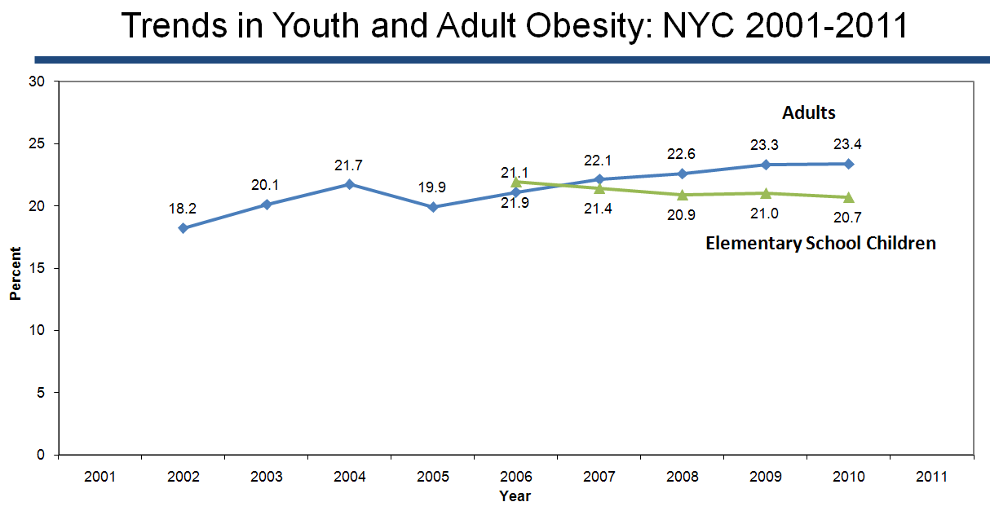
Obesity finding of New York City Task Force indicate obesity in on the rise
“Particularly amongst black, Latino and low-income communities where the rate of overweight and obesity reaches 70 percent in some neighborhoods.”
http://www.nyc.gov/html/om/pdf/2012/otf_report.pdf
Source: NYC Community Health Survey (CHS) 2002-2010, Youth Risk Behavior Survey (YRBS) 2001-2011, NYC FITNESSGRAM 2006-2010.

Slide 7
Childhood Obesity Facts
Childhood obesity has more than doubled in the past 30 years
The percentage of children aged 6–11 years increased from 7% in 1980 to nearly 18% in 2010.
The percentage of adolescents aged 12–19 years who were obese increased from 5% to 18% over the same period.
In 2010, more than one third of children and adolescents were overweight or obese.

Slide 8
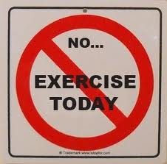
Causes of Obesity? Lack of Participation
“In 2011, 29% of high school students surveyed had participated in at least 60 minutes per day of physical activity on all 7 days before the survey, and only 31% attended physical education class daily.” CDC Physical Activity Facts
***Use The Information and Hyperlinks on slides
7-10 to help:
Step 3.Identifying The Causes Of The Problem Using Worksheet 3:
http://www2.maxwell.syr.edu/plegal/TIPS/worksheet3.html

Slide 9
New York City Youth in America today lack regular physical exercise
Including:
Running
Swimming
Walking
Bike riding
Jumping rope
Weight training
Playing sports

Slide 10
Additional underlying Factors that contribute to OBESITY
Household Influence
Poverty
Role Of Television

Slide 11
Poor Nutrition Habits also contributes to the problem of OBESITY
Including:
Eating Fast Foods – Fried Foods
Diet High In Salt
High Amounts of Sugar
High Fructose Corn Syrup
Trans Fat
Over Eating
Not eating regularly – 3x’s a day

Slide 12
***Use The Information and Hyperlinks on slides 12-16:
Step 4 – Evaluating Existing Public Policies: Using Worksheet 4: http://www2.maxwell.syr.edu/plegal/TIPS/worksheet4.html

Slide 13
Existing Policy Regulation A-812 Implementing Total Wellness In all Youth
By assuring all children and adolescents receive the education, resources and opportunities needed to live a life of wellness that includes regular physical activity and proper nutrition habits.
Proposed policy: NYC Chancellor’s Regulation A-812
NYCDOE Wellness Policy on physical activity and wellness include:
1. School Wellness Councils
2. Nutritional Quality of School Food Meals
3. Nutrition Education and Promotion
4. Physical Activity Opportunities and Physical Education
5. Staff Wellness
6. Monitoring and Policy Review

Slide 14
Reversing The Epidemic Existing public actions
Mayor Bloomberg announced:
December 2011 –
Drop in obesity rates amongst kindergartner – 8th grade
through:
- Expansion of physical activity opportunities
- Improved
nutrition
January 2012 - Obesity Task Force
Set out to “improving the food environment; making tap water more accessible; making public spaces more amenable to physical activity or active transportation; promoting building design that encouraged physical activity; or marshaling resources to identify and best treat children at risk of obesity-related diseases”.

Slide 15
Advantages of Physical Activity and Good Nutrition (Total Wellness)
Regular physical exercise in youth improves:
strength and endurance,
helps build healthy bones and muscles,
helps control weight,
increases self-esteem,
reduces anxiety and stress,
and may improve blood pressure and cholesterol levels

Slide 16
Promoting Nutrition & Physical Activity
School Health Guidelines to Promote Healthy Eating and Physical Activity

Slide 17
Physical Activity Facts and advantages
The U.S. Department of Health and Human Services recommends that young people aged 6–17 years participate in at least 60 minutes of physical activity daily.
Active Children and Adolescents who are physically active have higher levels of cardiorespiratory fitness and stronger muscles
Regular physical activity in children and adolescents promotes a healthy body weight and body composition.

Slide 18
Is There A Disadvantage? What Do You Think Are The Disadvantages To Implementing - Total Wellness In All Youth ?
Why will it not work?
Should this policy be replaced?

Slide 19
What Public Policy Solutions Alternatives Do You Suggest?
***Based on your current knowledge obtained and information gathered on slides 18-20 complete the following step:
Step 5 – Evaluating Existing Public Policies: Using Worksheet: http://www2.maxwell.syr.edu/plegal/TIPS/worksheet5.html

Slide 20
OBESITY Alternatives - Promoting Exercise in NYC Schools by taking action
Schools can promote physical activity through developing multiple programs in every school: comprehensive school physical activity programs, including recess, classroom-based physical activity, intramural physical activity clubs, interscholastic sports, and physical education.
Schools should ensure that physical education is provided to all students in all grades and is taught by qualified teachers.
Schools can also work with community organizations to provide out-of-school-time physical activity programs and share physical activity facilities.

Slide 21
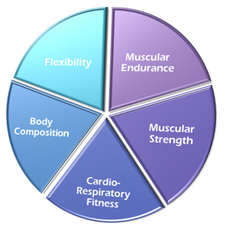
Is Total Fitness in NYC Schools a fitness solution?
Total Physical Fitness is defined in how well an individual performs in each of the 5 Physical Fitness Components

Slide 22
NYC Public Schools Progress
Physical education In High Schools:
Schoolfood menu:
Removal of snack filled vendor machines
Healthy Food Choices including fruits, vegetables, and fiber
Improve nutrition & taste
Regular Physical Education classes required
Students must meet Credit Requirement
Grades K-5 Physical Best
Grades 7-12
Fitness Gram Testing. See Video

Slide 23
BEST POLICY SOLUTION?
Action Plan?
Educate youth and professionals
Set physical fitness goals (Exercise at least five times a week, 60 minutes a day)
Develop an exercise plan including and exercise diet (Exercises should include anaerobic, aerobic, and flexibility exercises)
Eat three times a day
Eat in moderation
Consume fruits and vegetables
Choose grill or baked food (no trans fat)
Moderate salt and sugar intake

Slide 24
What Is The Best Public Policy Solution to the Problem – OBESITY in NYC youth?
What Is The Best Feasible Plan?
And
Most Effective Plan?
By looking at the problem and constructing your own knowledge obtained through the previous Public Policy Analyst Steps and Information gathered– Complete Worksheet 6:
Selecting The Best Public Policy Solution:
http://www2.maxwell.syr.edu/plegal/TIPS/worksheet6.html

Slide 25
References
Child Nutrition and Obesity (2012). Children’s Defense Fund. Online. Available:
http://www.childrensdefense.org/policy-priorities/childrens-health/child-nutrition/
“Childhood Obesity is a Serious Concern in New York City.” (2009). NYC Health. Retrieved from. NYC Vital Signs. Online. Available:
http://www.nyc.gov/html/doh/downloads/pdf/survey/survey-2009fitnessgram.pdf
“Childhood Obesity Facts.” (2013) .Center for Disease Control and Prevention. Retrieved from. CDC Adolescent and School Health.. Online. Available: http://www.cdc.gov/healthyyouth/obesity/facts.htm
Drewnowski, A., and Specter, S.E. (2004). Poverty and obesity: the role of energy density and energy costs. American Society for Clinical Nutrition. Retrieved from. The American Journal Of Clinical Nutrition. Online. Available: http://ajcn.nutrition.org/content/79/1/6.full
Dennison, B., and Edmunds, L.S. (2008). “The role of television in childhood obesity.” (2009). ScienceDirect . Retrieved from. Progress in Pediatric Cardiology. Online. Available: http://www.sciencedirect.com/science/article/pii/S1058981308000374
“Flexibility Exercise.” (2010). American Academy of Orthopedic Surgeons. Retrieved from. OrthoInfo. Online. Available: http://orthoinfo.aaos.org/topic.cfm?topic=A00038

Slide 26
References
Jeukendrup, A., and Michael Gleeson, M. (2013). “Normal ranges of body weight and body fat.” Human Kinetics. Retrieved from. Excerpts from Sport Nutrition, Second Edition. Online. Available:
http://www.humankinetics.com/excerpts/excerpts/normal-ranges-of-body-weight-and-body-fat
“Lack of exercise as 'deadly' as smoking”. (2012). NHS Choices. Online. Available: http://www.nhs.uk/news/2012/07July/Pages/Lack-of-exercise-as-deadly-as-smoking.aspx
“Nutrition for Children and Teens: Helping Your Kids Eat Healthier” (2013). Helpguide.org. Online. Available: http://www.helpguide.org/life/healthy_eating_children_teens.htm
“Nutrition, Physical Activity, & Obesity.” (2013) .Center for Disease Control and Prevention. Retrieved from. CDC Adolescent and School Health.. Online. Available: http://www.cdc.gov/healthyyouth/npao/strategies.htm
NYC schools encourage physical fitness. (2010). WABC-TV New York, New York. Eyewitness Education News. http://abclocal.go.com/wabc/story?section=news/education&id=7502171
“Physical Activity Facts.” (2013) .Center for Disease Control and Prevention. Retrieved from. CDC Adolescent and School Health.. Online. Available:http://www.cdc.gov/healthyyouth/physicalactivity/facts.htm

Slide 27
References
Rose, B., (2013). “The Effects of Poor Nutrition on your Health.” Food Pyramid. Online. Available:
http://www.foodpyramid.com/healthy-eating/the-effects-of-poor-nutrition-on-your-health-10409/
The New York City Obesity Task Force (2012). Reversing the Epidemic: - NYC.gov. Finding: indicate obesity in on the rise. http://www.nyc.gov/htmlom/pdf/2012/otf_report.pdf

