Slide 1
Global Warming
Steven Ligator
George Westinghouse Technical HS
sligator@schools.nyc.gov
Notes:
This slideshow present an overview of global warming issues, last updated 8/11/2006. A more detailed analysis of global warming issues is available at http://www.godandscience.org/apologetics/global_warming.html, including a printable PDF version. 

Slide 2
Introduction
Is the world getting warmer?
If so, are the actions of mankind to blame for earth’s temperature increases?
What can/should be done about these issues?
Are the potential resolutions worth the cost to implement them?
Notes:
In examining global warming, we will be looking at questions such as 
Is the world getting warmer? 
If so, are the actions of mankind to blame for earth’s temperature increases? 
What can or should be done about global warming? 
Are the potential resolutions to global warming worth the cost to implement them? 

Slide 3
Global Warming
EQ: Will Human-Induced Climate Change Destroy the World?
FQ: What is global warming?
Warm-up: What do you think global warming is, and give at least two reasons it is bad for humans.
Notes:
This slideshow present an overview of global warming issues, last updated 8/11/2006. A more detailed analysis of global warming issues is available at http://www.godandscience.org/apologetics/global_warming.html, including a printable PDF version. 

Slide 4
Step 1 of PPA: Define The Problem
Use Worksheet 1 to
Define the problem of global warming as it impacts upon the U.S.
Notes:
This slideshow present an overview of global warming issues, last updated 8/11/2006. A more detailed analysis of global warming issues is available at http://www.godandscience.org/apologetics/global_warming.html, including a printable PDF version. 

Slide 5
Step 2 of PPA: Gather Evidence Videos
The Truth About Global Warming
List at least three key ideas regarding global warming.
Global Warming Hoax
List at least three key ideas regarding global warming.
Notes:
In examining global warming, we will be looking at questions such as 
Is the world getting warmer? 
If so, are the actions of mankind to blame for earth’s temperature increases? 
What can or should be done about global warming? 
Are the potential resolutions to global warming worth the cost to implement them? 

Slide 6
Changes in Antarctica Ice Mass
1000
800
600
400
200
Ice Mass (km³)
0
-200
-400
-600
2003
2004
2005
Year
Notes:
These are the result of the GRACE study,  which show decreasing ice mass in Antarctica from 2002 to 2005. 

Slide 7
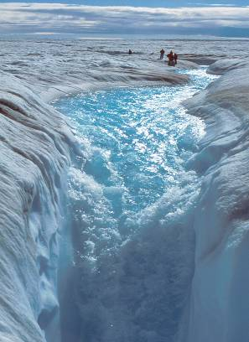
Ice Sheets Melting?
GRACE (gravity measured by satellite) found melting of Antarctica equivalent to sea level rise of 0.4 mm/year (2 in/century)
Zwally, 2005 (satellite radar altimetry)
confirmed Antarctica melting
Greenland ice melting on exterior, accumulating inland (higher precipitation)
Notes:
With these temperature increases, one main question is whether the ice sheets of Antarctica and Greenland are melting.    

Slide 8
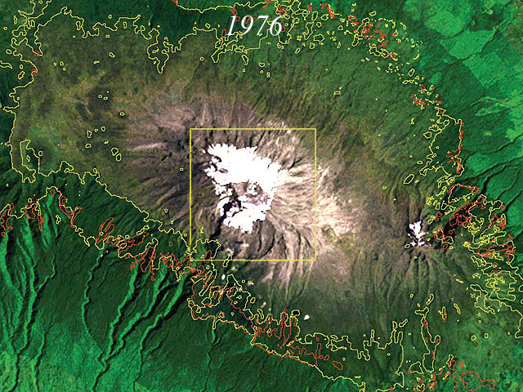
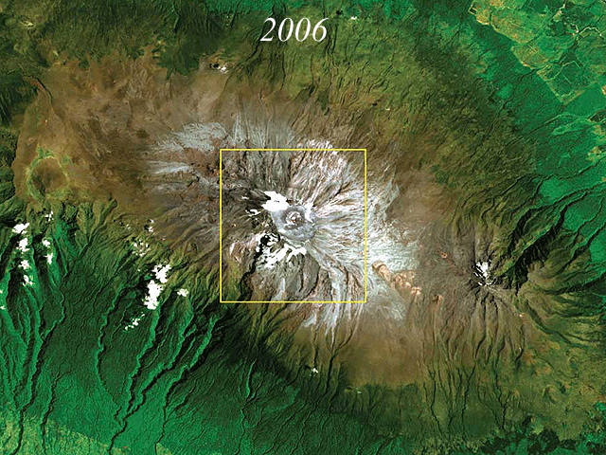
Melting Glaciers – Mt. Kilimanjaro
Notes:
Mount Kilimanjaro is the poster child of the global warming movement, since most of the glacier has disappeared over the last 30 years. However experts agree that the shrinking of the Mount Kilimanjaro glacier is more the result of deforestation of the surrounding area than changes due to global warming.

Slide 9
Global Warming Primarily Impacts the Northern Hemisphere
Northern vs. Southern Latitude
Land vs. Ocean
1.0
Northern Hemisphere
Southern Hemisphere
Land
Ocean
0.8
0.6
0.4
0.2
Temperature Change (°C)
0.0
-0.2
-0.4
-0.6
1920
1960
2000
1920
1960
2000
Year
Year
Notes:
Is global warming truly global? If we examine global warming from the perspective of the two hemispheres, we find that  temperatures in the northern hemisphere have increased much more than  temperatures in the southern hemisphere. In a similar fashion,  temperatures over land masses have increased much more than  temperatures over the oceans. This is because the oceans tend to moderate temperature changes. So, since two thirds of the earth’s land mass is in the northern hemisphere, we would expect global warming to have its largest impact there. 

Slide 10
Step 3 of PPA: Identify the Causes
From the readings, and videos list the possible causes of global warming. Remember to site material if necessary.
Notes:
This slideshow present an overview of global warming issues, last updated 8/11/2006. A more detailed analysis of global warming issues is available at http://www.godandscience.org/apologetics/global_warming.html, including a printable PDF version. 

Slide 11
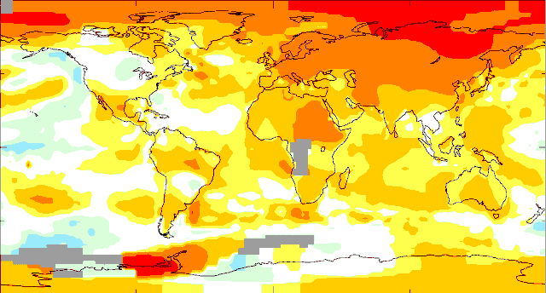
Global Warming is Due to Urban Heat Islands
2009 Temperature Changes Compared to 1951-1980
-4.1
-4
-2
-1
-.5
-.2
.2
.5
1
2
4
4.1
Notes:
Is global warming due to heat island effects? Heat island effects occur when a temperature station gets surrounded by buildings and streets, artificially raising the temperature readings. Here we see a plot of global temperature changes (higher in red and lower in blue) for 2009 compared with 1951-1980  What we notice here is that nearly all of the dramatic temperature increases have occurred in the far northern latitudes, where we would be hard pressed to find numerous cities where heat island effects would be expected to be found. 

Slide 12
CO₂ Concentration Vs. Temperature
370
320
31
30
CO₂ (ppm) Antarctica
SST (°C) Tropical Pacific
270
29
28
220
27
26
170
25
600000
400000
200000
0
Time (YBP)
Notes:
Is there a correlation between carbon dioxide levels and temperatures? If we compare  carbon dioxide measurements from Antarctica with  sea surface temperatures from the tropical Pacific, we find that there is a high coincidence of carbon dioxide levels and temperatures in the past. 

Slide 13
Conclusions
Global warming is happening
Most warming is probably the result of human activities
There will be positive and negative (mostly) repercussions from global warming
The costs to mitigate global warming will be high – better spent elsewhere?
Notes:
In conclusion,
Global warming is happening 
Most of the warming is probably the result of human activities 
There will be positive but mostly negative repercussions from global warming 
The costs to mitigate global warming will be high – better spent elsewhere? 

