Slide 1
Adolescent Obesity
Ms. Koren Henry
George Westinghouse High School
khenry8@schools.nyc.gov

Slide 2
Are you overweight?
Calculate you Body Mass Index
BMI
Body mass index (BMI) is a measure of body fat based on height and weight that applies to adult men/women, and child/teen BMI
Calculate your BMI
(Child/Teen) Enter Birth Date, Date of Measurement, Sex
Enter your weight and height
Select ”Calculate" and your BMI will appear.

Slide 3
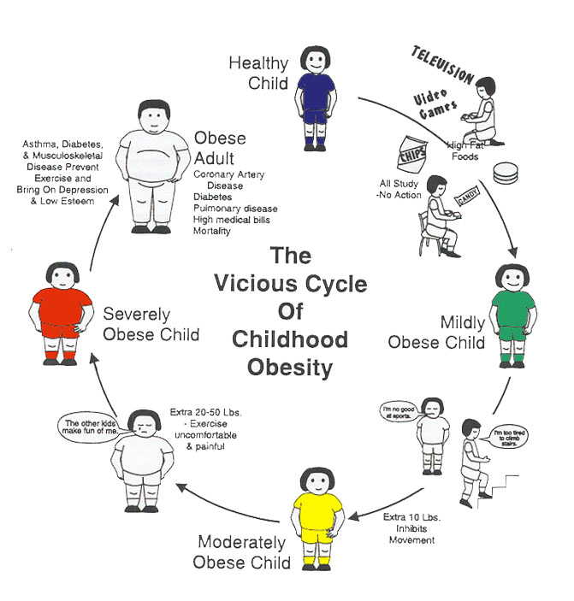
What are the concerns of Adolescent Obesity?

Slide 4
What are the Facts?
Past 20 Years
Dramatic increase in Obesity
In the United States
More than 1/3
Of U.S. adults
35% obese
Approximately 17%
12.5 Million children and adolescents
2-9yrs are obese

Slide 5
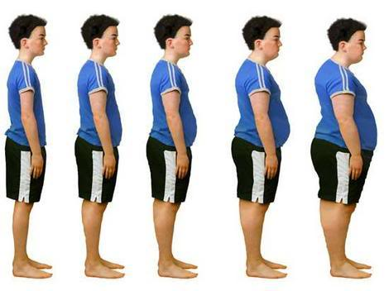
We will use the Public Policy Analyst (PPA) to evaluate Obesity in Adolescents.
Define the problem
Gather the Evidence
Identify the Causes
Evaluate an Existing Policy
Develop Solutions
Select the Best Solution

Slide 6
Define the problem
Where are the predominated locations of children with obesity?
What are the undesirable social conditions that result from being obese?
What are the problems associated with adolescent obesity?
Worksheet 1: Defining the Problem
Adolescent Obesity
Childhood Obesity

Slide 7
Gather the Evidence
Present evidence to support your claim.
Be precise…
Indicate statistics, measure-ments, research, etc..
Worksheet 2: Gathering evidence of the problem
Data and Statistics
Calculate you Body Mass Index

Slide 8
Identify the Causes
What are the underlying factors, that contribute to the problem?
Can you show evidence to support your facts?
Worksheet 3: Identifying the causes of adolescent obesity.
Obesity in Children
Childhood Obesity
Childhood Obesity Facts

Slide 9
Evaluate an Existing Policy
What is one MAJOR policy that exist today which deals with adolescent obesity?
In your own perspective what are Advantages and Disadvantages to this policy?
According to your evaluation of advantages and disadvantages should this current policy be replaced, strengthened, or improved?
Worksheet 4: Evaluating existing public policies
Competitive foods
Center for Disease and Prevention
Overweight and Obesity Policy Resources

Slide 10
Develop Solutions
What are original public policy alternatives?
Propose at least three new policies…
Are all your public policy alternatives at the same geopolitical level?
Be Specific… specifying the government agency that will carry out the proposal…
Which proposal is the most promising?
Use your group to consider which proposal is most promising.
Worksheet5: Developing public policy solutions

Slide 11
Select the Best Solution
What are three ways to reduce or prevent obesity in adolescents? (Use an abbreviation for each policy).
Where does your policy land in the matrix of effectiveness and feasibility? Is it highly achievable or not very adequate?
Worksheet 6: Selecting the best public policy solution

Slide 12
What does your results mean?
What does this mean?

Slide 13
Reminder - Why Is a Healthy Weight Important?
If you are overweight or obese, you are at higher risk of developing serious health problems,
including heart disease,
high blood pressure,
Increase risk of impaired glucose tolerance, insulin resistance, and type 2 diabetes,
Fatty liver disease, gallstones, and gastro-esophageal reflux (i.e., heartburn)
breathing problems, such as sleep apnea, and asthma
Social and psychological problems, such as poor self-esteem and discrimination
and certain cancers.

Slide 14
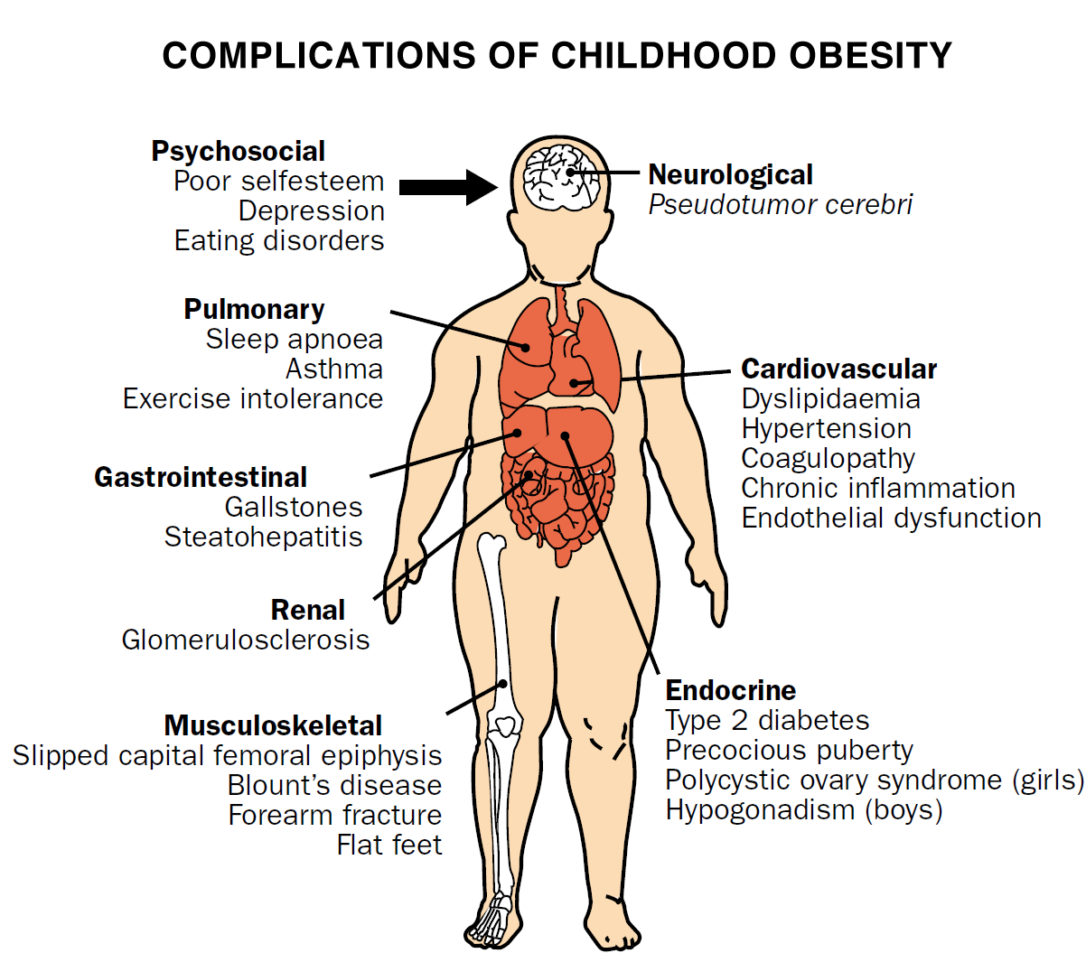

Slide 15
Sample You can reach and maintain a healthy weight if you:
Follow a healthy diet, and if you are overweight or obese, reduce your daily intake by 500 calories for weight loss
Are physically active
Limit the time you spend being physically inactive

Slide 16
Example of Causes and Solutions
Balancing your energy

Slide 17
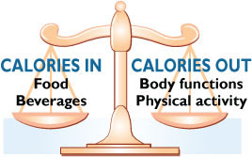
Caloric balance is like a scale. Caloric Balance Equation

Slide 18
Energy Balance
The same amount of energy IN and energy OUT over time = weight stays the same (energy balance)
More energy IN than OUT over time = weight gain
More energy OUT than IN over time = weight loss

Slide 19
Solution Sample Take Control!!!
Access your Weight
BMI
Waist Circumference
Lose Weight
Gradually and Steadily
Eating and Exercise habits
Prevent Weight Gain
Healthy Eating
Get Moving!
Self- monitoring

Slide 20
Healthy Weight
It’s not a diet
It’s a lifestyle
Selecting a Weight-Loss Program – Activity
Getting Started
Healthy Eating for a Healthy Weight
Physical Activity for a Healthy Weight
Check It Out: Before You Sign Up for Any Weight-Loss Program
Other Resources

Slide 21
References
Calculate your Body Mass Index
http://www.cdc.gov/healthyweight/assessing/bmi/index.html
Center for Disease Control and Prevention
http://www.cdc.gov/
Defining Overweight and Obesity
http://en.wikipedia.org/wiki/Obesity
Health Matters – Finding Balance
http://www.cdc.gov/CDCTV/FindingBalance/index.html
National Heart, Lung, and Blood Institute http://www.nhlbi.nih.gov/health/public/heart/obesity/lose_wt/index.htm
Nutrition
http://www.nutrition.com.sg/ho/index.asp
Teen Weight Loss
http://www.webmd.com/diet/features/teen-weight-loss-secrets

Slide 22
References
Obesity In Children And Teens
http://www.aacap.org/AACAP/Families_and_Youth/Facts_for_Families/Facts_for_Families_Pages/Obesity_In_Children_And_Teens_79.aspx
Childhood Obesity
http://aspe.hhs.gov/health/reports/child_obesity/index.cfm
Childhood Obesity Facts
http://www.cdc.gov/healthyyouth/obesity/facts.htm
Public Policy Analyst
http://www2.maxwell.syr.edu/plegal/TIPS/intro.html
Chancellor’s Regulations / Competitive foods (A- 812)
http://schools.nyc.gov/NR/rdonlyres/381F4607-7841-4D28-B7D5-0F30DDB77DFA/78296/A812FINAL.pdf
Center for Disease Control and Prevention / Overweight and Obesity Policy Resources
http://www.cdc.gov/nccdphp/DNPAO/policy/obesity.html

