Slide 1
Undocumented Students and Higher Education
By Ms. Fitzgerald

Slide 2
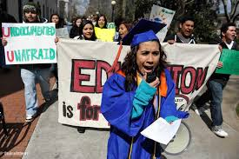
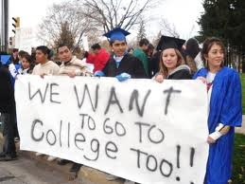
What is the social issue(s) surrounding higher education and undocumented students?

Slide 3
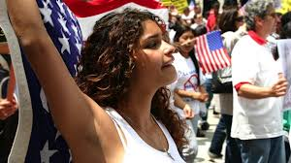
Who are “undocumented” students?
Undocumented students are those students who are present in the United States illegally, with or without their parents or caregivers.^{[1]} They face unique legal uncertainties and limitations within the U.S. educational system.

Slide 4
Using the PPA to analyze “undocumented” students
Define the problem
Gather evidence
Identify causes
Evaluate a policy
Develop solutions
Select best solution
We will be using these steps, today!

Slide 5
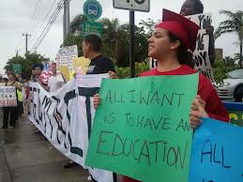
Defining the Problem…
Undocumented students are not attending higher educational institutions as often as their documented counterparts (peers).

Slide 6
Now let’s gather evidence!
In your groups, choose to analyze 3 out of the 6 sources.
With each source, list some evidence that the source provides that supports our problem: Undocumented students are not attending higher educational institutions as often as their documented counterparts (peers).
1. http://www.huffingtonpost.com/2012/08/17/young-undocumented-immigr_0_n_1795630.html
2. http://www.miamistudent.net/news/illegal-immigrants-struggle-to-afford-higher-education-1.2574992#.Uh4-BNKsh8E
3. http://inpathways.net/iza_article.pdf
4. http://digitalcommons.wcl.american.edu/cgi/viewcontent.cgi?article=1095&context=aulr&sei-redir=1&referer=http%3A%2F%2Fscholar.google.com%2Fscholar_url%3Fhl%3Den%26q%3Dhttp%3A%2F%2Fdigitalcommons.wcl.american.edu%2Fcgi%2Fviewcontent.cgi%253Farticle%253D1095%2526context%253Daulr%26sa%3DX%26scisig%3DAAGBfm39T2pmWVancpXmNX3_czQmjisZKg%26oi%3Dscholarr#search=%22http%3A%2F%2Fdigitalcommons.wcl.american.edu%2Fcgi%2Fviewcontent.cgi%3Farticle%3D1095%26context%3Daulr%22
5. http://www.e4fc.org/images/E4FC_TheCase.pdf
6.http://www.hacu.net/images/hacu/OPAI/H3ERC/2012_papers/Gildersleeve%20%20hernandez%20-%20undocumented%20students.pdf

Slide 7
Identify the causes!
Using the evidence gathered, each group come up with 3 causes to our problem.
1.
2.
3.

Slide 8
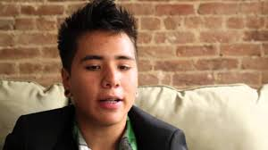
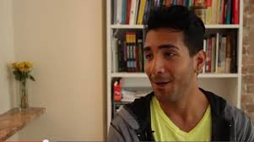
Evaluate a policy.
Click for Living Undocumented movie.
As you watch, take notes on the policies that now exist surrounding undocumented students.
Also take notes on proposed supplementary policies.

Slide 9
Policies
Based on the documentary, how would you evaluate the policies that are currently in place?
How would you evaluate the proposed DREAM Act?

Slide 10
Exit Slip
Create a new policy of your own views of immigration and based on what you’ve seen in the documentary!
Write down some ideas from current policies and potential future policies.
Why do you like this policy?

