Slide 1
Why Did African Americans Face Difficulties After The Civil War?

Slide 2
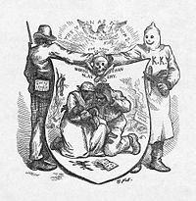
Social Problems
Even though slaves were set free, they faced major difficulties after the war
Grandfather Clause
Literacy Tests
Poll Taxes
KKK
Sharecropping

Slide 3
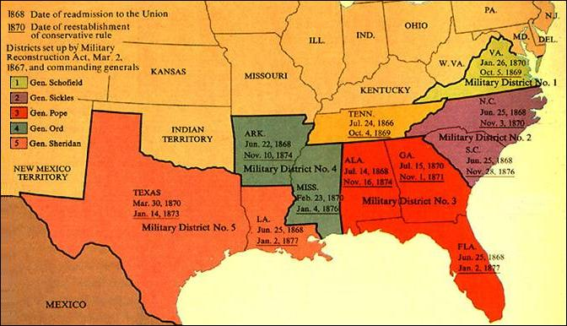
Location
Most of the discriminations for African Americans took place in the south
This does not mean life was perfect in the north
Racism was everywhere during that time period

Slide 4
Informational Tools
The worksheet “Defining the Social Problem” can help us gather information on the topic being discussed
http://www2.maxwell.syr.edu/plegal/TIPS/select.html

Slide 5
Evidence
African Americans had to face racism and discrimination
They were not given the rights promised to them in the 13th, 14th, and 15th Amendments
Had to pay taxes to vote
Could not vote unless they could pass a test
Could not vote unless their grandfather voted
Were harassed by society especially members of the KKK

Slide 6
Causes of the Problem
Racism:
Society was not ready to accept African Americans as equals
Anger:
The South was struggling to survive without slavery. Many people took out their anger on African Americans
Little Government Enforcement:
Though the government created laws to give rights to African Americans, they had little manpower to enforce the laws throughout the United States

Slide 7
Students Can Use the Following Websites to Help Collect Data
http://voices.yahoo.com/the-difficulties-african-americans-during-reconstruction-577359.html?cat=37
With a partner complete the following
http://prezi.com/pst3qvjwpinu/the-reconstruction-era-african-americans-struggle-for-full-citizenship/

Slide 8
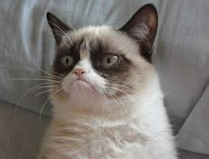
Teacher Information
Sara Rhindress
George Westinghouse High School
Srhindress@schools.nyc.gov

