Slide 1
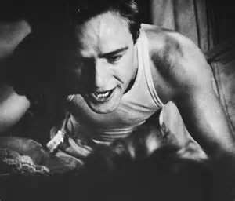
SUBSTANCE ABUSE
A modern correlation between today’s young people and
A Streetcar Named Desire
MR. MILLER

Slide 2
Definition of Addiction:
The compulsive need for and use of a habit-forming substance (as heroin, nicotine, or alcohol) characterized by tolerance and by well-defined physiological symptoms upon withdrawal; broadly : persistent compulsive use of a substance known by the user to be harmful
www.merriam-webster.com

Slide 3
Primary factors that affect increased drug use among young people:
Risk
Perceived social approval
Perceived availability
Family problems or abuse
Family history of alcohol or substance abuse
Psychological or learning problems
Poor impulse control
Adolescent Substance Abuse Knowledge Base, or ASK

Slide 4
A Streetcar Named Desire Theme of Drugs and Alcohol
Alcohol is used as a means of escape in A Streetcar Named Desire. Main character Blanche DuBois uses booze to distract herself from reality and to retreat further into a world of fantasy and cleverly contrived artifice.

Slide 5
The Attraction of Risk
There is no question that kids and teens are wired differently.
A recent study warns that there appears to be a bio-chemical reason why some kids take more risks than others and one that could make them more susceptible to abusing substances. the IMAGEN project

Slide 6
Perceived social approval
The challenge we face in curtailing teen drug use and abuse is that the perceived "benefits" of using a certain drug are known sooner and spread faster than perceived risks.
The benefits of a drug (euphoria, the energy, the numbness) are immediately evident, and electronic forms of communication like blogs, chats, and text messages allow these positive experiences to be broadcast and spread quickly.
Article Source: Teen Drug Abuse

Slide 7
Drinking is a masculine habit in A Streetcar Named Desire.
Habitual drinking isn’t ideal for a woman’s reputation in the 1940s, so the habit is often hidden or disguised. For the male gender, alcohol is very much tied to physical aggression and plays a part in the play’s worst violence.

Slide 8
Perceived availability
In 2010, 21.4 percent of high school seniors used marijuana in the past 30 days, while 19.2 percent smoked cigarettes. "The increases in youth drug use reflected in the Monitoring the Future Study are disappointing," said Gil Kerlikowske, director of the White House Office of National Drug Control Policy.

Slide 9
Family Problems or Abuse
Teens with family members who have problems with alcohol or other drugs are more likely to have serious substance abuse problems. Also, teens who feel that they are not connected to or valued by their parents are at greater risk. Teens with poor self-esteem or emotional or mental health problems, such as depression are also at risk. E Medicine Article

Slide 10
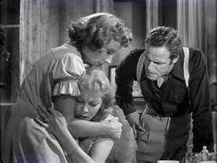
Family history of alcohol or substance abuse increases chances of addiction.

Slide 11
Psychological or learning problems
Individuals with mood disorders, learning problems, and frequent depression are prone to addiction as any addictive substance or drug or even activity such as sex that gives short term pleasure can cause the addict to return to this activity or substance again and again so that the depression is forgotten for a while. This need for short term pleasure leads to repeated pleasure seeking behavior and thus creates addiction.

Slide 12
Poor impulse control
There is a very high co-occurrence between addictive behaviors and poor impulse control. Poor impulse control issues are commonly seen in individuals struggling with addictive behaviors. One possible and plausible explanation is that addictive behaviors may initially be used inappropriately to relieve symptoms of other mental health problems.

Slide 13
Streetcar driven out of control:
To be driven by desire, Tennessee Williams seems to be saying, is self-destructive, yet the victims of an overpowering passion are carried along helplessly, unable to escape. Blanche's fate is foreordained, and the playwright stresses this in the streetcar image. Stella is driven by the same force, having abandoned herself to her passionate love for Stanley. What her final destination might be is not shown - except perhaps in Eunice?

Slide 14
Can you become a public policy analyst?
PPA
Define the problem and get started now!
http://www2.maxwell.syr.edu/plegal/TIPS/select.html

Slide 15
Jeffrey Miller, ELA Teacher Jmiller5@schools.nyc.gov
George Westinghouse High School
Brooklyn NY

