Slide 1
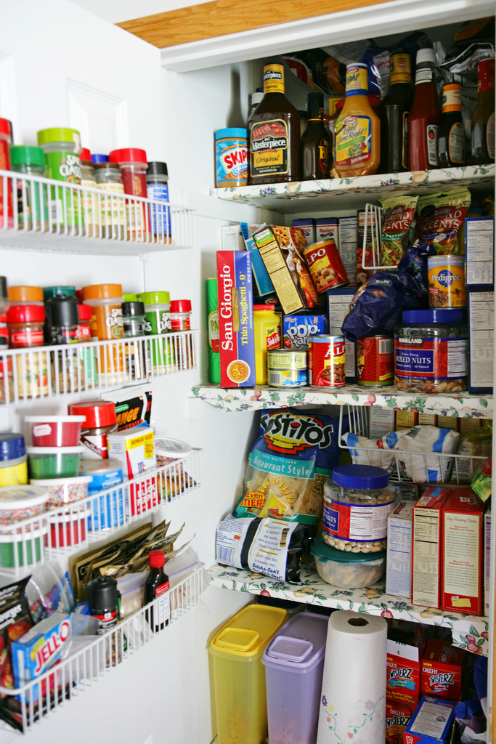
HOW SAFE IS OUR FOOD?
GENETICALLY MODIFIED FOODS

Slide 2


George Westinghouse High School
105 TECH PLACE BROOKLYN, NY 11201
Janine L. Kieran, Principal
Teacher: Ms. Lindo

Slide 3

ASSIGNMENT NUMBER 1
PLEASE COMPLETE THE FOLLOWING QUESTIONAIRRE
Notes:
AT THIS POINT OF THE LESSON, WE ARE GOINT TO TAKE SOME TIME TO CAREFULLY COMPLETE A QUESTIONAIRRE.

Slide 4
Questionnaire
Please respond to each statement using the following by circling the number that best reflect your feeling about each statement. Please check the final statement on this page.
5 = Strongly agree 4 = Agree 3 = Neutral 2 = Disagree 1= Strongly disagree
I always read the labels about foods. 1 2 3 4 5
I do not know anything about genetically modify foods. 1 2 3 4 5
I like to eat pop corn. 1 2 3 4 5
I believe that genetically modify foods are safe. 1 2 3 4 5
I believe that foods involving genetic engineering are always wholesome. 1 2 3 4 5
I am not afraid to eat genetically modify foods. 1 2 3 4 5
I believe that genetically modify foods may have an added gene sequence. 1 2 3 4 5
I believe that genetically modify foods may have a deleted gene sequence. 1 2 3 4 5
I believe that all genetically modify foods are grown in the United States. 1 2 3 4 5
I would like to learn more about genetically modify foods. 1 2 3 4 5

Slide 5
I have no food allergies. 1 2 3 4 5
I believe that a gene is a portrait of a DNA molecule. 1 2 3 4 5
I believe that genetic engineering is the technology use to add genes to crops. 1 2 3 4 5
I believe that genetically modify foods include animal products but not meat. 1 2 3 4 5
I believe that genetically modify foods only include cooking oil, cheeses and milk. 1 2 3 4 5
I am a male student ( ) I am a female student ( )

Slide 6

WHAT DO YOU KNOW ABOUT GENETICALLY MODIFY FOODS?

Slide 7
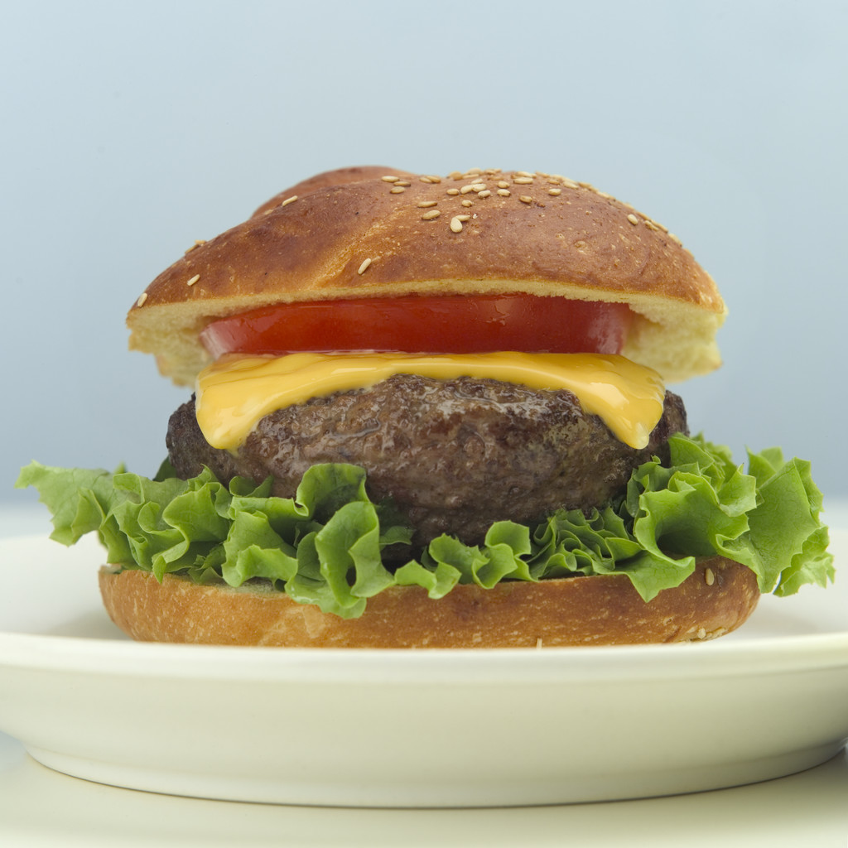
WHY IS IT IMPORTANT THAT YOU SHOULD HAVE AN AWARENESS OF THEM?

Slide 8
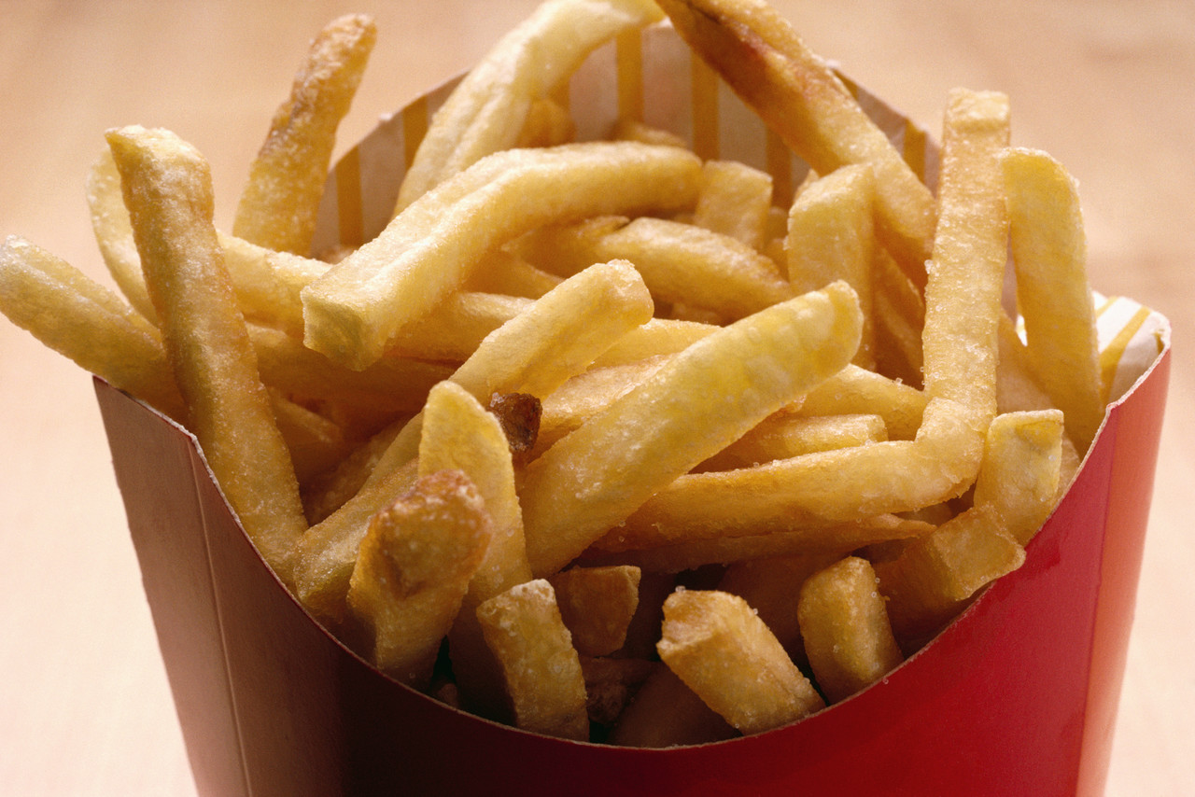
HOW DO YOU SUPPORT YOUR ANSWER?

Slide 9
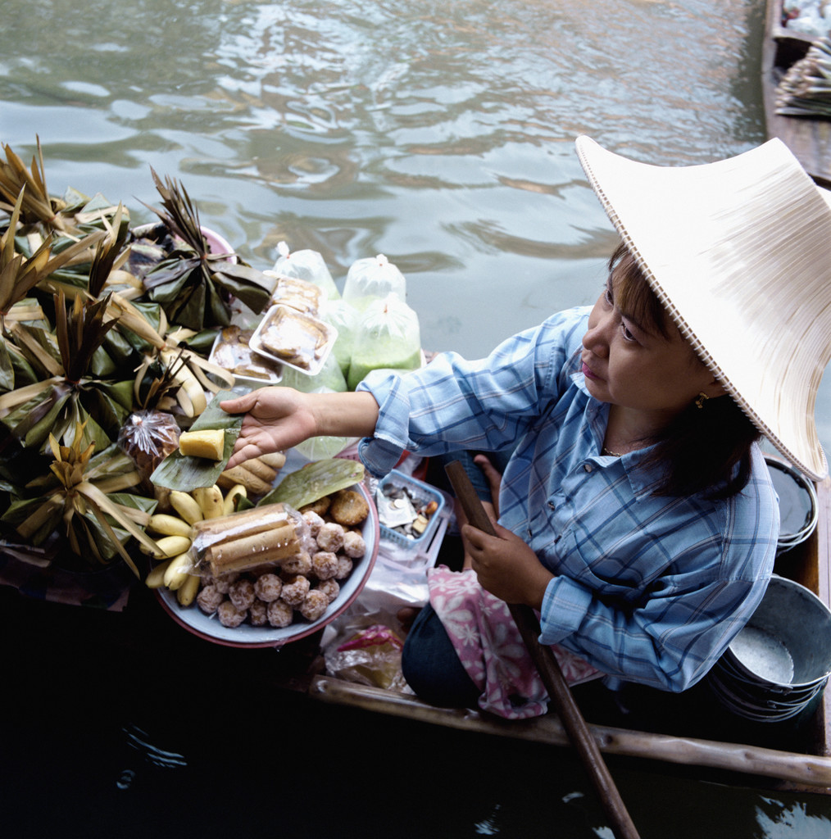
FOR THE LAST DECADE UNKNOWN TO MANY, WE HAVE BEEN EATING FOODS CREATED IN A SCIENCE LAB. IN MANY CASES NO LONG TERM STUDIES HAVE BEEN CONDUCTED AS TO THE EFFECT OF THESE FOODS ON HUMAN.

Slide 10
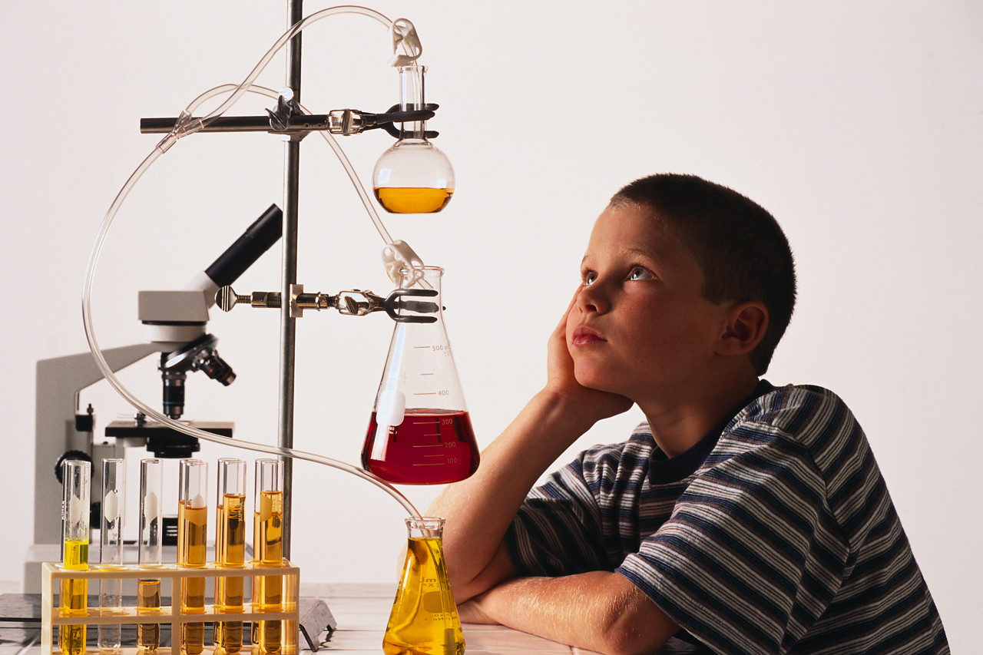

HUMAN S ARE BEING USED AS GUINEA PIGS:

Slide 11
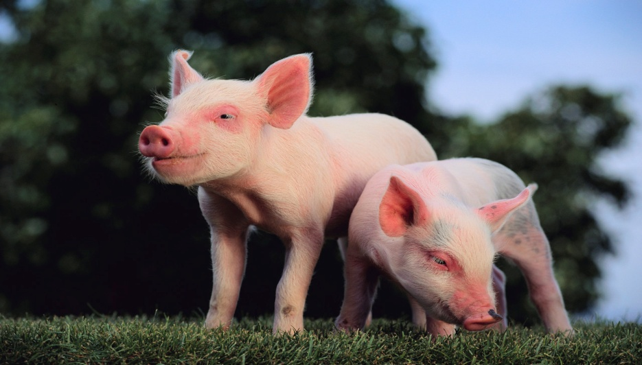
IN YOUR TEAMS, DISCUSS T HE FOLLOWING:
YOUR UNDERSTANDING OF THE TERM GENETICALLY MODIFIED FOODS
THE ADVANTAGES OF GENETICALLY MODIFIED FOOD
WHY DO YOU THINK THAT MOST INFORMATION ABOUT GENETICALLY MODIFIED FOODS ARE NOT MADE KNOWN T O THE PUBLIC?
DO YOU THINK T HAT YOU ARE BEING USED AS GUNEA PIGS IN GENETICALLY MODIFIED FOODS PRODUCTION?

Slide 12

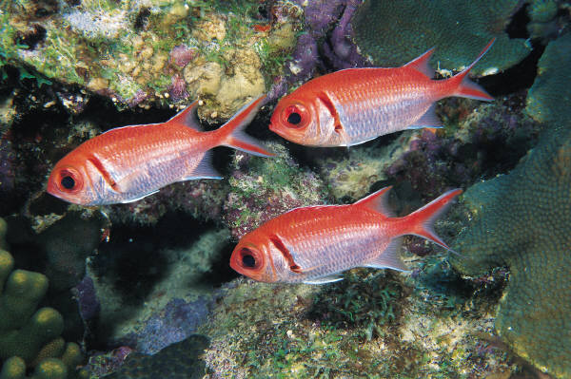
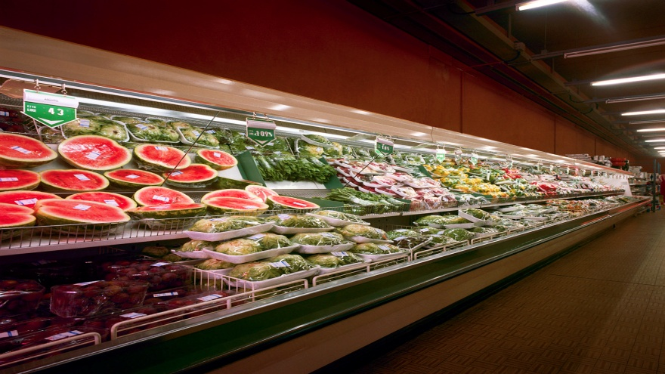
SHARE OUR YOUR ANSWERS

Slide 13
ARE GENITICALLY MODIFIED FOODS A PROBLEM ?

Slide 14
BRAINSTORM USING THE FOLLOWING AS YOUR GUIDE
WHAT KIND OF PROBLEMS DO YOU THINK COULD OCCUR IF YOU CONTINUE TO EAT GENETICALLY MODIFIED FOODS?
DO YOU KNOW OF ANYONE WHO HAS DEVELOPED FOOD ALLERGIES?
WHY DID THIS HAPPEN?
WHAT I S GEORGE WESTINGHOUSE HIGH SCHOOL ROLE IN EDUCATING Y OU AS STUDENTS ABOUT GENETICALLY MODIFIED FOODS?

Slide 15
WHAT ARE GENETICALLY MODIFIED FOODS?

Slide 16
GENETICALLY MODIFIED FOODS ARE:
FOODS WITH NEW GENES ADDED TO THE DNA
FOODS FROM ANIMALS FED WITH GENETICALLY MODIFIED FOODS
FOODS PRODUCED BY GENETICALLY MODIFIED ORGANISMS

Slide 17
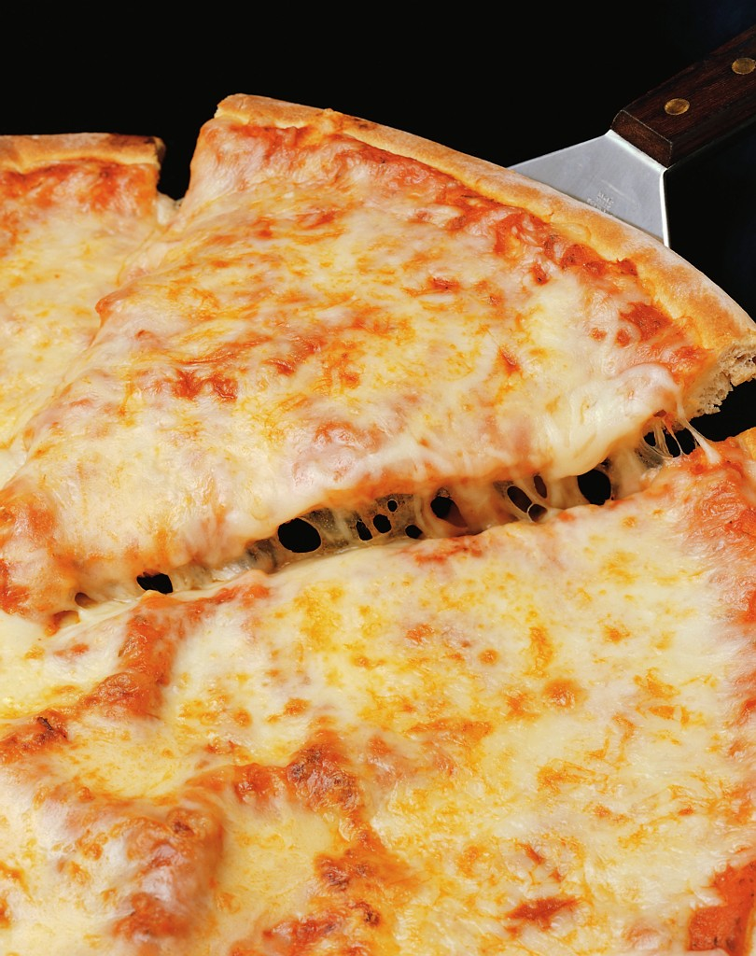
WHAT ARE SOME EXAMPLES OF GENETICALLY MODIFIED FOODS?
MEATS
CHEESES (PIZZA AND ITS TOPPINS)
VEGETABLES
RICE
TOMATOES
POTATOES (FRENCH FRIES)

Slide 18
WHY GENETICALLY MODIFIED FOODS ?

Slide 19
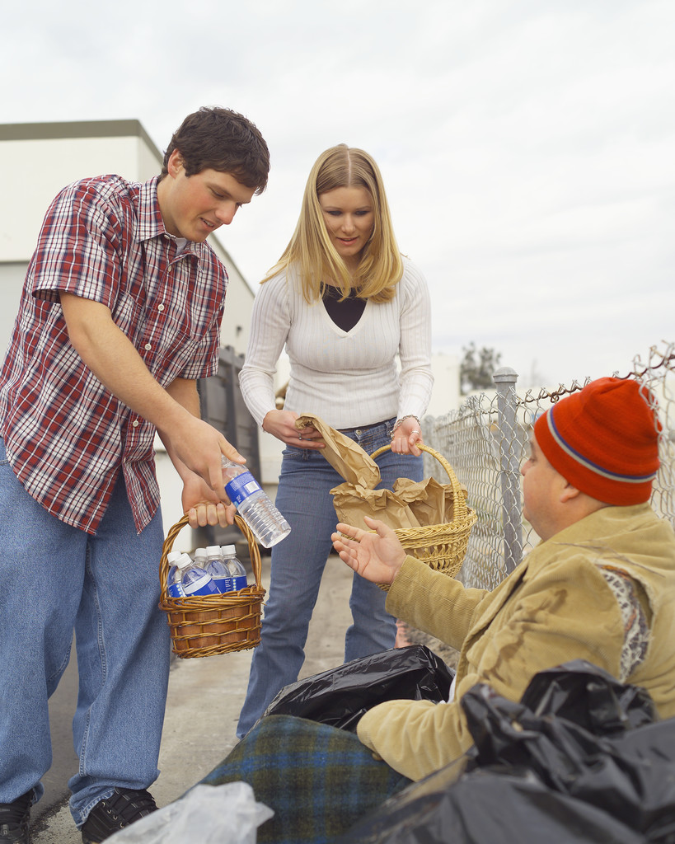
BIOTECH TCH COMPANIES THAT PRODUCE AND MARKET GENETICALLY MODIFIED FOODS PROMOTE THEIR PRODUCTS AS
PROVIDING A SOLUTION TO WORLD HUNGER
PROVIDING A SOLUTION TO ENVIROMENTAL PROBLEMS
PROVIDING BENEFITS TO HUMAN
PROVIDING A SOLUTION TO ERADICATE POOR NUTRITION

Slide 20

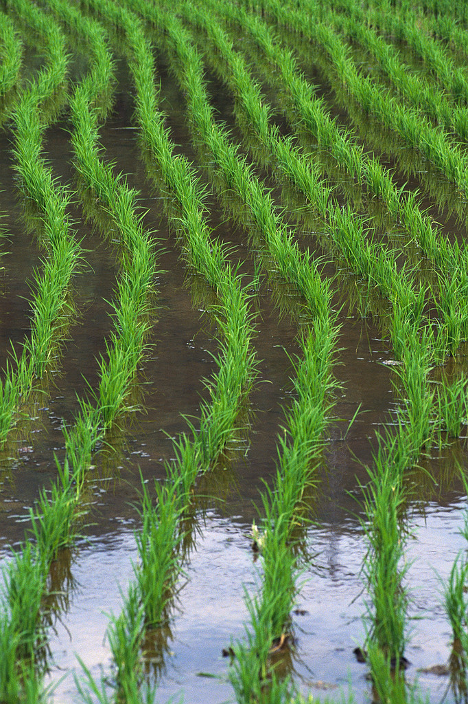
ASSIGNMENT 2
READ DALE, P. J. CLARKE, B. EMG FONTES; POTENTIAL FOR THE ENVIRONMENTAL IMPACT OF TRANSGENIC CROPS. NATURE BIOTECHNOLOGY , VOLUME 20. 2002 pp. 567 - 574.
IDENTIFY THE SIX PRINCIPAL COUNTRIES THAT GREW 99% OF THE GOBAL TRANSGENIC CROPS.
WHAT WERE THE MAIN CROPS GROWN ON ALMOST 100 % OF THE TOTAL AREA OF TRANSGENIC CROP PRODUCTION?

Slide 21
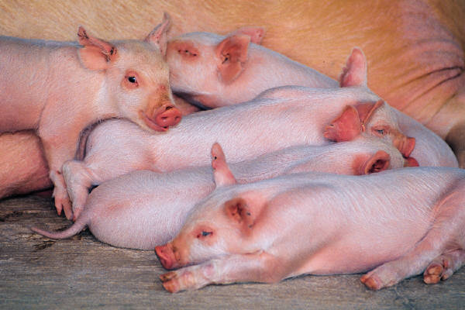
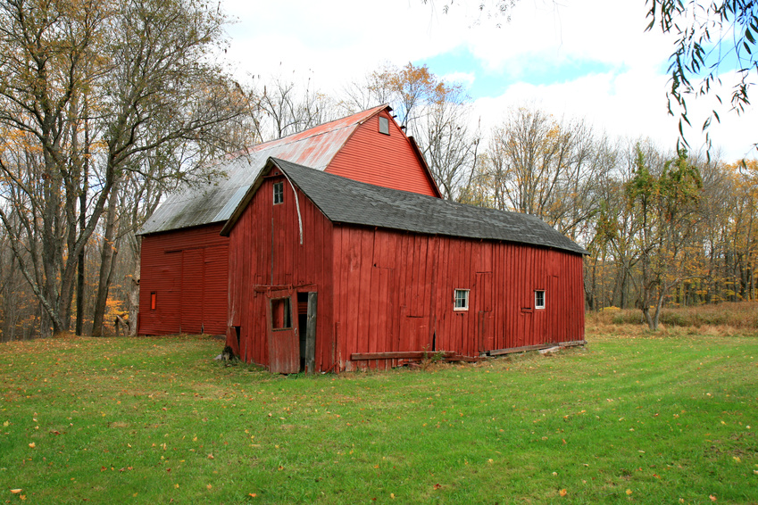
THE SIX PRINCIPAL COUNTRIES ARE AS FOLLOWS:
UNITED STATES OF AMERICA
ARGENTINA
CANADA
BRAZIL
CHINA
SOUTH AFRICA

Slide 22
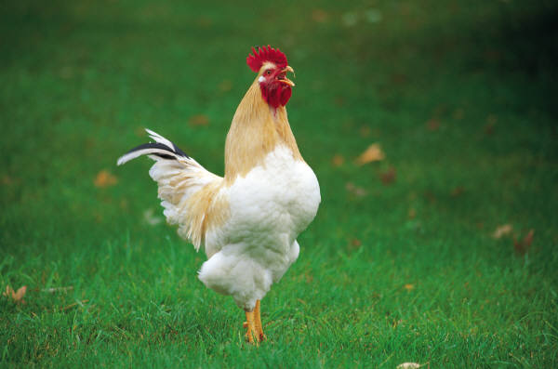
MAIN CROPS AND ALMOST 100 % OF PRODUCTION
CROPS PERCENTAGE BY COUNTRIES
SOYA BEANS 61 % UNITED STATES 63 %
MAIZE 23 % ARGENTINA 21 %
COTTON 11 % CANADA 08 %
CANOLA 05 % BRAZIL 04 %
OTHERS 01 % CHINA 04 %
PAPAYA 01 % SOUTH AFERICA 01 %

Slide 23
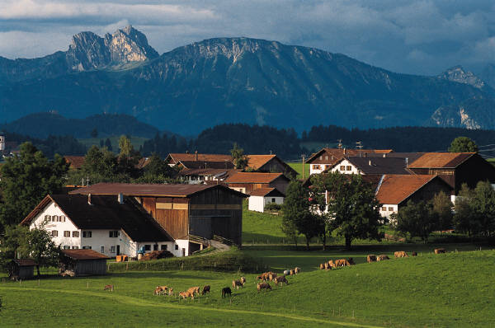
PREPARE A GRAPHICAL REPRESENTATION OF THE INFORMATION ON SLIDE 20.
WHAT KINDS OF TREND DO YOU IDENTIFY?

Slide 24

CONTROVERSIES:
CONSUMERS OF GENETICALLY MODIFIED FOODS ARE WORRIED ABOUT THE LONG TERM EFFECTS OF THESE FOODS ON THE HUMAN BODY.
VERY FEW LONG TERM STUDIES HAVE BEEN DONE ON THE HARMFUL EFFECTS OF THESE FOODS.
SOME PEOPLE CONSIDER THESE FOODS TO BE INORGANIC

Slide 25
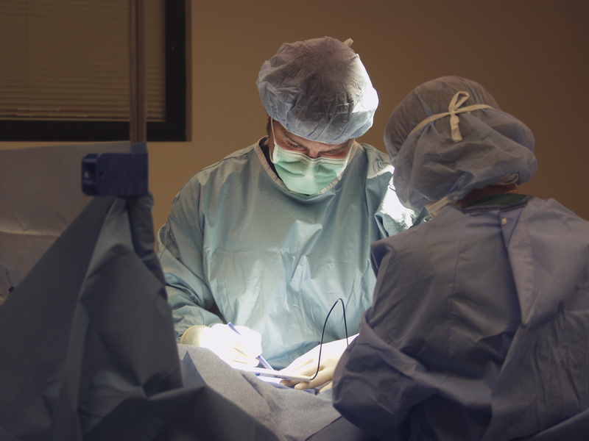
WHAT KIND OF EVIDENCE IS THERE TO SUPPORT THE CONTROVERSIES INVOLVING GENETICALLY MODIFIED FOODS?

Slide 26

TECHNOLOGY USUALLY INVOLV E RISK AND S OMETIMES THESE RISKS TURN OUT TO BE THE UNEXPECTED ONES. FOR EXAMPLE, CHLOROFLUIROCARBON IN SPRAY CANS HELP TO DESTROY THE OZONE LAYERS IN THE UPPER ATMOSPHARE WHICH HELP TO PROTECT THE EARTH FROM DANGEROUS RADIATION.
HOWEVER, SPECIFIC GENETICALLY MODIFIED ORGANISMS MAY HAVE SPECIFIC HARMFUL EFFECTS BY ALTERING THE NORMAL GENE COMBINATION THEY POSSESS.

Slide 27
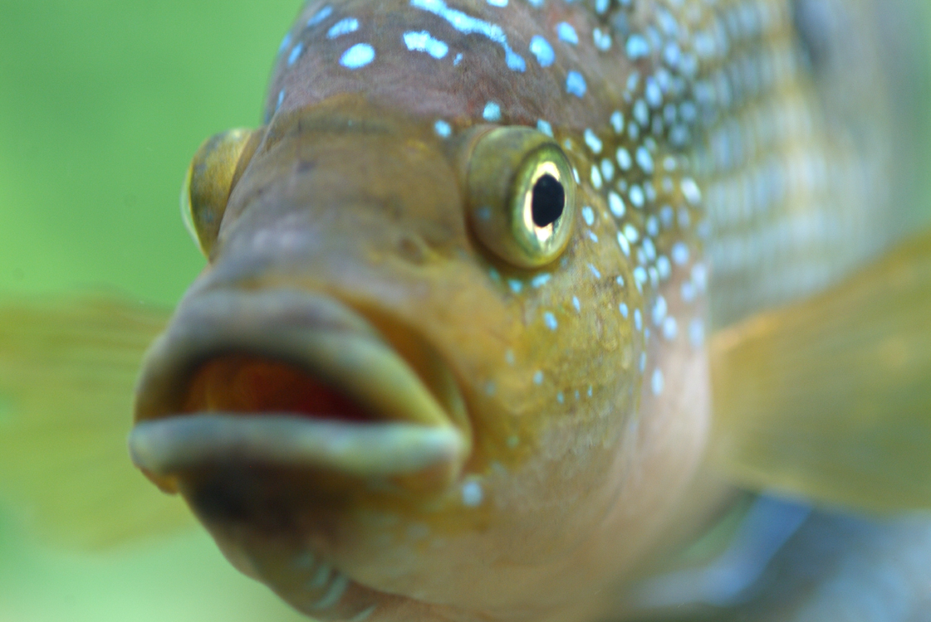
GENE ALTERING MAY INCLUDE:
NEW ALLERGENS IN FOOD SUPPLIES FOR EXAMPLE, A MOTHER WHO GIVES ALLERGENIC MILK MAY NOT REALIZE THAT SHE NEEDED TO AVOID GENETICALLY MODIFIED CARROTS.
EATING GENETICALLY MODIFIED FOODS MAY REDUCE THE EFFECTIVENESS OF ONE’S ANTIBODIES TO FIGHT DISEASES IF ANTIBIOTICS ARE TAKEN AT THE SAME TIME AS THE FOODS.
ADDITION OF FOREIGN GENES TO PLANTS SUCH AS RICE OR WHEAT COULD ENDANGER ANIMALS THAT EAT THESE PLANTS OR THEIR BI-PRODUCTS.
FISHES DESIGNED TO TOLERATE MERCURY SEQUENCING CAN BECOME HARMFUL IF EATEN BY PREDATORS

Slide 28
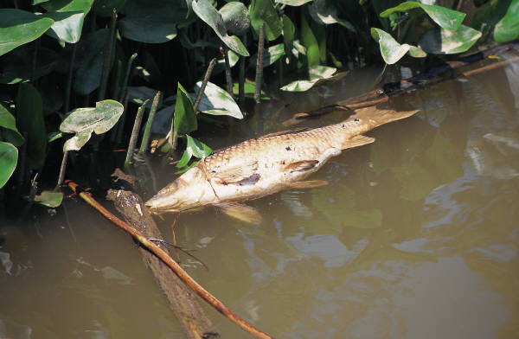
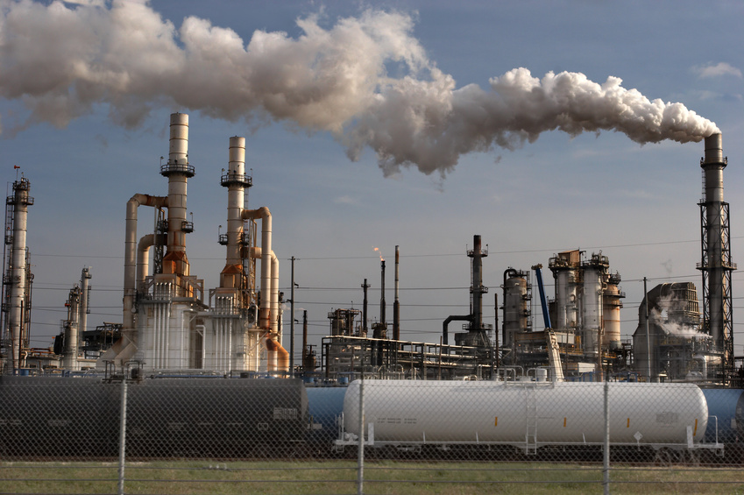
AWARENESS:
WHAT PROGRAMS AND POLICIES ARE AT GEORGE WESTINGHOUSE HIGH SCHOOL TO ADDRESS THESE ISSUES?

Slide 29
WHAT CAN THE STUDENYS DO TO ADDRESS THE PROBLEM?

Slide 30

PREPARE A BROCHER DESIGNED TO BUILD PUBLIC AWARENSS ABOUT THE POSSIBLE EFFECTS OF GENETICALLY MODIFIED FOODS. PLEASE INCLUDE THE BENEFITS AND RISKS OF THESE FOODS.
OR
WRITE A LETTER TO THE PRINCIPAL OF GEORGE WESTINGHOUSE HIGH SCHOOL IN AN EFFORT TO CONVINCE HER THAT A POLICY INVOLVING GENETICALLY MODIFIED FOODS SHOULD BE IN PLACE TO BUILD SOCIETAL AWARENESS OF THE POSSIBLE EFFECTS OF THESE FOODS.

