Slide 1
Social Media & the Spread of Misinformation

Slide 2
Growing Number of Social Media Users are Misinformed About Current Events
People who rely mainly on social media for news are often misinformed on current events or have formed an opinion on a topic without researching or fact checking.
Journalists sometimes report actual news stories that are based on inaccurate social media updates.
PPA Step # 1 http://www2.maxwell.syr.edu/plegal/TIPS/select.html

Slide 3
More social media users rely on links from friends/family contacts rather than actual news organizations
Graphic Source: Pew Research Center's Project for Excellence in Journalism / 2012 State of the News Media
PPA Step # 1 http://www2.maxwell.syr.edu/plegal/TIPS/select.html

Slide 4
While social media can help break real news...
In 2009, Twitter user Janis Krums (@jkrums) tweeted photos of the US Airways “Miracle on the Hudson” plane that crashed in New York’s Hudson River. He was on one of the ferries that responded to the crash site before traditional news outlets knew about the incident.
SOURCE: Social Media Today
http://socialmediatoday.com/dlawrence/475239/social-media-now-major-source-breaking-news

Slide 5
While social media can help break real news...
In 2011, Twitter user Sohaib Athar (@reallyvirtual) tweeted about a helicopter annoying him over his home in Abbottabad, Pakistan, at 1am local time. Unbeknownst to him, he was live-tweeting about the US raid that killed Osama Bin Laden.
SOURCE: Washington Post
http://www.washingtonpost.com/blogs/blogpost/post/sohaib-athar-tweeted-the-attack-on-osama-bin-laden%20--%20without-knowing-it/2011/05/02/AF4c9xXF_blog.html

Slide 6
…Not everything published online is necessarily true.
Jackie Chan died in March 2011…according to numerous Facebook posts. The actor then had to release a statement, via his Facebook page, to prove that the rumors were false and that he was alive.
Source: People.com http://www.people.com/people/article/0,,20477260,00.html

Slide 7
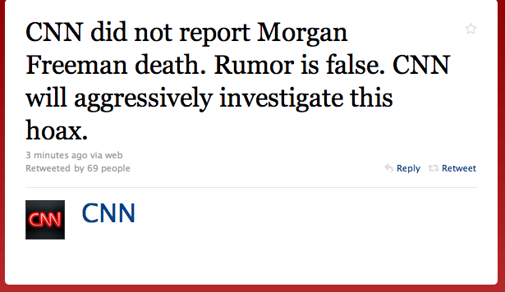
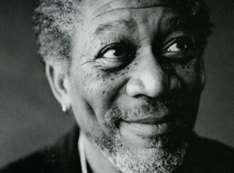
…Not everything published online is necessarily true.
Morgan Freeman died in December 2010 and the news was credited to CNN… according to numerous “tweets” on Twitter. CNN then had to clarify that they never reported the news and that Morgan Freeman was, in fact, alive.
Source: Mediate http://www.mediaite.com/online/cnn-says-no-it-never-sent-out-tweet-reporting-death-of-actor-morgan-freeman-whos-alive/

Slide 8
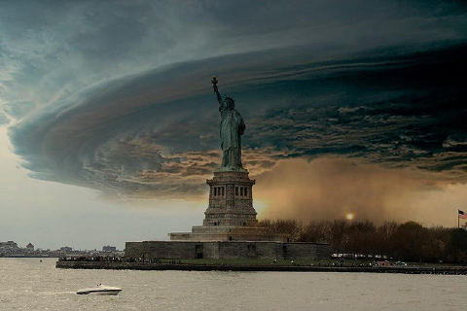
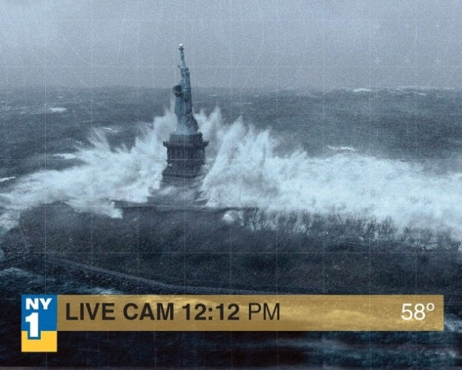
…Not everything published online is necessarily true.
In 2012, photos that social media users claimed to be taken during Hurricane Sandy went viral on social networks such as Facebook, Twitter, and Instagram. The photos were actually from previous events or doctored photos. Websites such as Buzzfeed had to clarify which photos were not actually from the current news coverage of the super storm.
Source: BuzzFeed http://www.buzzfeed.com/reyhan/viral-photos-that-arent-hurricane-sandy

Slide 9
Fake News Goes “Viral” Online
Many social media users “retweet”, “share”, and “like” these erroneous reports.
These users include average citizens and journalists who don’t fact-check before spreading the news.
PPA Step # 3 http://www2.maxwell.syr.edu/plegal/TIPS/identify.html

Slide 10
Several journalism organizations have taken notice.
The Poynter Institute tells journalists to follow 3 steps to check if an image has been manipulated.
Check the file’s metadata. It will give you information on the date the photo was taken, software used to edit it, and even the type of camera used.
Look for marks of photo editing, such as repeated pixels or a smaller image repeated over and over again.
Most doctored photos don’t get everything right, such as shadows, reflections, and perspective lines.
PPA Step # 4
http://www2.maxwell.syr.edu/plegal/TIPS/existing.html

Slide 11
Several journalism organizations have taken notice.
In the wake of fake Hurricane Sandy photos being circulated, Poynter also suggested the following:
Develop human sources and talk to them, rather than relying on images shared by indirect sources.
Check social media account user’s account history, friend connections and their previous posts.
Use the WHOIS domain registration lookup to see who’s behind the website posting questionable photos or information.
Source: The Poynter Institute http://www.poynter.org/latest-news/regret-the-error/173387/three-ways-to-spot-if-an-image-has-been-manipulated/

Slide 12
What Solutions Can We Come Up With To Solve This Problem?
What can we do to help mitigate the spread of misinformation on social media networks like Facebook and Twitter?
Use Step 5 of the PPA to develop possible solutions to this problem.

Slide 13
What Solution Is Feasible & Effective?
Is there a feasible and effective solution to this problem?
Use Step 6 of the PPA to decide which solution is the most feasible and most effective to implement.

