Slide 1
Human Impact on Invasive Species
Living Environment
Mr. Woods
Cardinal Spellman High School
jwoods@cardinalspellman.org
*All pictures courtesy of Google Images*

Slide 2
How have human activities lead to invasive species?

Slide 3
Invasive Species
Introduced by people accidentally or intentionally
Ex: Carried in shipping containers
Ex: Smuggled in as pets and then released
Can cause problems if no natural enemies are present
Outcompete native species and use up resources and habitat area

Slide 4
Asian Carp in Great Lakes

Slide 5
Burmese Python in Florida

Slide 6
Zebra Mussels

Slide 7
What are you going to do?
Form groups of four and choose one invasive species
Develop a solution to the problem using the Public Policy Analyst (PPA)
Present your solution to the class

Slide 8
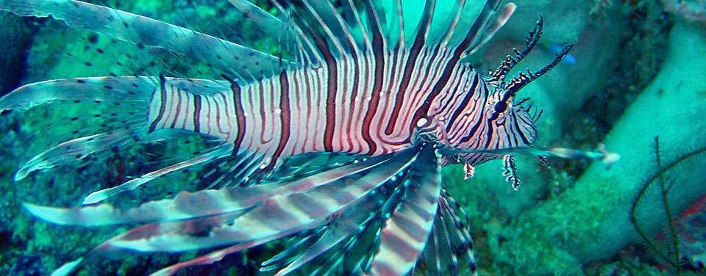
Define The Problem
Determine what invasive species you will be researching
Decide on the specific area in which to study this species
Complete Worksheet #1

Slide 9
Gather Evidence
Use these websites to search for evidence on your invasive species:
National Invasive Species Information Center
Invasive and Exotic Species of North America
National Wildlife Federation: Invasive Species
The New York Invasive Species Clearinghouse
Complete Worksheet #2

Slide 10
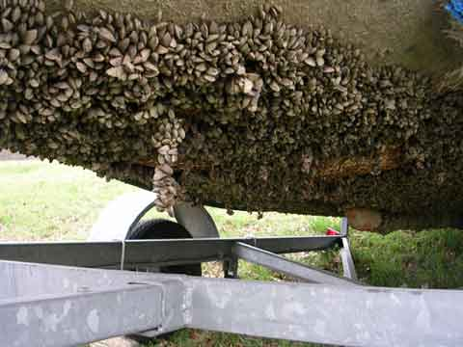
Identify the Causes
Identify how your invasive species has been introduced to the environment or how it has become a problem in its new environment
Record that information in Worksheet #3

Slide 11
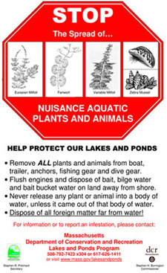
Develop Solution
Propose at least three possible public policy actions to solve the problem
One possible solution could be to lessen the introduction of invasive species
Another solution could be a method to contain them once they have been introduced

Slide 12
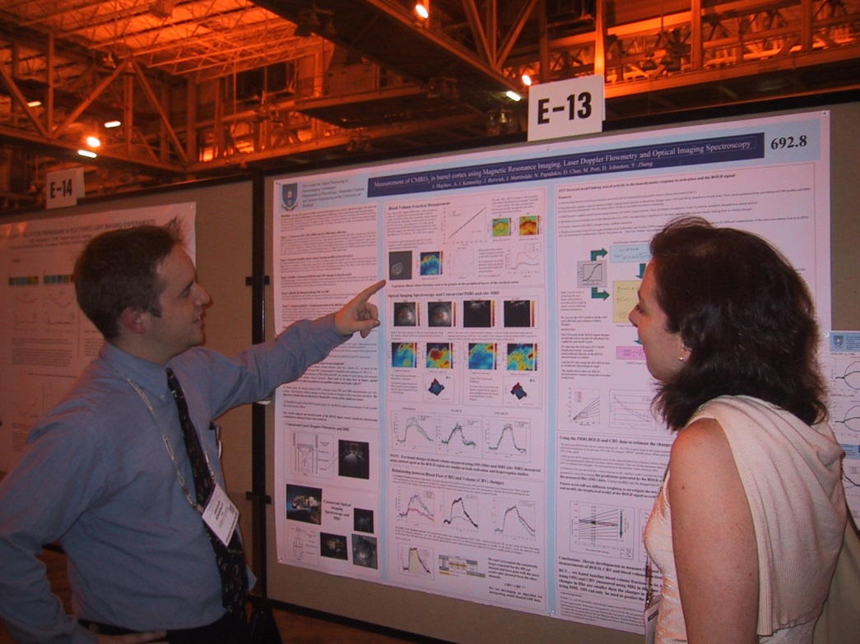
Present Your Solutions
Create a poster to present your problem and possible solutions to the class
As a class we will decide which possible solution would be the most effective and most feasible

