Slide 1
A Streetcar Named Desire: Domestic Abuse and its Consequences
Ranisha Singh
Harry S Truman High School
rsingh15@schools.nyc.gov

Slide 2
What is Domestic Abuse?
Domestic= within the home
Abuse= misuse, treating with cruelty
It can happen to anyone
1 in 4 women experiences domestic violence in her life
Women between 20-24 are at the greatest risk
Women experience more than 4 million physical assaults and rapes because of their partners
Men are victims of nearly 3 million physical assaults
In New York City, 25% of homeless heads of household become homeless due to domestic violence (Safe Horizon)

Slide 3
What Causes Domestic Abuse?
In your groups, answer the following question:
What are some factors that contribute to domestic abuse?
(Think of causes that could be related specifically to New York City!)
Answer the question on the worksheet.

Slide 4
Are There Any Solutions?
“Most domestic violence incidents are never reported.”
In your groups, create possible solutions in order to help victims to report cases of domestic violence or abuse.
Report your solutions on the worksheet.

Slide 5
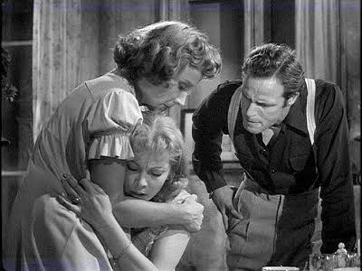
A Streetcar Named…Abuse?
Stanley has passionate relationships with both Stella and Blanche…but when does it go too far?
In pairs, create a list of:
Examples of Stanley’s abusive actions towards Stella
Possible causes of Stanley’s behavior towards Stella

Slide 6
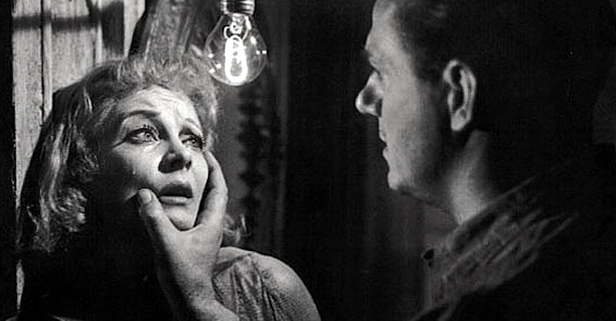
A Streetcar Named…Abuse?
In pairs, create a list of:
Examples of Stanley’s abusive actions towards Blanche
Possible causes of Stanley’s behavior towards Blanche

Slide 7
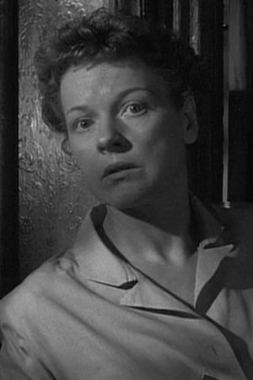
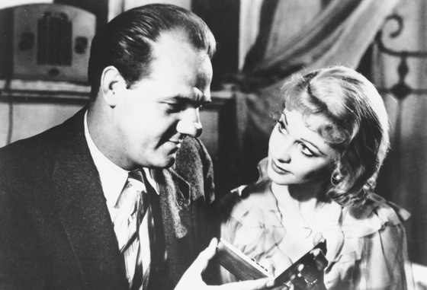
A Streetcar Named…Abuse?
“Abuse” can be both physical and verbal. It involves mistreating or acting with cruelty towards someone.
Using this definition, which other characters in the play could also have been perpetrators or victims of domestic abuse? (Hint: use the pictures below if you are stuck!)

Slide 8
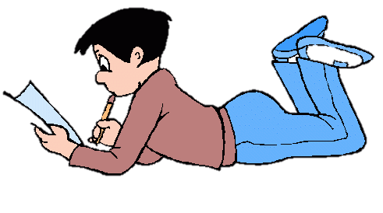
Homework
“At least one in every three women has been beaten, coerced into sex or otherwise abused during her lifetime. Most often, the abuser is a member of her own family.” (Domestic Violence Statistics)
Think about the ending of the play…who “won” the conflict?
Connect this with the statistic above. How does the ending of the play affect the lives of Stanley? Stella? Blanche?

