Slide 1
Teenage Drinking and driving
Ms. Sigismondo Harry S. Truman High School jsigismondo@schools.nyc.gov

Slide 2
Teenage Drinking and Driving
Public Policy Analyst
1 – Define the Problem http://flippedtips.com/plegal/tips/worksheet1.html
2 – Gather the Evidence
http://flippedtips.com/plegal/tips/worksheet2.html
3 – Identify the Cause
http://flippedtips.com/plegal/tips/worksheet3.html
4 – Evaluate an Existing Policy
http://flippedtips.com/plegal/tips/worksheet4.html
5 – Develop Solutions
http://flippedtips.com/plegal/tips/worksheet5.html
6 – Select the best Solution, (Feasibility Vs Effectiveness)
http://flippedtips.com/plegal/tips/worksheet6.html

Slide 3
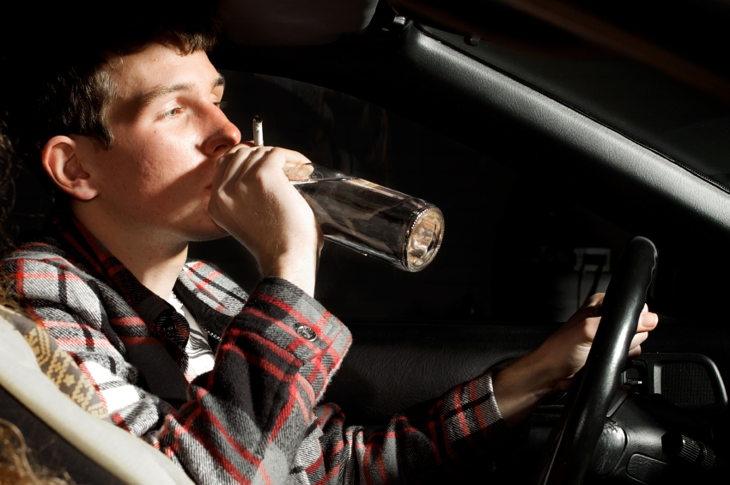
Teenage Drinking and Driving
Step One- Define the Problem
Car crashes are the leading cause of death among people ages 15 to 20. About 1,900 people under 21 die every year from car crashes involving underage drinking.

Slide 4
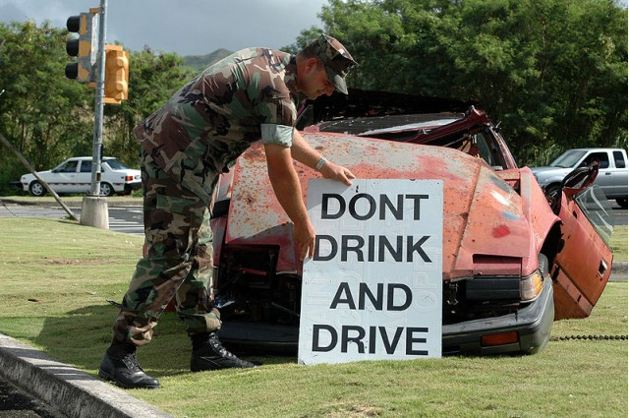
Teenage Drinking and Driving
Teen alcohol use kills about 4,700 people each year, more than all illegal drugs combined.
Even when their blood alcohol contents (BACs) are not high, young drinkers are involved in driving accidents at higher rates than older drivers with similar BACs

Slide 5
Step two- Gather the Evidence-Survey For You:
Why do you (or your peers) drink or take other
substances?
Does it make you feel:
more mature?
more confident and strong?
more relaxed?
more appealing to the opposite sex?
more willing to take chances?
better able to escape your problems?
like you belong?

Slide 6
Gather the Evidence-Step Two
About 10 million people ages 12 to 20 reported drinking alcohol in the last month.
About 6.5 million were binge drinkers (having 5+ drinks on same occasion).
About 2 million were heavy drinkers (having 5+ drinks on the same occasion on 5+ days in a month).
3.1% of 12 and 13 year olds reported using alcohol.
12.4% of 14 and 15 year olds reported using alcohol.
24.6% of 16 or 17 year olds reported using alcohol.
48.9% of 18 to 20 year olds reported using alcohol.
How many underage drinkers binge drink?

Slide 7
Gather the Evidence-Step Two
Alcohol is involved in 31% of teenage car accident fatalities.
There is a much better chance that an individual will drink and drive if they had their first drink prior to age 19.
The average blood-alcohol level of intoxicated underage car accident victims was 0.40 percent, five times the legal limit for driving.
Compared to every other age group, young people age 15-20 years old are more often involved in alcohol-related car accidents. Age 21 is the peak for fatal crashes.

Slide 8
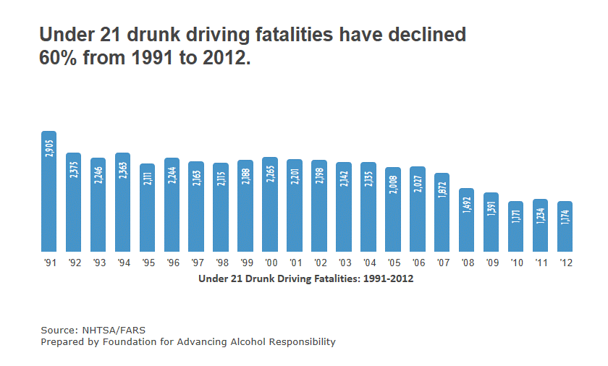
The Good News:
Based on the graph, what was the percent decrease between 1991 and 2000?
What do you think has caused this decrease?
Do you feel that the decrease is sufficient enough?

Slide 9
Causes- Step Three
Based on answers from the survey and statistics provided to you ….What are some of the general causes of teenage drinking and driving?
Share it Out…
Read some possible explanations here:
https://answers.yahoo.com/question/index?qid=20081123064645AAqK0gM

Slide 10
Now that we Are informed- Why is teenage drinking and driving a Problem?
You can use all information given and record your answers on the worksheet below.
http://flippedtips.com/plegal/tips/worksheet2.html
Also See
http://parentingteens.about.com/od/alcohol/a/Risks-Teen-Drinking-Alcohol.htm
http://www2.potsdam.edu/alcohol/YoungDriversAndAlcohol.html

Slide 11
Existing Solutions- Are they Effective?
Students Against Drunk Driving are still SADD
Every day there is a tragedy involving a student who drives drunk. There is an organization which meets frequently to attempt to reduce the student drinking population through education of the hazards of this dangerous addiction.
MADD- Mothers against drunk driving.

Slide 12
SADD
SADD is now called Students Against Destructive Decisions and is an informative alcohol and drug abuse prevention program for adolescents and young teens which helps redirect young student energy to more positive pastimes.

Slide 13
Solutions
Helping victims of drunk driving (this includes family members and other loved ones of both innocent victims and guilty impaired drivers)
Maintaining the minimum legal drinking age at 21 years
Strict policy in a variety of areas, including an illegal blood alcohol content of .08% or lower and using stronger sanctions for DUI offenders, including mandatory jail sentences, treatment for alcoholism and other alcohol abuse issues, ignition interlock devices and license suspensions
RESEARCH MORE POLICIES TO PREVENT DRINKING AND DRIVING

Slide 14
Solutions- Are they working? How can we prevent teens from drinking and driving?
In small groups- come up with a new solution to the problem at hand. Please use the following worksheet to write down your ideas.
http://flippedtips.com/plegal/tips/worksheet5.html

Slide 15
Sell Your Solution
As your final assessment you will be required to present your group’s solution to the entire class. It can be in the form of a presentation, a brochure or a poster. You must provide all reasons as to why you think your solution is the most feasible and effective way to combat underage drinking and driving.

