Slide 1
Teenage Texting and Driving in NYC
John Schoenberg
Cardinal Spellman High School
jschoenberg@cardinalspellman.org

Slide 2
The 6 Steps of the Public Policy Analysis
1- Define the Problem
2- Gather The Evidence
3- Identify the causes
4- Evaluate an Existing Policy
5- Develop Solutions
6- Select the Best Solutions
http://flippedtips.com/plegal/tips/welcome.html

Slide 3
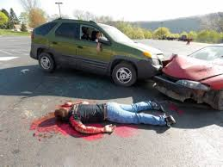
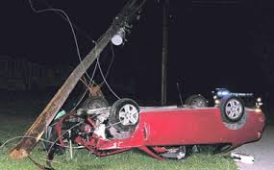
Teen Distracted Driving
Distracted Driving
Go to distracted diving and write a 2 sentence reaction to the pictures
Step 1: Define the Problem

Slide 4
Group work
In your group discuss:
The proportion of alcohol-related traffic crash deaths
Texting-related traffic fatalities
Step 2: Gather the Evidence

Slide 5
Teen Distracted Driving
Driving while Texting Six Times More Dangerous than Driving while Drunk
Step 2: Gather the Evidence

Slide 6
Teen Distracted Driving
Under New York State law you cannot use a hand-held mobile telephone or send a text or an email while you drive. If you use a hand-held mobile telephone while you drive or use a device to text or send email, you can receive a traffic ticket and be subject to a fine and a surcharge.
Step 4: Examine Existing Policy

Slide 7
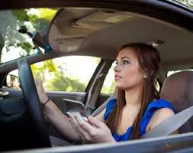
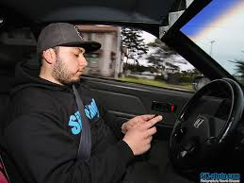
What is NYC doing about teenager distracted driving?
High Visibility Enforcement
Programs May 31, 2013, this violation carries three driver violation points for offenses committed between October 5, 2011 and
for offenses committed on or after June 1, 2013, this violation carries five driver violation points
Step 4: Examine Existing Policy

Slide 8
In Conclusion: Teenager cell phone
Teenager driving
Watch Teenager Driving, Each group will give a presentation on the 15th of the month
Each group will discuss :
The dangers of texting & driving
The solution to solve the problem of TEEN DISTRACTED DRIVING
Step 5: Develop Solutions

