Slide 1
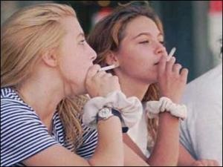
PREVENTING TEEN SMOKING IN HIGH SCHOOL
http://www.dailytech.com/Teen+Smoking+Linked+to+Reduced+Brain+Activity/article21072.htm
http://healthdiseasessymptoms.blogspot.com/2013/04/why-smoking-is-dangerous-habit-in.html
Robbin Harrison
Cardinal Spellman High School
rharrison@cardinalspellman.org

Slide 2
Is Smoking Bad?
Bell Ringer
What do you think?
Why or why not?
Do you or anyone you know smoke?
Do you think smoking is a problem in our school?

Slide 3
The TIPS Procedure
WHAT IS THE PROBLEM?
GATHER INFORMATION?
WHAT ARE THE CAUSES?
WHAT ARE CURRENT DETERRENTS?
WHAT ARE SOME SOLUTIONS?
WHAT DO YOU THINK IS THE BEST SOLUTION?

Slide 4
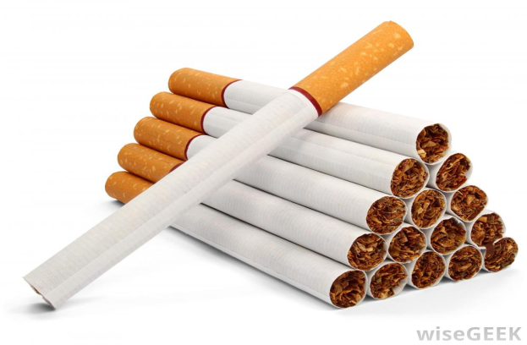
Teen Smoking Start with Worksheet #1
90 percent of adult smokers began at or before age 18
22.4 percent of high school students report current use of tobacco (cigarettes, smokeless, and/or cigars), including 27.0 percent of high school boys and 17.8 percent of high school girls
More than one-third of all kids who ever try smoking a cigarette become regular, daily smokers before leaving high school

Slide 5
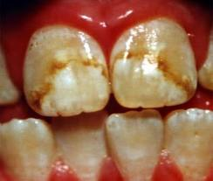
Why Should Teens Avoid Smoking?
http://www.health.com/health/gallery/0,,20484672,00.html
http://www.intelligentdental.com/2012/06/19/why-are-my-teeth-discolored-part-1/
Smoking is addictive
Smoking will stain teeth, fingers and clothing
Smokers suffer from mild airway obstructions and are more susceptible to getting sick
Smoking has been linked to increased headaches and vision problems
Smoking has been proven to cause numerous cancers
http://images.halloweencostumes.net/products/11317/1-1/moss-winged-tombstone.jpg

Slide 6
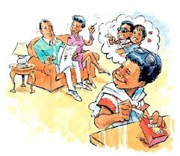
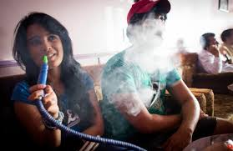
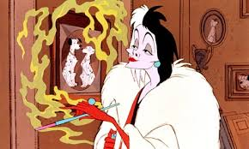
What are the Causes of Teen Smoking
Use this worksheet to guide your thinking
choose Worksheet #3

Slide 7
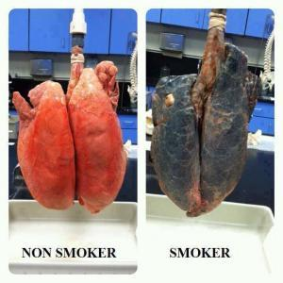
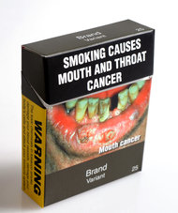
What are some existing deterrents to teen smoking?
Evaluate the current deterrents to teenage smoking. Use this form to help formulate your ideas.
http://graphics8.nytimes.com/images/2012/08/01/opinion/01fixes-cigarettes/01fixes-cigarettes-articleInline.jpg
http://m5.paperblog.com/i/52/521328/dont-smoke-cigarettes-L-e2y3QU.jpeg

Slide 8
Let’s Develop a Policy to Prevent Teen Smoking
What Would You Do?
You are your team brainstorm on ways to curtail or stop Teen Smoking
Follow this guideline

Slide 9
Resources
Centers for Disease Control and Prevention
Tobacco Free Kids.org
Mayo Clinic - Setting Examples to Stop Smoking
Cancer.gov

