Slide 1
12 ANGRY Men (the effects of Stereotypes, prejudice and Discrimination)
By: Arthur Guints
aguints@schools.nyc.gov
Truman High School

Slide 2
What are stereotypes?
widely held but fixed and oversimplified images or ideas of a particular type of person or thing.

Slide 3
Examples
Stereotyping: All blondes are dumb. All guys want is sex. All teenagers are lazy. All young people are irresponsible. All old people are boring.

Slide 4
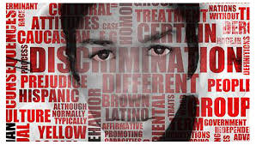
Prejudice vs Discrimination
Prejudice has to do with the inflexible and irrational attitudes and opinions held by members of one group about another, while discrimination refers to behaviors directed against another group. Being prejudiced usually means having preconceived beliefs about groups of people or cultural practices. It only becomes discrimination when a person acts on their prejudices.

Slide 5
Examples of Discrimination
Talking down to (or avoiding) blondes. Having sex when you are too young or uninterested because that's what boys expect if you're a girl/that's what you're supposed to do it you're a boy. Not hiring (insert race). Not giving young people a chance. Not giving old people the time of day.

Slide 6
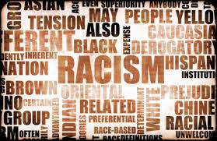
Turn and Talk
With your partner, talk about a time that you or someone you know has been the victim of stereotypes, prejudice or discrimination.

Slide 7
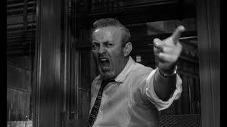
Group work
In groups of 4, using your graphic organizers, identify 3 examples of stereotyping, prejudice and discrimination in 12 Angry Men. Then complete worksheet 1 where you summarize and state, the nature and location of the social problem, propose undesirable social conditions that may result from this problem, and propose action that we can take as a class to prevent the problem.

Slide 8
In groups of 4, complete the worksheet below
It will be graded.
worksheet

