Slide 1
Loss of Biodiversity
Public Policy Analysis

Slide 2
Steps of the Public Policy Analysis (PPA)
Define the Problem
Gather Evidence
Identify the Causes
Examine the Existing Policy
Develop Solutions
Select the Best Solution

Slide 3
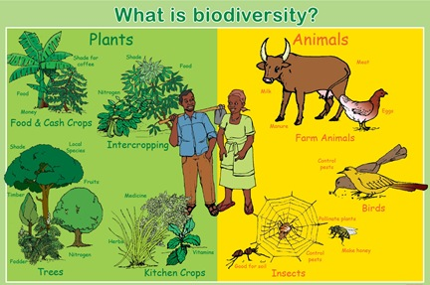
What is Biodiversity?
The diversity, or variety, of plants and animals and other living things in a particular area or region. Source: California Biodiversity Council, http://biodiversity.ca.gov/Biodiversity/biodiv_definition.html

Slide 4
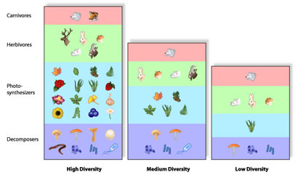
Biodiversity also refers to the abundance of different species living within a particular region. Source: California Biodiversity Council, http://biodiversity.ca.gov/Biodiversity/biodiv_definition.html

Slide 5
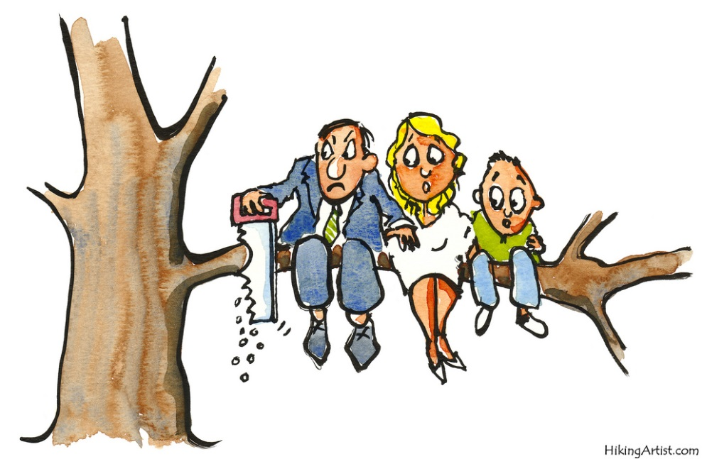
Define the problem
Despite knowing about biodiversity’s importance for a long time, human activity has been causing mass extinctions.
Many species are disappearing at an alarming rate.

Slide 6
Gather Evidence
According to the International Union for Conservation of Nature, at threat of extinction are
1 out of 8 birds
1 out of 4 mammals
1 out of 4 conifers
1 out of 3 amphibians
6 out of 7 marine turtles
Source: http://www.globalissues.org/article/171/loss-of-biodiversity-and-extinctions

Slide 7
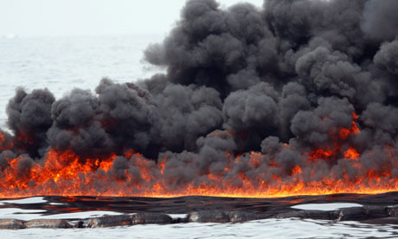
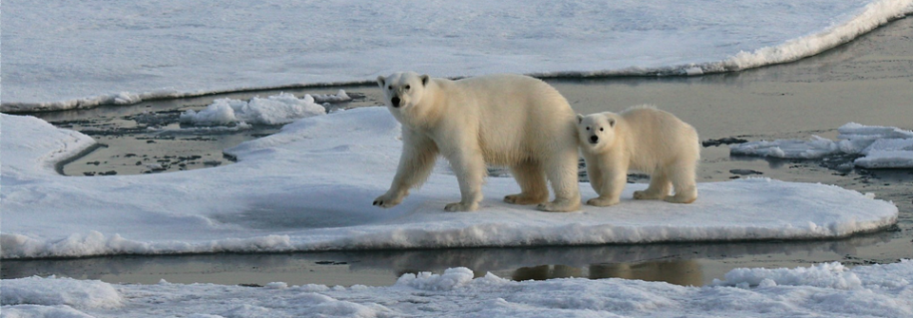
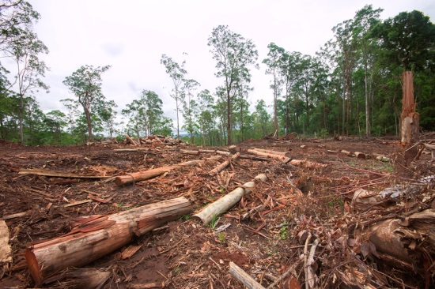
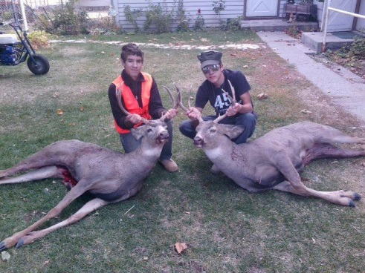
Causes
What are some of the things humans are doing that negatively affect plants and animals, reducing Earth’s biodiversity?
Task: Use this worksheet to make a list of possible causes for biodiversity loss: http://flippedtips.com/plegal/ppas/worksheet3.html

Slide 8
Examine the existing policy
Example: deforestation. Policy: The United States Forest Service is in favor of logging, as it benefits the economy. The Forest Service and the EPA work together to make sure that the permits for logging companies in the United States are granted in such a way that the forests are kept healthy and sustainable.
Task:
Research the current U.S. policy for one of the possible causes of biodiversity loss you identified on the previous worksheet.
Use the attached worksheet to explore the existing policy in more detail:
http://flippedtips.com/plegal/ppas/worksheet4.html

Slide 9
Develop Solutions
Problem: Deforestation Policy: Good for the economy, within limits Solutions: 1) Ban deforestation; 2) Require companies to plant 10 new trees for every one they cut down.
Task:
For the problem you identified and researched, think up some changes to the current policy that you would like to see implemented.
Use the attached worksheet to explore these solutions in more detail:
http://flippedtips.com/plegal/ppas/worksheet5.html

Slide 10
Pick the best solution
Which of the possible solutions you brainstormed is the most feasible?
Use the attached worksheet to rate the effectiveness and feasibility of the solutions you proposed:
http://flippedtips.com/plegal/ppas/worksheet6.html

