Slide 1
Dealing with Natural Disasters
Mr. Basa
Cardinal Spellman High School
in the United States
mbasa@cardinalspellman.org
All images courtesy of Google Images

Slide 2
Natural Disasters
Disaster-prone areas are susceptible to severe weather such as hurricanes, tornadoes, earthquakes, floods, and tsunamis.
Natural disasters negatively impact lives.
The effects of natural disasters can be costly.
Severe weather occurs over the whole planet.

Slide 3
Hurricanes
EXAMPLES

Slide 4
Tornadoes

Slide 5
Earthquakes

Slide 6
Floods

Slide 7
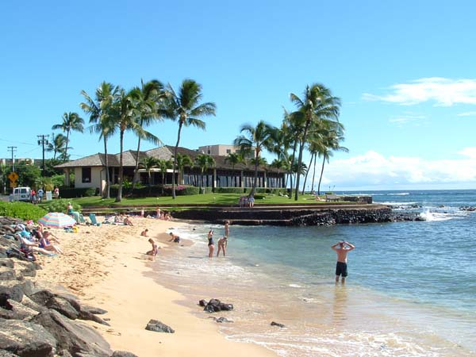
Effects of Population Change
In the United States, population density and where we choose to live can account for the rising cost of hurricanes and other forms of natural disasters.

Slide 8
Your task
Form groups of four and choose one type of natural disaster and the effects that people experience for a particular area (examples: “Tornado Alley” in the Midwest; hurricanes in the southeastern part of the United States; earthquakes in California).
Develop a solution to the problem using the PPA (Public Policy Analyst).
Present your solution to the class.

Slide 9
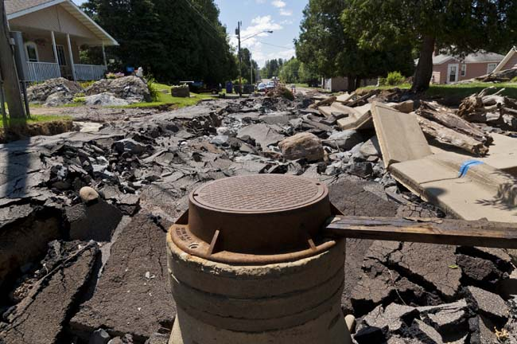
Define the Problem
Choose a natural disaster and a particular area in the United States in which it occurs, and describe the effects that are experienced. (Worksheet 1)

Slide 10
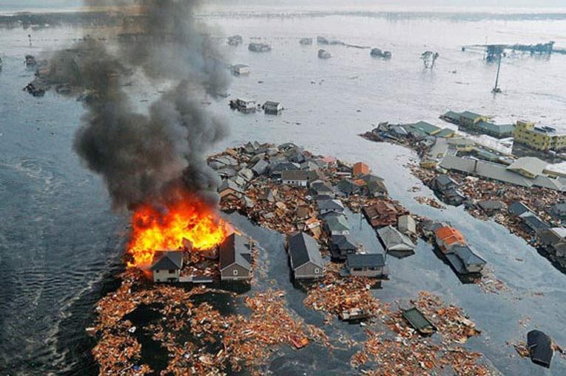
Gather Evidence
Using the Internet and the websites provided, create an alternative policy for lessening the effects of a particular natural disaster:
Natural Disasters (CDC)
National Weather Service
National Hurricane Center
OXFAM on Haiti Earthquake
Tornado Data
The “Nature” of the Problem
2. Describe some negative impacts that people experience during a natural disaster. (Worksheet 2)

Slide 11
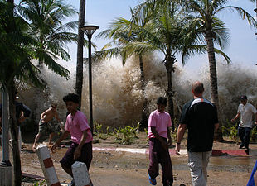
Identify the Causes
3. What are some reasons for the negative impacts that we experience as a result of a natural disaster? (Worksheet 3)

Slide 12
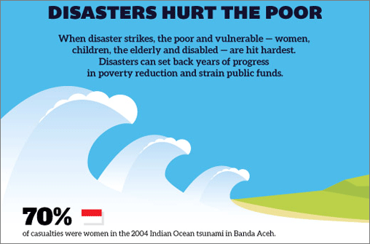
What policies are currently in place?
4. Evaluate existing policies in dealing with the costs of a natural disaster. Do they work? List the pros and cons of such policies. (Worksheet 4)

Slide 13
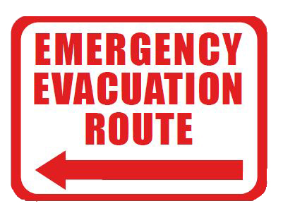
Create a Policy
5. Create a policy that would lessen property damage and improve people’s lives during a natural disaster. Include improvements on current precautions/preparedness and evacuation procedures for the area in which you live. (Worksheet 5)
For example, relocating to an even higher ground and further away from the shore for people living near the shores the Gulf of Mexico, or prohibiting people from living in such areas.

Slide 14
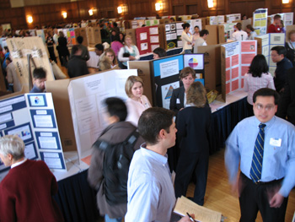
Present Your Solution
6. Determine whether your policy is feasible, and create an abbreviation or a short word to summarize each policy. Create a poster that your group will present to the class. (Worksheet 6)

