Slide 1
The Gap in Achievement for ELL’s of NYC

Slide 2
What are ELL’s?
ELL (English Language Learners) is defined as an active learner of the English language who may benefit from various types of language support (K-12)
57% of ELL’s were born in the US
43% were born outside the US
ELL’s do not fit into simple categories – diverse groups of varying ethnicities, nationalities, race, languages, and cultures

Slide 3
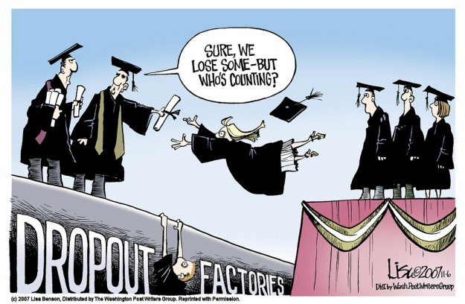
Defining the Social Problem:
ELLs in New York City graduation rates fall 20 percentage points below the rate for the City’s students overall
Only 7 percent of ELLs graduate on time and ready for college and careers
ELL’s are the fastest growing segment of the student population (highest growth occurring 7-12 grades)

Slide 4
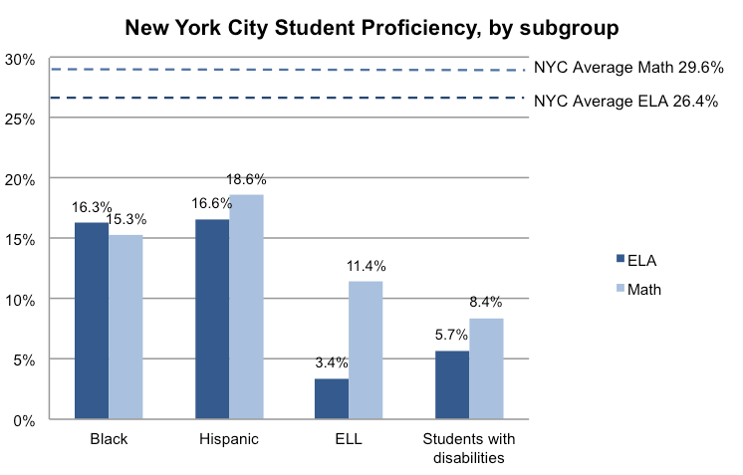
Gathering Evidence of the Problem:
Non-Native English speakers show a 4% proficiency on reading portion of NAEP exam vs. 31% native speakers
Non-Native English speakers ages 14-18 y/o were 21 percent less likely to have completed high school in 2005
City Statistics

Slide 5
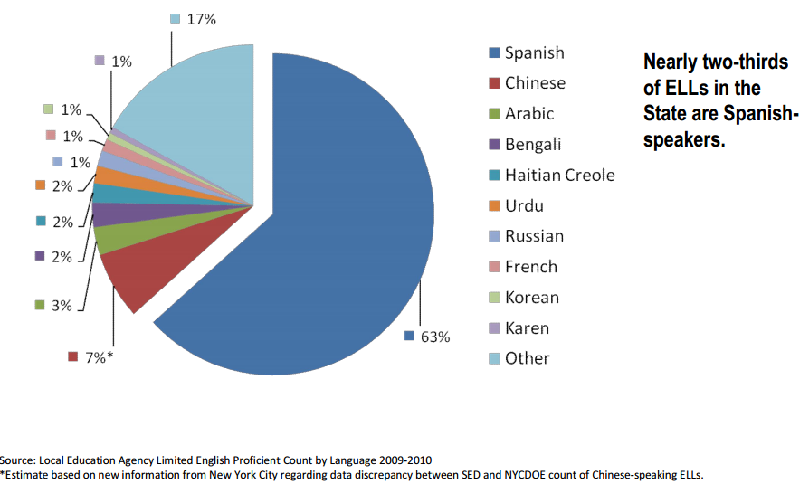
TOP 10 ELL Languages in NYC

Slide 6
Identifying the Causes of the Problem
Where have schools and communities failed to support our large ELL populations in NYC?
Why is NYC heavily impacted by ELL populations?
What is the disparity between Native English Speakers and Non-Native speakers “ELL”?
Use the Worksheet to Hypothesize Causes of the Problem → Worksheet

Slide 7
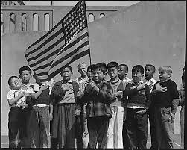
Evaluating Existing Public Policies
In 1973, Keyes v. Denver - U.S. Supreme Court ruled desegregate of schools
In 1974, the Lau v. Nichols - instructional program in which they can be given equal access to an education.
In 1978, Castañeda v. Pickard – educational programming for ELLs to be:
1. based on sound educational research
2. implemented with adequate commitment resources
3. evaluated and proven to be effective
No Child Left Behind Act (2001)

Slide 8
Public Policy Analyst Steps to Solve Our Problem!
1 – Define the Problem
2 – Gather the Evidence
3 – Identify the Cause
4 – Evaluate an Existing Policy
5 – Develop Solutions
6 – Select the best Solution, (Feasibility Vs Effectiveness)

Slide 9
Developing Public Policy Solutions
How would you change your own school’s ELL graduation statistics?
What policies would you put in place for teachers, students, parents, and administrators?
Develop Solutions - Click Here for Worksheet

Slide 10
Selecting the Best Public Policy Solution
What solutions did your group decide would be best?
Why would this solution be successful?
Some Valuable Resources:
Article 1: The Blueprint for ELL Success
Article 2: Content Based Language Instruction
Article 3: Commissioner's Regulations
NYC DOE Website ELL

Slide 11
Citations
http://www.ncte.org/library/NCTEFiles/Resources/PolicyResearch/ELLResearchBrief.pdf
http://www.p12.nysed.gov/biling/docs/DecRegPPPart154PDF.pdf
http://aplusnyc.org/english-language-learners/

