Slide 1
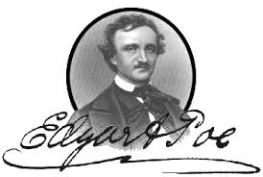
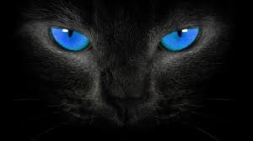
Alcoholism in “The Black Cat” by Edgar Allan Poe: A PPA Approach
Ms. Martinez
Truman High School
Notes:
Click on the picture on any of the pages that contain E.A.Poe to go to the website of the Poe Museum and learn more about the author.
Click on the picture of the black cat for story text.

Slide 2
Aim: What are the psychological effects of Alcoholism and how are they presented in the narrator?
Do Now:
Pair up and in your group create a “T” chart that lists reasons people might give for drinking alcohol. List should be split into a positive/negative sides.
Positive:
Negative:

Slide 3
Using the TIPS PPA Method to understand this problem as a Public Policy Issue:
“A public policy is a government action usually intended to deal with a social problem…The six versions of the Public Policy Analyst (PPA) will guide you through the problem solving skills necessary to study historical and current American and global public policy issues.”
Define the problem
Gather evidence
Identify causes
Evaluate a policy
Develop solutions
Select best solution

Slide 4
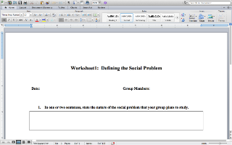
Step 1 of PPA: Defining the problem of Alcoholism:
Follow the image and use it to define what alcoholism is and some of the negative effects it has on the individual and family. Then, follow the second picture and complete worksheet number one.

Slide 5
Connections to story:
How does the narrator exhibit the signs of alcoholism? Find quotes that show he is an alcoholic, either through direct statement or through indirect description.
Notes:
Click on the picture on any of the pages that contain E.A.Poe to go to the website of the Poe Museum and learn more about the author.
Click on the picture of the black cat for story text.

Slide 6
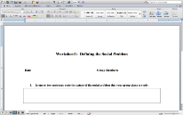
Step 2 of PPA: Gathering Evidence
Choose the following links to find evidence of the problem of alcoholism:
Use Worksheet #2 to list statistics you have found:

Slide 7
Connection to story:
How does the narrator fit into some of the statistics that you have found?
Notes:
Click on the picture on any of the pages that contain E.A.Poe to go to the website of the Poe Museum and learn more about the author.
Click on the picture of the black cat for story text.

Slide 8
Step 3: Identifying the cause of the problem
What are some of the underlying reasons that people engage in binge alcohol or chronic alcohol consumption?
Use worksheet #3 to exam what some of the reason can be, you can go back to any of the sites used before to find the information.
Add to the sheet information on what you think are the underlying reasons for the narrator to engage in this behavior.

Slide 9
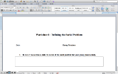
Step 4: Evaluate Policy
Below are two different policies that have been created to try to ameliorate the problem of alcoholism. Use worksheet #4 to evaluate these two policies.

Slide 10
Step 5: Develop Solution
Use the link to the worksheet to develop different solutions to the social problem of alcohol and to analyze to what you may find is the short comings of each policy you evaluated before.
Make sure that your solutions address your initial problem

Slide 11
Step 6: Select Best Solution
Analyze the policies that chose and the ones you evaluated by checking it on the matrix on worksheet six.
Remember that “two criteria that will assist in determining the best policy are feasibility and effectiveness.”
“Feasibility refers to the likelihood that your policy would be enacted by the government or government agency. Feasibility can be affected by factors such as cultural acceptance and the anticipated costs in comparison to the benefits.”
“Effectiveness refers to the likelihood that your policy will produce results that lessen the social problem.”

Slide 12
Final Connection to Text!
Based on your research and analysis, which of the two policies do you think would have been best for the narrator. Make sure to include textual evidence in your evaluation.
Notes:
Click on the picture on any of the pages that contain E.A.Poe to go to the website of the Poe Museum and learn more about the author.
Click on the picture of the black cat for story text.

