Slide 1
Aim: How is the PPA used to determine public policy?
Day 1: PPA Introduction
Ms. DiLucchio
Harry S Truman High School
Living Environment

Slide 2
Do Now:
Discuss the following question with your
partner, come to a consensus on the answer and write it down in your notebook.
When creating public policy/laws/regulations what are some factors that must be considered before decisions are ultimately made?

Slide 3
Factors to Consider
Which factor do you think is the most important when deciding public policy? Explain your answer.

Slide 4
Public Policy Analyst: Includes the following steps
Define the Problem
Gather Evidence
Identify the Causes
Evaluate the Existing Policy
Develop Solutions
Select the Best Solution (Feasibility vs. Effectiveness)

Slide 5
Focus of Activity:
We are going to use the PPA steps to identify a solution that is best for a given situation considering the following factors which greatly determine/influence current public policy.
1. Feasibility
2. Effectiveness
What do you think these words mean?
Where have you heard them before?

Slide 6
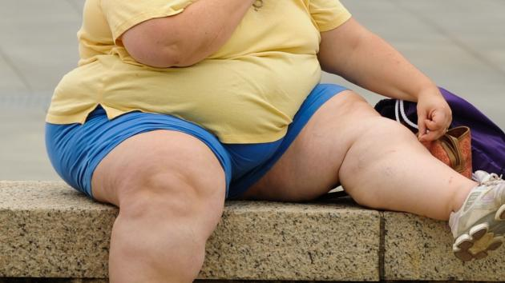
Example of Public Policy Analyst
Problem: 1 in 3 adults is overweight/obese, health care costs are increasing
Evidence:
Cause:
Eating food too high in fat, sugar and cholesterol without exercising enough. Not enough movement based on job demands, lifestyle, etc.
Notes:
Present the following problem/cause and evidence to the class.

Slide 7
Continuation
Current/Existing Policy:
Develop Solutions:
1. Jobs require all employees to go to a gym one hour for four days a week
2. Increase the cost of health insurance for those that are overweight/obese since they will cost more long-term
3. Offer incentives to employees to join/attend a gym, offer healthier snacks in work vending machines.
Notes:
Write down student answers for current/existing policy; Provide students will the following solutions, have them right them down in their notebook.

Slide 8
Deciding on the Best Solution
For each of the 3 solutions that you have agreed upon, use the chart below to determine their feasibility vs effectiveness
 | High Feasibility | Medium Feasibility | Low Feasibility
High Effectiveness
Medium Effectiveness
Low Effectiveness
Notes:
Allow students to work together to complete the chart based on the three solutions you have provided. After they are finished, instruct students to choose the one that is the best and provide an explanation to support their choice based on the above chart.

Slide 9
Summary: How do you think that using the PPA can benefit you and society?
What are some decisions that you think were made using PPA that directly effect you?
(ex: metrocards for students; what problem do you think it was solving?)

