Slide 1
The dangers of social apathy
Patricia Silva
Truman High School

Slide 2
“The opposite of love is not hate, it's indifference. “
Elie Wiesel

Slide 3
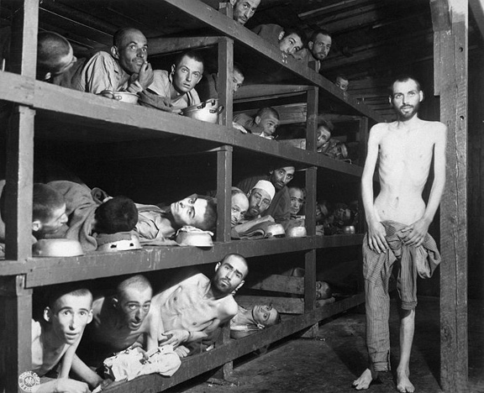
In his memoir, Night, Elie Wiesel went through the very difficult process of finding the words to describe the Holocaust, the systematic murder of millions of innocent people. It took him quite some time for him to feel that he was ready to mentally “revisit” the memory of the deaths of his family and the destruction of the world he had known as a child.

Slide 4
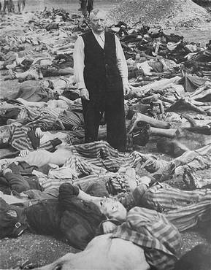
As a survivor of one of the most horrifying moments in our collective history, Wiesel is not alone. Unfortunately, there have been too many accounts of horrible crimes against humanity.
Each time we hear about genocides, most of us ask “How could that have happened?” and “Why didn’t anyone do anything to stop this?”
The first part of the answer is usually APATHY.

Slide 5
What is APATHY?
In the Merriam-Webster dictionary, APATHY is defined as :
1: lack of feeling or emotion
2: lack of interest or concern
How APATHETIC are you? Take the following quiz to find out.

Slide 6
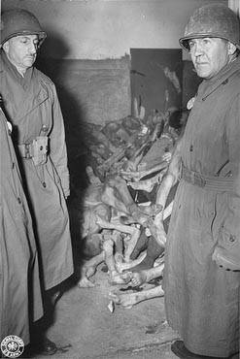
What can you do?
Although it may seem that we are all APATHETIC at some point of our lives, AWARENESS is the first step to making sure that horrors like the Holocaust and other genocides never happen again.
"Apathy is one of the characteristic responses of any living organism when it is subjected to stimuli too intense or too complicated to cope with. The cure for apathy is comprehension.“
John Dos Passos

Slide 7
Your Task
In studying an issue to be recognized as a social problem, we will apply the steps of the TIPS Public Policy Analysis
Your task is to develop a Public Policy, using the TIPS Website, that local communities can follow to deal with any one of the issues :
Bullying
Discrimination against Immigrants
Police Abuse (shootings, “Stop and Frisk”)
Poverty (Unemployment/Homelessness)
Poor academic performance (absenteeism/dropping out, low morale, vandalism)
Physical and Emotional Abuse (Spouse or Child)
Violence (school, gang, guns, repeat offenders…)
Drug use

Slide 8
Define the Problem
As a public policy analyst, your group will first need to select a problem topic and then specifically define a social problem. A social problem is a condition that at least some people in a community view as being undesirable.
From the list, select a social problem that everyone would be interested in studying.
Decide on the specific community location (our school, your neighborhood, city/state) in which to study the problem
Define your specific social problem by using one of methods in the Information Tools.
Complete your first PPA worksheet.

Slide 9
Identify causes
Why is this happening?
The goal of these activities is to develop problem solving skills through using the Internet. Therefore, this step requires your group to use the Internet to locate at least three different types of evidence to support the existence of your problem.
Complete your second PPA worksheet.

Slide 10
Develop Solutions
How can we make it better?
Eliminate or lessen its causes
Improve an existing policy
Complete your third PPA worksheet.

Slide 11
Select the best solution
After listing 2-3 alternative policies, select the policy that your group prefers.
Your preferred policy should be both feasible and effective.
Feasibility refers to the likelihood that your policy would be accepted by those involved and then enacted by the government or government agency.
Effectiveness refers to the likelihood that your policy will produce results that lessen the social problem.
Complete your fourth PPA worksheet.

Slide 12
Final Product
Create a group PowerPoint Presentation using all four of your PPA worksheets.
Write an individual informative essay analyzing your findings.

Slide 13
“I swore never to be silent whenever and wherever human beings endure suffering and humiliation. We must always take sides. Neutrality helps the oppressor, never the victim. Silence encourages the tormentor, never the tormented.”
Elie Wiesel
As we read Elie Wiesel’s Night, how APATHETIC
will you be?

