Slide 1
Teenage Drinking & Driving
Mr. Schoenberg
Cardinal Spellman High School
jschoenberg@cardinalspellman.org

Slide 2
Teenage Drinking & Driving
Public Policy Analyst
1 – Define the Problem
2 – Gather the Evidence
3 – Identify the Cause
4 – Evaluate an Existing Policy
5 – Develop Solutions
6 – Select the best Solution, (Feasibility Vs Effectiveness)

Slide 3
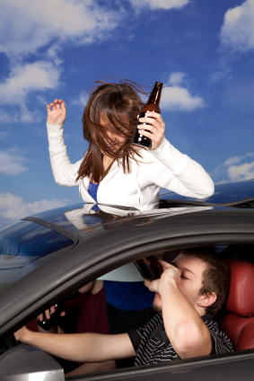
Teenage Drinking & Driving
Drinking and Driving
Car crashes are the leading cause of death among people ages 15 to 20. About 1,900 people under 21 die every year from car crashes involving underage drinking.
Step 1 of the PPA: Define the Problem

Slide 4
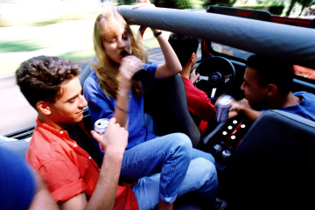
Teenage Drinking and Driving
Young people are more susceptible to alcohol-induced impairment of their driving skills. Drinking drivers aged 16 to 20 are twice as likely to be involved in a fatal crash as drinking drivers who are 21 or older.
Step 1 of the PPA: Define the Problem

Slide 5
INSURANCE RATES
For example, the Rocky Mountain Insurance Information Association cited an insurance quote based on a male and female teenager driving a 2003 Honda. Read more: The Average Car Insurance Costs for an 18-Year-Old Boy | eHow.com http://www.ehow.com/info_8622390_average-insurance-costs-18yearold-boy.html#ixzz2JIIENOyt

Slide 6
Insurance Rates
The RMIIA found that a teenage male residing in Pueblo, Colorado would pay $1,101 for a six-month policy, while a newly licensed female teenager would pay $898. In 2010, a Wall Street Journal article reported that State Farm said it charges approximately 40 percent more for boys than girls.

Slide 7
Insurance Rates
Whether a teenager is a male or female driver makes a difference in what the teenager pays. Insurance companies have conducted research and determined, based on the results, that female drivers are statistically safer drivers. Subsequently, the average rate for female teenage drivers is lower than for teenage male drivers. According to the Auto Insurance website, insurance rates for female teen drivers increase by up to 50 percent, but rates for male teen drivers increase by 100 percent. Read more: What Is the Average Cost of Auto Insurance for a Teenage Driver? | eHow.com http://www.ehow.com/info_8643370_average-auto-insurance-teenage-driver.html#ixzz2JIJIwbtH

Slide 8
Insurance Rates
Subsequently, the average rate for female teenage drivers is lower than for teenage male drivers. According to the Auto Insurance website, insurance rates for female teen drivers increase by up to 50 percent, but rates for male teen drivers increase by 100 percent.

Slide 9
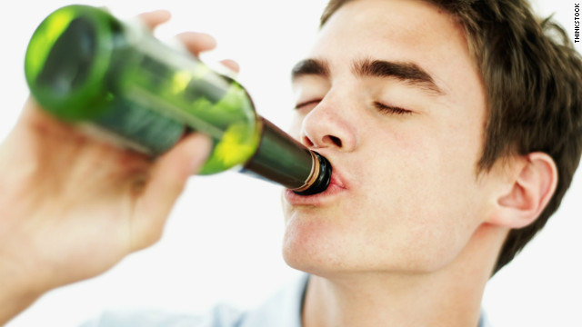
Gather the Evidence
85% of teens in high school who report drinking and driving in the past month also say they binge drank. In the survey, binge drinking was defined as having 5 or more alcoholic drinks within a couple of hours.
Step 2 of the PPA: Gather the Evidence

Slide 10
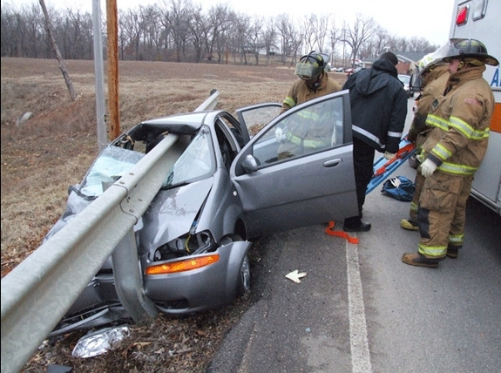
Gather the Evidence
1 in 5 teen drivers involved in fatal crashes had some alcohol in their system in 2010. Most of these drivers (81%) had BACs* higher than the legal limit for adults
Step 2 of the PPA: Gather the Evidence

Slide 11
Causes
There are several explanations for the disproportionately high numbers of teenage alcohol-related motor vehicle accidents - explanations that range from the false notion on "teenage invincibility" to the increase in personal freedoms (i.e. reaching the legal ages for driving and later, for drinking).
Step 3 of the PPA: Identify the Causes

Slide 12
Causes
Peer Pressure doesn’t have to be overt. It can be very subtle. And because it’s so important for teens to feel "in," Peer Pressure, subtle or overt, is a very powerful force. Source(s):
http://answers.yahoo.com/question/index?qid=20081123064645AAqK0gM
Step 3 of the PPA: Identify the Causes

Slide 13
Causes
Beer Commercial 1996:
Beer Commercial 2012:
Step 3 of the PPA: Identify the Causes

Slide 14
Solutions
Students Against Drunk Driving are still SADD
Every day there is a tragedy involving a student who drives drunk. There is an organization which meets frequently to attempt to reduce the student drinking population through education of the hazards of this dangerous addiction.
Step 5 of the PPA: Develop Solutions

Slide 15
Solutions
This group, SADD, which originally stood for Students Against Driving Drunk, ( commonly transposed as Students Against Drunk Driving ), and is now called Students Against Destructive Decisions, is an informative alcohol and drug abuse prevention program for adolescents and young teens which helps redirect young student energy to more positive pastimes.
Step 5 of the PPA: Develop Solutions

Slide 16
Solutions
"The mission of Mothers Against Drunk Driving is to stop drunk driving, support the victims of this violent crime and prevent underage drinking."^{[3]}
Generally MADD favors:
Education (about the dangers of drunk driving), advocacy and victim assistance
Step 5 of the PPA: Develop Solutions

Slide 17
Solutions
Strict policy in a variety of areas, including an illegal blood alcohol content of .08%^{[4]} or lower and using stronger sanctions for DUI offenders, including mandatory jail sentences, treatment for alcoholism and other alcohol abuse issues, ignition interlock devices,^{[5]} and license suspensions
Step 5 of the PPA: Develop Solutions

Slide 18
Solutions
Helping victims of drunk driving (this includes family members and other loved ones of both innocent victims and guilty impaired drivers)
Maintaining the minimum legal drinking age at 21 years
Mandating alcohol breath-testing ignition interlock devices (IIDs) for everyone convicted of driving while legally impaired
Step 5 of the PPA: Develop Solutions

Slide 19
Feasibility Vs Effectiveness
MADD announced an "Eight-Point Plan“..
Increase driving while intoxicated (DWI)/driving under the influence (DUI) enforcement, especially the use of frequent, highly publicized sobriety checkpoints.
Enact primary enforcement seat belt laws in all states.
Step 6 of the PPA: Select the Best Solution

Slide 20
Feasibility Vs Effectiveness
Create tougher, more comprehensive sanctions geared toward higher-risk drivers.
Develop a dedicated National Traffic Safety Fund.
Reduce underage drinking.
Increase beer excise taxes to the same level as those for spirits.
Reinvigorate court monitoring programs.[
Step 6 of the PPA: Select the Best Solution

Slide 21
Feasibility Vs Effectiveness
SADD’s approach involves young people presenting education and prevention messages to their peers through school and community activities. Projects include peer-led classes and forums, teen workshops, conferences and rallies, prevention education and leadership training, awareness-raising activities and legislative work.
Step 6 of the PPA: Select the Best Solution

Slide 22
Feasibility Vs Effectiveness
As of 2012, there are nearly 10,000 Middle school, high school, and college chapters with SADD advisors. There are 350,000 students actively participating (“members”) in SADD chapters.
Step 6 of the PPA: Select the Best Solution

