Slide 1
PowerPoint Presentation The Treaty of Versailles, 1919
Mr. Niebergall
Global Studies
Harry S Truman High School
THE TIPS PROGRAM-GHPPA

Slide 2
GHPPA WORKSHEET # 1
COMPLETE WORKSHEET # 1
DEFINING THE ISSUE
COMPLETE THIS IN YOUR GROUPS

Slide 3
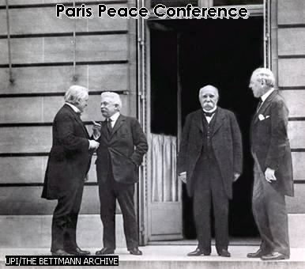
Define the Problem: Definition of the Treaty of Versailles
These images represent the Treaty of Versailles, make a word list of what the treaty was about?

Slide 4
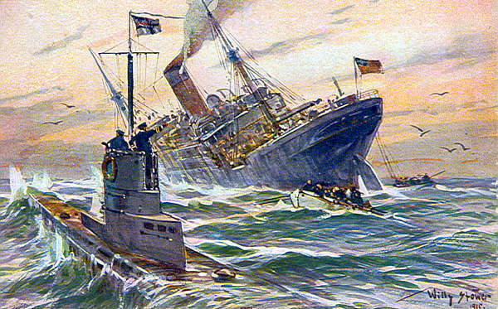
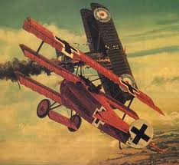
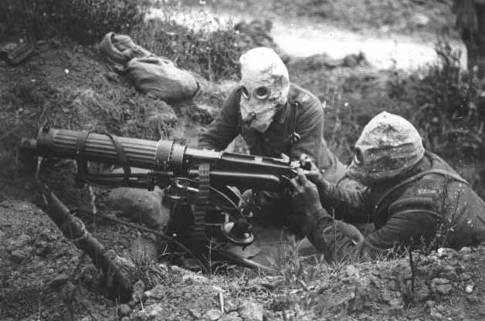
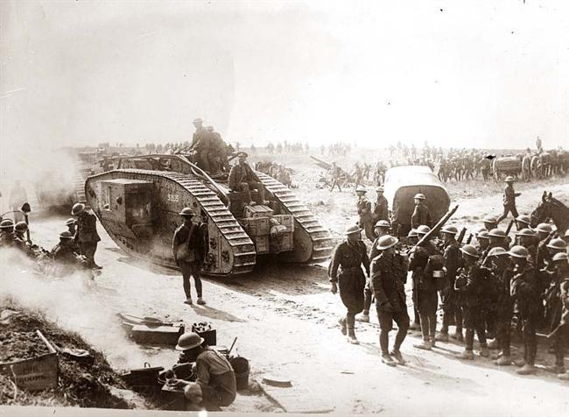
Identify the causes of why the Versailles Treaty was created??

Slide 5
GHHPA Worksheet4: "Evaluate the Policy"(HTML Version)
Complete Worksheet #4 based on slides shown in the PowerPoint Presentation.

Slide 6
In Each of upcoming Slides, use them to complete Worksheet #4
Be sure to evaluate the following slides to complete the worksheet to evaluate the Treaty of Versailles as public policy with its advantages and disadvantages.

Slide 7
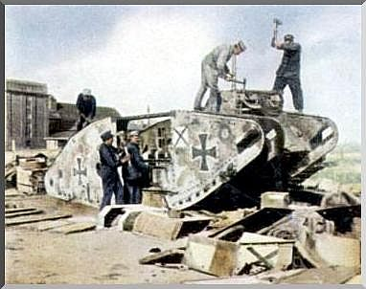
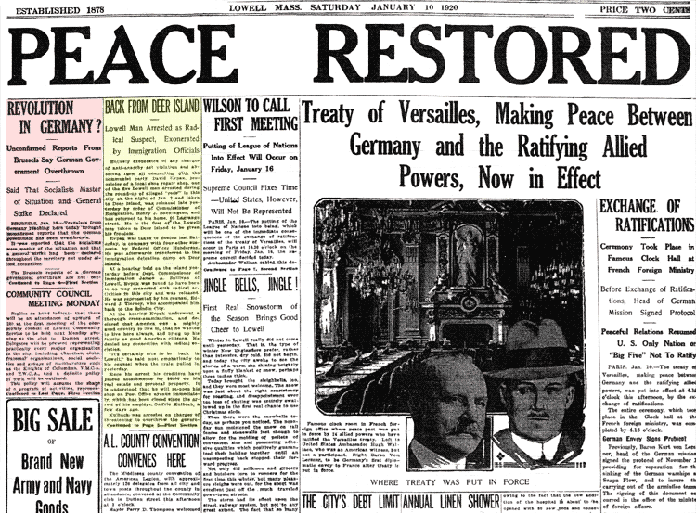
SLIDE# 1: What were the advantages of the Treaty of Versailles as a public policy?

Slide 8
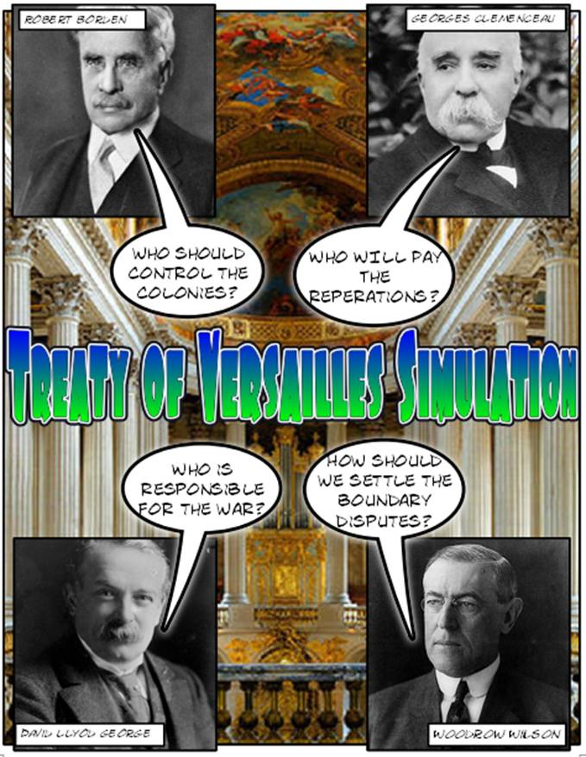
SLIDE #2: What was the disadvantage of the Treaty of Versailles as public policy?

Slide 9
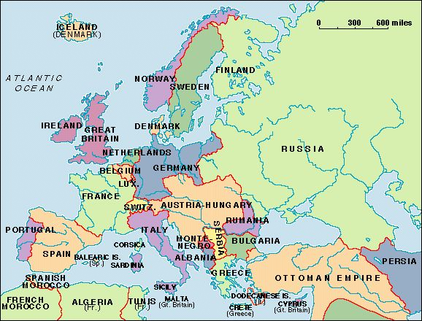
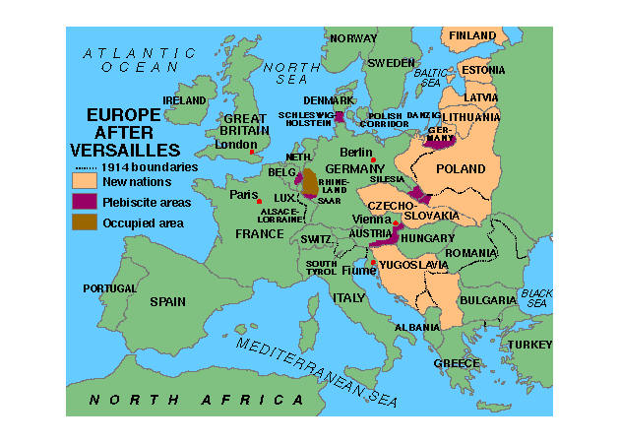
SLIDE #3: Examine the images, was the Treaty of Versailles an advantage or disadvantage as a public policy?
Europe BEFORE World War I
Europe AFTER World War I

Slide 10
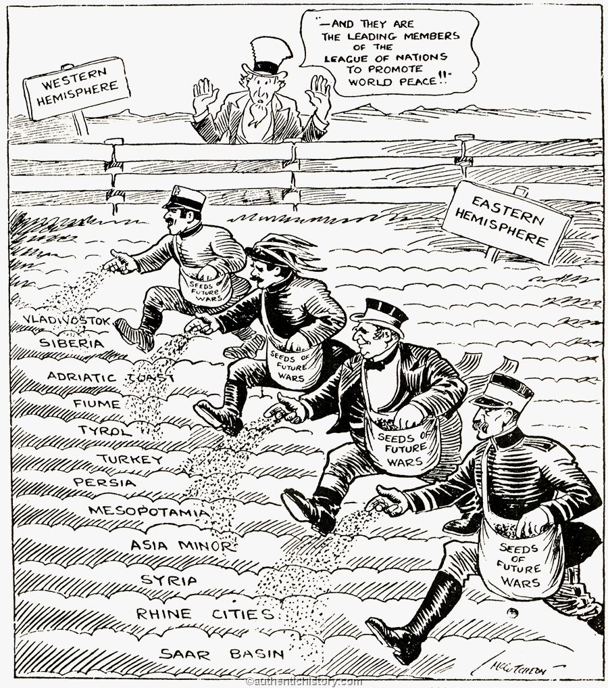
SLIDE # 4: Examine the images, was the Treaty of Versailles an advantage or disadvantage as a public policy?

Slide 11
SLIDE # 5: Examine the images, was the Treaty of Versailles an advantage or disadvantage as a public policy?

Slide 12
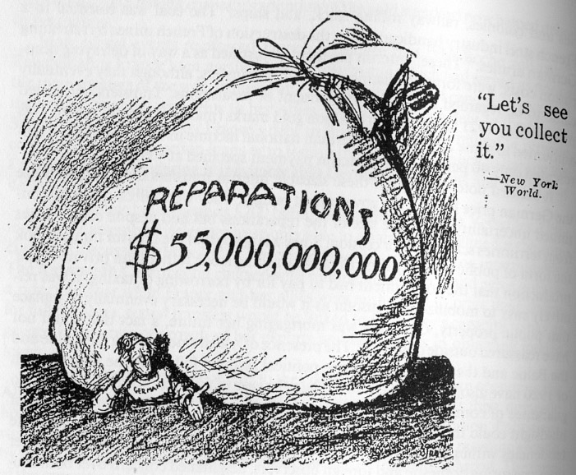
SLIDE # 6: Examine the images, was the Treaty of Versailles an advantage or disadvantage as a public policy?
Germany

Slide 13
SUMMARY: Complete Worksheet4: Evaluating existing public policies
Be sure to complete all questions.
Use the answers to the questions to develop an overall evaluation of the Treaty of Versailles.

Slide 14
HOMEWORK ASSIGNMENT: Develop Solutions
Write a two paragraph response to the following:
How could the Versailles Treaty have been rewritten or changed to better keep peace after WWII?

Slide 15
Standards
SOCIAL STUDIES STANDARDS:
Standard 2 - World History use a variety of intellectual skills to demonstrate their understanding of major ideas, eras, themes, developments, and turning points in world history and examine the broad sweep of history from a variety of perspectives.
COMMON CORE STANDARDS:
Writing
2. Write informative and explanatory texts, including the narration of historical events.
4. Produce clear and coherent writing in which the development, organization, and style are appropriate to task, purpose, and audience.

