Slide 1
Global Warming
Ms. Neumann

Slide 2
PPA Steps
Define the Problem
Gather the Evidence
Identify the Causes
Evaluate an Existing Policy
Develop Solutions
Select the Best Solution (Feasibility vs. Effectiveness)

Slide 3
What do you think Global Warming is?

Slide 4
Definition
The rise in the average temperature of Earth's atmosphere and oceans since the late 19th century and its projected continuation.
Step 1 of the PPA: Define the Problem

Slide 5
Effects of Global Warming
Rise in sea levels worldwide
More killer storms
Massive crop failures
Widespread extinction of species
Disappearance of coral reefs
http://epa.gov/climatechange/kids/impacts/effects/index.html
Step 1 of the PPA: Define the Problem

Slide 6
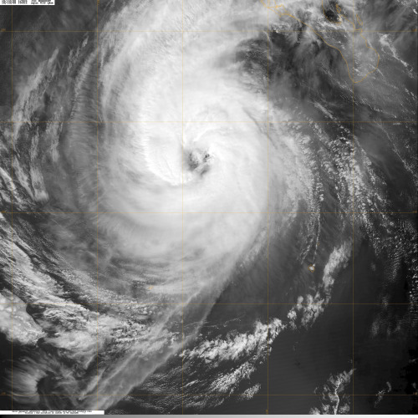
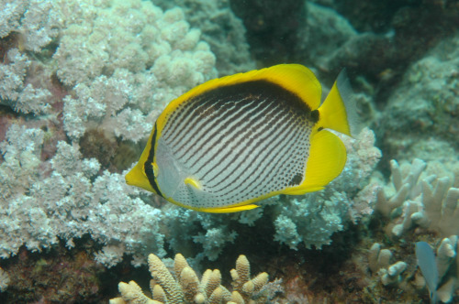
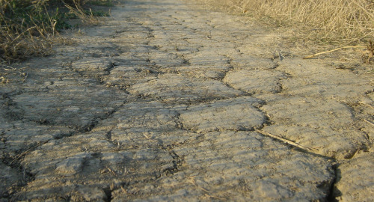
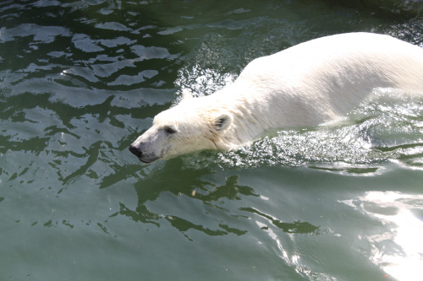
Effects
Step 1 of the PPA: Define the Problem

Slide 7
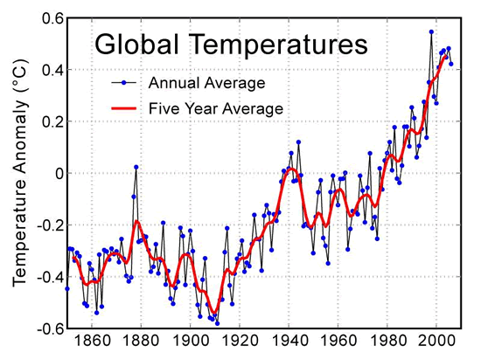
Rising Temperatures
Step 2 of the PPA: Gather the Evidence

Slide 8
Causes of Global Warming
Carbon dioxide emissions from fossil fuel burning power plants
Methane emissions from animals, agriculture such as rice paddies, and from Arctic seabeds
Deforestation, especially tropical forests for wood, pulp, and farmland
Increase in usage of chemical fertilizers on croplands
Step 3 of the PPA: Identify the Causes

Slide 9
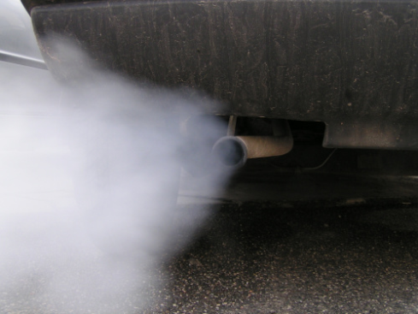
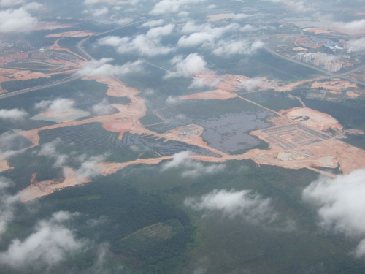
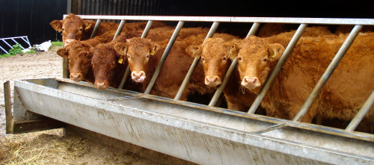
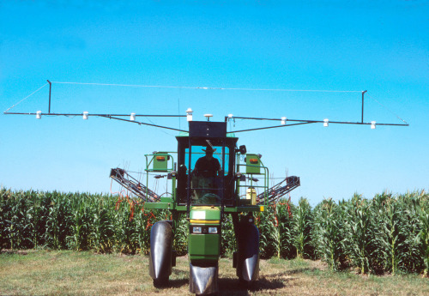
Causes
Step 3 of the PPA: Identify the Causes

Slide 10
What is the BEST solution to Global Warming?

Slide 11
Solutions
Boosting energy efficiency
Greening transportation
Revving up renewables
Phasing out fossil fuel electricity
Managing forests and agriculture
Developing and deploying new low-carbon and zero-carbon technologies
Ensuring sustainable development
Step 5 of the PPA: Develop Policy Solutions

Slide 12
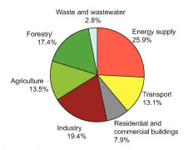
Step 5 of the PPA: Develop Policy Solutions

