Slide 1
Teen Smoking
Jamie Karlsson

Slide 2
PPA Steps
Define the Problem
Gather the Evidence
Identify the Causes
Evaluate an Existing Policy
Develop Solutions
Select the Best Solution (Feasibility vs. Effectiveness)

Slide 3
Defining Teen Smoking
90 % of smokers start off as teens
396,000 smokers who began as teenagers die each year from smoking related illnesses
6,000 children under the age of 18 start smoking
Teen smokers become addicted faster than adults
Step 1 of the PPA: Define the Problem

Slide 4
Effects of Teen Smoking
Shortness of breath
Poor lung function
Respiratory problems
Heart problems
Addiction
Oral health problems
Cancer
Step 1 of the PPA: Define the Problem

Slide 5
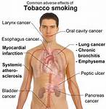
Effects
Step 1 of the PPA: Define the Problem

Slide 6
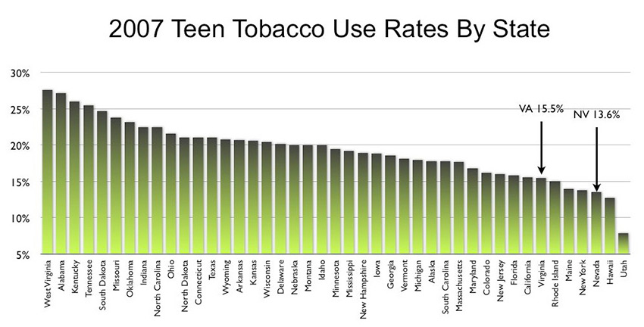
Rates of Teen Tobacco Use
Step 2 of the PPA: Gather the Evidence

Slide 7
Why do Teens Smoke?
Easy Access
Peer Pressure
Parents Smoke
Media
Lose Weight
Reduce Stress
Addiction
Step 3 of the PPA: Identify the Causes

Slide 8
What is the Best Solution To Teen Smoking?
Read the attached article on teen smoking. Decide on the best solutions to the social problem, Teen Smoking.
http://www.modernmom.com/article/solutions-to-teen-smoking
Complete the attached worksheet and brainstorm three possible solutions to the social problem.
http://www2.maxwell.syr.edu/plegal/ppa/ippads1.html
Step 5 of the PPA: Develop New Solutions

