Slide 1
Low Literacy Rates in New York City Middle Schools
Ms. Vespe

Slide 2
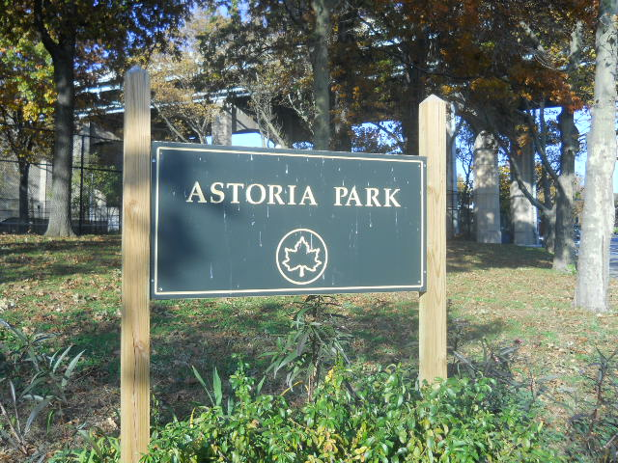
Ask yourself:“Do I read everyday?”
Books
Newspapers
Magazines
Comic Books
Street Signs
Recipes
Text Messages
Websites
Of course you do!

Slide 3
Steps of the PPA
1. Define the Problem
2. Gather the Evidence
3. Identify the Causes
4. Evaluate an Existing Policy
5. Develop Solutions
6. Select the Best Solution
(Feasibility vs. Effectiveness)
*Reminder: Use the PPA Website as a guide to complete the process!

Slide 4
Define the Problem
The problem being addressed is low literacy proficiency rates in New York City middle schools.
Common Core State Test data exhibits that the majority of NYC middle school students earned Level 1 and 2 scores in 2014.
Remediation is necessary in order to improve the scores and increase the proficiency rates.
The question is HOW?

Slide 5
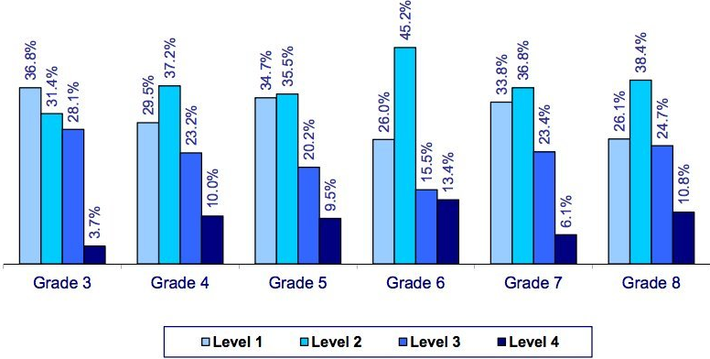
Gather the Evidence
2014 Common Core English Scores
For New York Students

Slide 6
Stop and Jot: What makes a good reader?
According to ReadingRockets.org, good readers…
Set goals before they read
Read words accurately and quickly while making meaning
Use background knowledge to make predictions
Make inferences using background knowledge and context clues
Self monitor and self correct when necessary
Think about what they read and summarize the main idea

Slide 7
Identify the Causes Group Work Create a ten question survey to distribute to your peers. The questions should investigate how much time is spent reading outside of school. You should seek answers to questions about what students prefer to read, their access to books, and their overall attitudes towards reading.

Slide 8
Evaluate Current Policy
Whole class literacy instruction using grade level curriculum and materials in the general education classroom
Differentiated tasks meeting the needs of different learning styles and abilities in the general education classroom
Individualized literacy services provided in different settings such as a resource room, integrated co-teaching classroom, 12:1:1 self-contained classroom

Slide 9
Develop Solutions
Engage in a discussion with your group and
identify possible solutions to improve the
current social problem you are investigating.
Consider the following questions:
How can school literacy instruction be more effective?
How can literacy engagement in the home be increased?
How can student attitudes towards literacy be improved?
What materials or tools can be utilized to improve the problem?

Slide 10
Select the Best Solution
Working as a group, consider the effectiveness and feasibility
of the proposed solutions. Based on the criteria, select the best one.
 | High Feasibility | Medium Feasibility | Low Feasibility
High Effectiveness
Medium Effectiveness
Low Effectiveness

Slide 11
Assessment
Students will be assessed based on:
Group work contribution
Extension Homework: Research school programs that promote literacy in the home
Individual research of causes and possible solutions

