Slide 1
Gang Violence
How to solve the problem of city gangs in Queens
Mr. Snyder
IS 126

Slide 2
Public Policy Analysis
Mr. Snyder’s Public Policy Analysis Project
ELA Seventh Grade
The link to a more in-depth study on the steps of public policy can be found here.

Slide 3
Defining the Problem
Using this worksheet, define the social problem of gangs found in Queens.

Slide 4
Where’s the Evidence?
In your groups, gather three or more pieces of evidence that this social problem exists in Queens.

Slide 5
The Causes
Within your group, explain some underlying causes for this problem.
A four part documentary on the history of gang in NY can be found here for your own interest.

Slide 6
Current Policy
How is the borough of Queens currently dealing with this social problem of gang violence?
Explain the results of your research here.

Slide 7
Better Solutions
Develop three new public policies that help solve the social problem of gang violence in Queens.
Once your group has developed three policies, have your secretary write them down here.

Slide 8
The Best Solution
Rate each solution on the below graph to find the best solution to the problem of gang violence in Queens.
 | High Feasibility | Medium Feasibility | Low Feasibility
High Effectiveness
Medium Effectiveness
Low Effectiveness

Slide 9
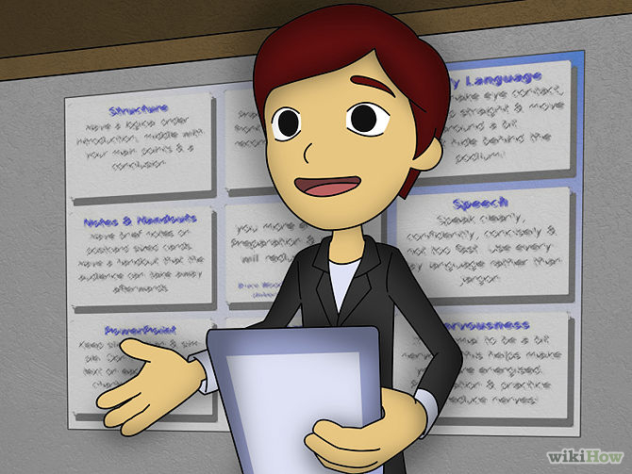
Presentation
Using the oral presentation rubric from the syllabus, be prepared to present your group’s ideas to the class.

