Slide 1
by: Mrs. Narain I.S.126Q anarain2@schools.nyc.gov

Slide 2
Follow these steps to become a Public Policy Analyst:
Define the Problem
Gather the Evidence
Identify the Causes
Evaluate an Existing Policy
Develop Solutions
Select the Best Solution (Feasibility vs. Effectiveness)

Slide 3
Do you prepare for tests?
What are your study habits?
Why is it important to study for your exams?
Look at the following graphs and statements about study habits and discuss with your group members what you have observed.

Slide 4
WHAT IS MEANT BY “POOR STUDY HABITS?”
Students who have poor study habits usually read without recognizing meaning or skim so quickly they miss important facts.
They also may be careless, messy in their paperwork, or tend to overlook or skip problems and tasks.
Students with poor study habits are easily distracted, do not stick to a task, daydream or try to study while watching television or listening to music.
They rarely ask meaningful questions or they constantly ask questions just to avoid getting to their assignments.
Many poor students have never received help to learn “how to study.”

Slide 5
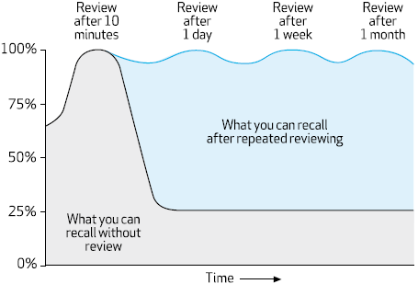
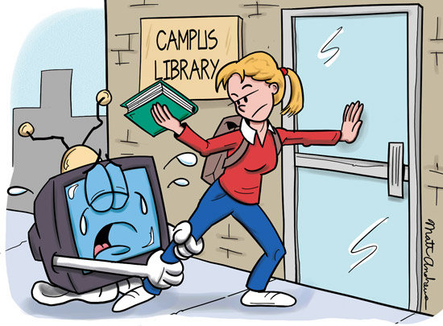
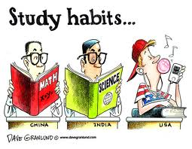

Slide 6
Bad Study Habits
Study partners can serve as a valuable educational resource - provided they're the right ones. Not every friend makes a good study partner.
Music and television serve as major distractions, even when enjoyed by family members in other rooms of your home. Flickering lights and sounds not only pique your interest, they slow down the learning process and hinder reading comprehension.
Social connectivity can serve as an ongoing distraction for older kids, with constant text messages, push notifications, alerts, and incoming calls.
If you're expecting to finish your math homework in the 10 minute commute from the school parking lot to the soccer field for practice, you might want to reconsider.
It can be difficult for students to carve out adequate space and quiet learning time in the center of their bustling households.
Unorganized notes, books and bags.

Slide 7
Define the Problem (Step 1)
Based on the pictures and statements you’ve examined in the previous slides and the questions you have discussed with your group.
You will now act as a Public Policy Analyst (PPA) to define the problem.
Here ‘s an example of the worksheet you’ll be using to define the problem. See link below.
Define the Problem

Slide 8
Gather the Evidence (Step 2)
Use the following links to aid you in your research to find solutions to the problem you have defined.
http://www.bookrags.com/articles/16.html
http://blog.careerfutura.com/study-habits-learning-techniques-strategies/
Here ‘s an example of the worksheet you’ll be using to gather the evidence. See link below.
Gather the Evidence

Slide 9
Read pages 4-5 of the document in the link below.
Chttp://www.google.com/url?sa=t&rct=j&q=&esrc=s&frm=1&source=web&cd=7&cad=rja&uact=8&ved=0CEcQFjAG&url=http%3A%2F%2Fwww.williamgladdenfoundation.org%2Fimages%2FImage%2Fuser%2FStudy%2520Habits.doc&ei=coUsVMumKIa4yQTo6IGoCA&usg=AFQjCNG1j5CpYVz8qPZoWQQwlMulwQq

Slide 10
Identify the Causes (Step 3)
Here ‘s an example of the worksheet you’ll be using
to identify the causes of poor study habits of students.
See link below.
Identify the Causes

Slide 11
Develop Solutions
Now that you have defined the problem, work with your group to develop solutions to the problem.
http://www.gcisd-k12.org/Page/11908
Each group will present their solutions to the class by making book marks with good study habits.
The following link is an example of the worksheet you will be using to develop your solutions as a Public Policy Analyst.
Develop Solutions

