Slide 1
Teenage Violence in Middle Schools in New York City
Alyssa Mescia

Slide 2
Steps of the PPA
Defining the Problem
Identifying the causes of the problem
Gathering evidence
Describing existing causes of the problems
Formatting Solutions
Selecting the Best Solution
feasibility vs. effectiveness
Refer to the PPA Website for more information!

Slide 3
What is violence?
Some words/adjectives that come to mind when we think of violence are……
Brutal
Aggressive
Cruel
Hurt
Injure
Murder

Slide 4
TEEN Violence
As defined by the CDC, “Interpersonal violence is defined as ‘the intentional use of physical force or power, threatened or actual, against another person or against a group or community that results in or has a high likelihood of resulting in injury, death, psychological harm, maldevelopment, or deprivation” (Dahlberg and Krug 2002).
“Research and programs addressing youth violence typically include persons between the ages of 10 and 24, although patterns of youth violence can begin in early childhood”.
Source: http://www.cdc.gov/violenceprevention/youthviolence/definitions.html

Slide 5
Defining the PROBLEM
The problem being addressed is teen violence in NYC Public Schools.
There are violent crimes committed every year by teens.
The National Youth Violence Prevention Resource Center gives the following statistics on teen violence regarding violent crimes:
In 2000, about 1,561 youth under the age of 18 were arrested for homicide.
In 2000, nine percent of the murders in the United States were committed by persons under the age of 18”.
“One in ten teens arrested has been engaging in a violent activity that could have resulted in the serious injury or the death of another person”.
Source: http://www.teenhelp.com/teen-violence/teen-violence-statistics.html

Slide 6
What is causing teen violence?
Abuse at home
Media: television, movies, video games, and music
Gangs
Alcohol and drugs
Mental health disorder

Slide 7
Turn and Talk
Why would some teens participate in violence?
Why might other teens not partake in violence?

Slide 8
What can be done?
In small groups work to develop at least two solutions (up to four) that could prevent teen violence.

Slide 9
Which solution is the best?
Consider…
Feasibility [Can it really happen?]
Effectiveness [Will it work?]

Slide 10
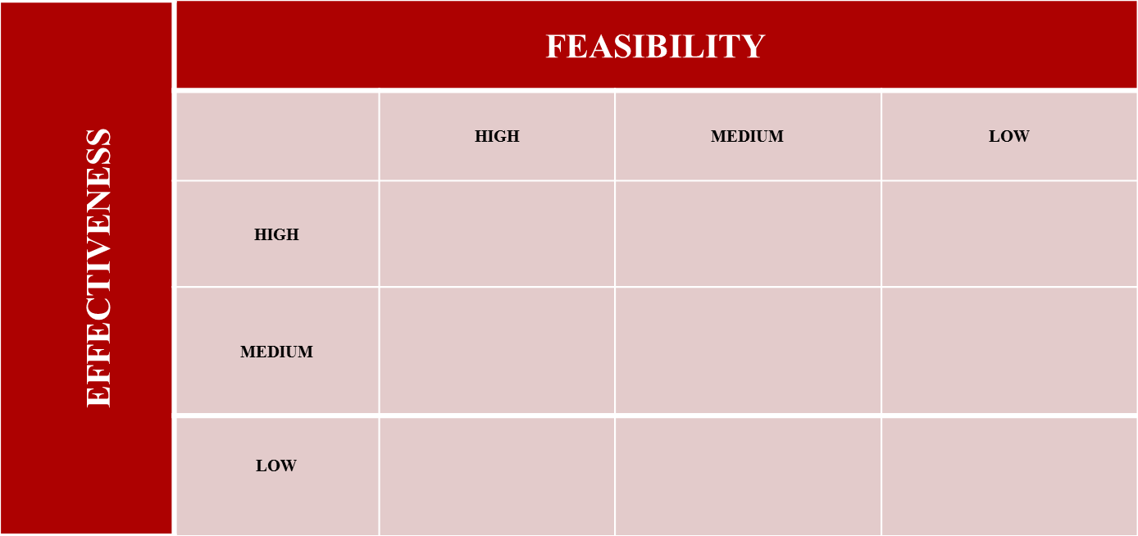
Choose a solution!

Slide 11
Assessment
Students will be assessed based on their class participation individually and with their groups.
Students will be assessed on a homework extension activity in which they will research more about teen violence and locate one organization or group that works to prevent teen violence or can that can help people who are victims of teen violence.

