Slide 1
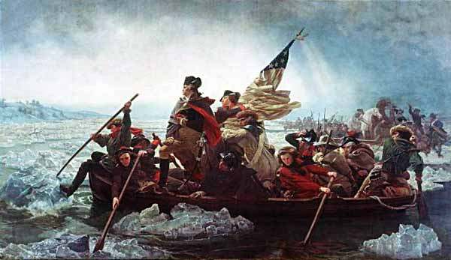
Project HISTORY PowerPoint Presentation
Causes of the American Revolution
By Mrs. McLaughlin
Social Studies 7
St. Francis of Assisi School

Slide 2
Historical Background
There were many causes of the American Revolution.
The long struggle between England and her 13 colonies
in America took place over the course of several years
during the middle of the 18th century. A number of
important events lead up to the Revolutionary War,
which resulted in freedom for the colonists and the birth
of the United States of America.

Slide 3
Social Problem: Have you ever been forced to do something that you didn’t agree with?
How did it make you feel? Is this question relevant to the colonists? Use this to help you answer this.

Slide 4
AHPPA Steps
As a group-
Must Do: Determine the Causes of the American Revolution by completing the AHPPA Worksheet. Click on the slide title to read more.
Can Do: Take the point of view, of either a Patriot or a Loyalist, and design a political cartoon showing your opinion on one of the causes that you studied.
AHPPA Worksheet

Slide 5
Task
In teams of four, you will analyze the following five slides and list the causes for the American Revolution on your chart.
Document # | Cause of Revolution

Slide 6
#1: Proclamation of 1763
1) What did many colonial settlers want to do after the French and Indian War?
2) Give two reasons why the British passed the Proclamation of 1763.
3) What were the eastern and western boundaries of the “Indian Territory”?

Slide 7
#2: Stamp Act: Taxed Items & Amounts
Why did the British impose the Stamp Act?
List 3 taxable items and the cost of the tax.
What was meant by the slogan, “No taxation without representation” ?

Slide 8
#3: America’s First Political Cartoon
Why did Patriots feel the disjoined snake would be a good symbol for
their cause?

Slide 9
#4: The Quartering Act
What three things did the Quartering Act force the colonists to provide for the British soldiers?

Slide 10
#5: The Boston Massacre
1) Describe how the soldiers in the picture are organized. Are they firing
from close range or from a distance?
2) Are the colonists in the crowd armed with weapons or fighting back?
3) In the year 1770, why might a picture have a larger audience and a
greater effect than a newspaper article?
4) Propaganda is misinformation, or a half-truth that gives only one side of the story. It is used for the purpose of stirring up feelings or emotions. Why could this engraving be considered colonial propaganda?

