Slide 1
Poor Academic Performance
Ms. Martello
St. Francis of Assisi
amartello@sfaschool.org

Slide 2
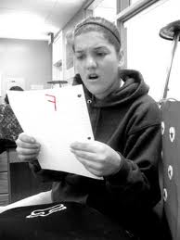
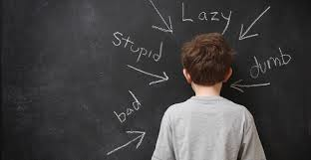
Have you ever had this reaction after receiving a grade on an assignment?
Have you ever felt like this when you don’t do as well on an assignment?

Slide 3
Define the problem
What does poor academic performance look and sound like?
Worksheet 1

Slide 4
Create one collaborative t-chart with your table members about what poor academic performance looks and sounds like.
Poor academic performance looks like…
Poor academic performance sounds like…

Slide 5
Gather Evidence
Worksheet 2
Have you ever received a poor grade?
Do you know what contributed to your poor grade?
Time Management
Getting Bad Grades

Slide 6
Determine the causes
What causes poor academic performance?
Are there many different causes that are avoidable?
Worksheet 3
Wasting Time
Organization
Sleep

Slide 7
Create a t-chart to display the different causes of poor academic performance and some solutions.
Poor academic performance is caused by…
Poor academic performance can be prevented by…
Success in School

Slide 8
Copyright
The following websites are included in this PPT to assist students in researching about poor academic performance.
http://pbskids.org
http://www.reuters.com

