Slide 1
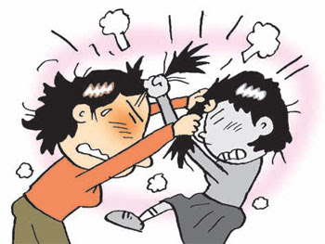
Fighting at The Albert Shanker School for Visual and Performing Arts (IS 126 Q)
By
Rafeek Khan
Rkhan10@schools.nyc.gov

Slide 2
Background
The Albert Shanker School for Visual and Performing Arts is a Middle School located in the Long Island City area of Queens NYC.
The school population consists of predominantly Black and Hispanic students.
It is a Title I school.

Slide 3
Click on the link below to view a video of a brawl in Astoria Park.
http://www.huffingtonpost.com/2013/04/19/teen-brawl-in-astoria-par_n_3117600.html

Slide 4
Turn and talk with your partner about the video that you saw.
Discuss how this could be the end result of a situation that originated in a classroom or through social media.

Slide 5
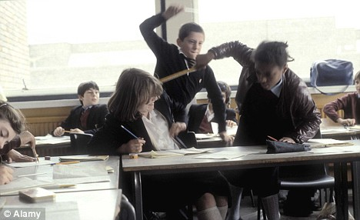
How do we define fighting in the classroom?
What does it look like? Feel like? Sound like?
(Elicit student responses)

Slide 6
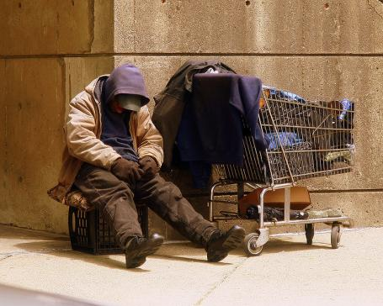
PPA-Define the Problem: Why is fighting an issue in IS 126?
What are some of the short term outcomes of disruptive classroom behavior?
What are some of the long term outcomes of disruptive classroom behavior?
(students discuss with a partner and then share with the class).

Slide 7
Gathering the Evidence
Use the link below to obtain a worksheet to gather evidence of disruptive behavior in the classroom in New York City as well as the United States.
http://flippedtips.com/plegal/tips/worksheet2.html

Slide 8
PPA-Identify the Causes:
Utilize a discussion web to identify the main causes of fighting in the classroom.
Causes of fighting

Slide 9
Evaluate an Existing Policy
Is there an existing policy in place to address fighting in the classroom in NYC schools?
If so, is it working?
Using the worksheet, discuss with your partner the merits and demerits of the current policy.
http://flippedtips.com/plegal/tips/worksheet4.html

Slide 10
PPA-Develop Solutions: How would we have acted differently? How can we prevent ourselves from becoming disruptive in class?
What would you do?
What would you say?

Slide 11
Brainstorm solutions: What policies can you create to correct the problem? What are the pros and cons of each solution?
Utilize a discussion web to brainstorm solutions to the problem.
Solutions for fighting

Slide 12
Brainstorm solutions:
After discussing with your partner and the whole class, use the worksheet below to develop three to four original solutions to the problem.
http://flippedtips.com/plegal/tips/worksheet5.html

Slide 13
Selecting the Best Policy
Using the feasibility and effectiveness worksheet, assign values to each aspect of the solutions developed in stage five to arrive at the best policy to address the issue of fighting in the classroom.
http://flippedtips.com/plegal/tips/worksheet6.html

Slide 14
Congratulations
Policy

