Slide 1
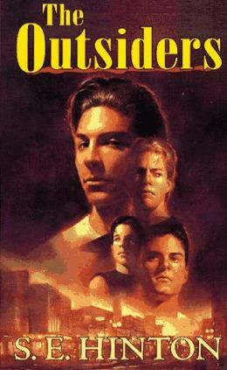
How does child abuse impact the characters of The Outsiders
By: Thomas
Grossman

Slide 2
Problem:
Children are suffering from a hidden epidemic of child abuse and neglect. Every year more than 3 million reports of child abuse are made in the United States involving more than 6 million children (a report can include multiple children). The United States has one of the worst records among industrialized nations – losing on average between four and seven children every day to child abuse and neglect.
Step 1 of the PPA: Define the Problem

Slide 3
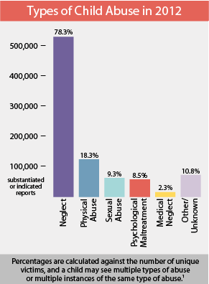

Slide 4
Students Will be able to
Identify examples of child abuse as it effects characters in The Outsiders.
State how child abuse currently effects children and teenagers in the United States.
Brainstorm reasons why child abuse is a major issue in our country. What can be done to address the issue of children facing child abuse?
Remember to use the PPA steps:
http://flippedtips.com/plegal/ppae/ppae3.html

Slide 5
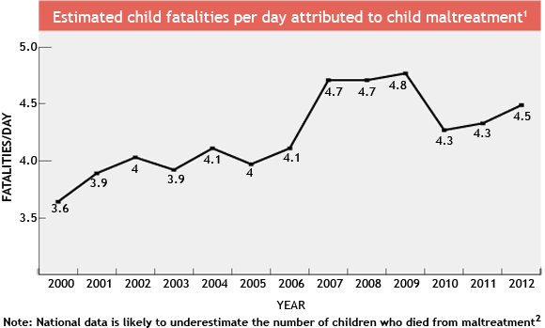
Children Are Killed by Child Abuse
Step 2 of the PPA: Gather the Evidence

Slide 6
How does Child Abuse affect the characters of the Outsiders?
1) List three examples from The Outsiders of a character experiencing child abuse.
2) Choose one of your examples and briefly discuss how this character was effected by it.

Slide 7
United States Department of Justice: Special Report, 2002
CHILDREN WHO GROW UP IN HOMES WHERE VIOLENCE IS PRESENT ARE:-
6 times more likely to commit suicide-
24 times more likely to be sexually assaulted-
67 times more likely to engage in delinquent behavior as an adolescent-
100 times more likely to be abusers themselves-
1500 times more likely to be abused or neglected

Slide 8
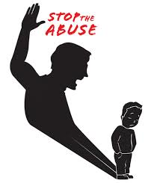
Small group/Class Discussion
WHY ARE CHILDREN WHO GROW UP IN HOMES WHERE VIOLENCE IS PRESENT MORE LIKELY TO TURN INTO ABUSERS?

Slide 9
Small group/Class Discussion
WHAT CAN BE DONE TO PREVENT CHILD ABUSE?
Step 5 of the PPA: Develop Solutions

Slide 10
Evaluation
EVALUATION:
Students will be evaluated twice for this project.
One class work grade will be given for today’s worksheet about child abuse in the United States.
Extra credit will be given to those who participate in the group discussion.

