Slide 1
Diabetes
Tiberi
I.S. 126, the Albert Shanker School for Visual and Performing Arts
atiberi@schools.nyc.gov

Slide 2
Do Now
In your journals, answer:
Do you know anyone with diabetes?
Describe some of the symptoms experienced by someone with diabetes?

Slide 3
Symptoms
Frequent urination
Unusual thirst
Extreme hunger
Unusual weight loss
Extreme fatigue
Irritability
Blurred vision
Very dry skin
Cuts or bruises that are slow to heal
Tingling or numbness in the hands or feet
Recurring skin, gum or bladder infections
No symptoms (develop too slowly to be noticed)

Slide 4
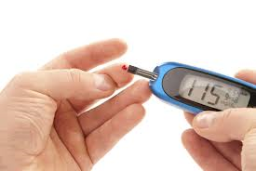
What is diabetes?
Having higher than normal blood glucose levels.
Diabetes is a lifelong (chronic) disease in which the body does not produce or properly use insulin, a hormone that is needed to convert sugar, starches and other food into energy (glucose) needed for daily life.

Slide 5
Types of diabetes
Type 1 diabetes
insulin-dependent diabetes mellitus or juvenile-onset diabetes
5% of all diagnosed cases of diabetes.
Type 2 diabetes
non-insulin-dependent diabetes mellitus or adult-onset diabetes
90% to 95% of all diagnosed cases of diabetes.
Gestational diabetes
only pregnant women get.
2% to 10% of all pregnancies but usually disappears when a pregnancy is over.
Other specific types of diabetes
resulting from specific genetic syndromes, surgery, drugs, malnutrition, infections, and other illnesses may account for 1% to 5% of all diagnosed cases of diabetes.

Slide 6
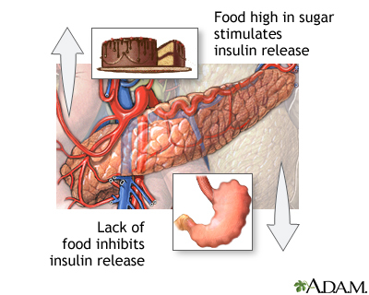
Symptoms of Diabetes
in a normal system
food is broken down for energy
glucose enters the blood stream
pancreas makes insulin
insulin allows for glucose to move from blood into cells
Notes:
For link—chapter 1, 2nd dot

Slide 7
Public Policy Analyst (PPA)
Problem There is too high a level of diabetes in NYC.
Evidence How many people suffer from diabetes related problems in our community?
Causes What are some of the causes?
Existing Policies What has NYC done to eliminate the causes?
Develop Solutions Come up with alternative solutions.
Best Solution

Slide 8
EVIDENCE: Diabetes in NYC
Diabetes in New York City has increased 13% since 2002.
1 in 8 (800,000) New Yorkers have diabetes—about a third don’t know it
People can often prevent diabetes by maintaining a healthy weight and exercising
People with diabetes can often manage their illness—to live longer and healthier lives

Slide 9
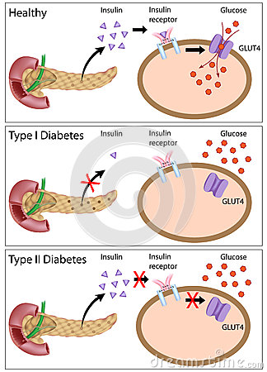
What CAUSES the symptoms
in a diabetic system
People have high blood glucose because:
The pancreas does not produce enough insulin (Type I)
The cells do not respond to the insulin normally (Type II)
Both of the above

Slide 10
What are the risk factors?
Being overweight or obese
Being older (45 years old or older)
Having a parent, brother, or sister with diabetes
Being African American, American Indian, Asian American, Pacific Islander, or Hispanic American/Latino heritage
Having a prior history of gestational diabetes or birth of at least one baby weighing more than 9 pounds
Having high blood pressure measuring 140/90
Having abnormal cholesterol with HDL (“good”) cholesterol is 35 or lower, or triglyceride level is 250 or higher
Being physically inactive--exercising fewer than three times a week.

Slide 11
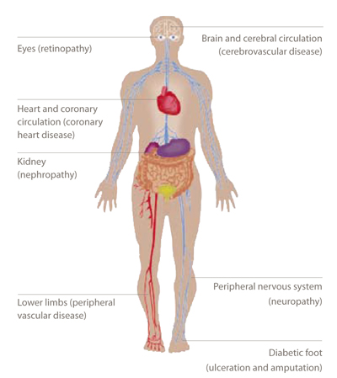
Complications
Alzheimer’s disease
Eye problems/blindness
Hearing problems
Skin and mouth conditions
Heart and blood vessel disease
Kidney damage
Nerve damage
Foot damage
Osteoporosis
Notes:
Heart and blood vessel disease. Diabetes dramatically increases the risk of various cardiovascular problems, including coronary artery disease with chest pain (angina), heart attack, stroke, narrowing of arteries (atherosclerosis) and high blood pressure. The risk of stroke is two to four times higher for people with diabetes, and the death rate from heart disease is two to four times higher for people with diabetes than for people without the disease, according to the American Heart Association.
Nerve damage (neuropathy). Excess sugar can injure the walls of the tiny blood vessels (capillaries) that nourish your nerves, especially in the legs. This can cause tingling, numbness, burning or pain that usually begins at the tips of the toes or fingers and gradually spreads upward. Poorly controlled blood sugar can eventually cause you to lose all sense of feeling in the affected limbs. Damage to the nerves that control digestion can cause problems with nausea, vomiting, diarrhea or constipation. For men, erectile dysfunction may be an issue.
Kidney damage (nephropathy). The kidneys contain millions of tiny blood vessel clusters that filter waste from your blood. Diabetes can damage this delicate filtering system. Severe damage can lead to kidney failure or irreversible end-stage kidney disease, requiring dialysis or a kidney transplant.
Eye damage. Diabetes can damage the blood vessels of the retina (diabetic retinopathy), potentially leading to blindness. Diabetes also increases the risk of other serious vision conditions, such as cataracts and glaucoma.
Foot damage. Nerve damage in the feet or poor blood flow to the feet increases the risk of various foot complications. Left untreated, cuts and blisters can become serious infections. Severe damage might require toe, foot or even leg amputation.
Skin and mouth conditions. Diabetes may leave you more susceptible to skin problems, including bacterial and fungal infections. Gum infections also may be a concern, especially if you have a history of poor dental hygiene.
Osteoporosis. Diabetes may lead to lower than normal bone mineral density, increasing your risk of osteoporosis.
Alzheimer's disease. Type 2 diabetes may increase the risk of Alzheimer's disease and vascular dementia. The poorer your blood sugar control, the greater the risk appears to be. So what connects the two conditions? One theory is that cardiovascular problems caused by diabetes could contribute to dementia by blocking blood flow to the brain or causing strokes. Other possibilities are that too much insulin in the blood leads to brain-damaging inflammation, or lack of insulin in the brain deprives brain cells of glucose.
Hearing problems. Diabetes can also lead to hearing impairment.

Slide 12
Sources
http://www.ncbi.nlm.nih.gov/pubmedhealth/PMH0002194/
http://www.pamf.org/diabetes/whatis/
http://www.diabetes.org/diabetes-basics/?loc=GlobalNavDB
http://www.diabetes.org/in-my-community/local-offices/new-york-new-york/
http://www.cdc.gov/diabetes/consumer/prevent.htm
http://www.mayoclinic.com/health/type-2-diabetes/DS00585/DSECTION=complications
http://www.nyc.gov/html/doh/downloads/pdf/public/dohmhnews5-04.pdf
http://www2.maxwell.syr.edu/plegal/ppa/intro.html

