Slide 1
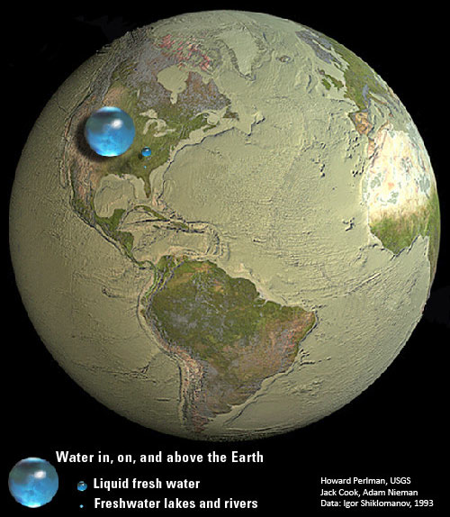
Conservation of Water by: Mrs. Narain I.S.126Q anarain2@schools.nyc.gov

Slide 2
Public Policy Analyst:
Define the Problem
Gather the Evidence
Identify the Causes
Evaluate an Existing Policy
Develop Solutions
Select the Best Solution (Feasibility vs. Effectiveness)

Slide 3
Water and People
How many times a day do you think about water?
Do you think other people have to think about water?
Look at the following pictures and graphs and discuss with your group members what you have observed.

Slide 4
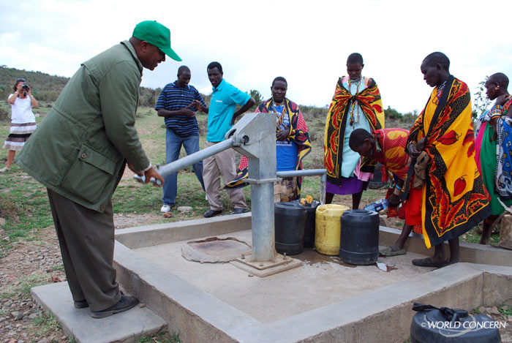
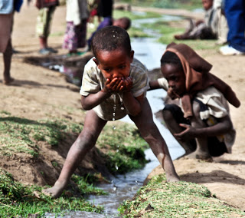
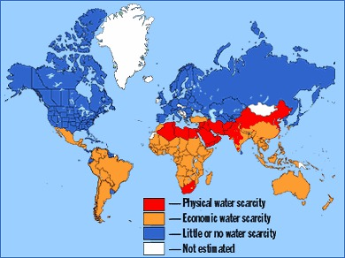
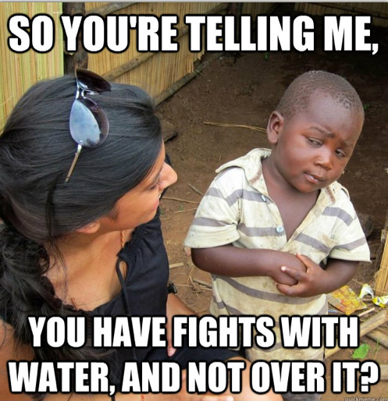

Slide 5
Define the Problem
Based on the photos you’ve examined in the
previous slides and the questions you have
discussed with your group.
You will now act as a Public Policy Analyst (PPA) to
define the problem.
Here ‘s an example of the worksheet you’ll be using
to define the problem. See link below.
Define the Problem

Slide 6
Gather the Evidence
Use the following links to aid you in your research to find solutions to the problem you have defined.
http://realtruth.org/articles/435-edws.html
http://oecdinsights.org/2013/03/22/world-water-day-big-problems-but-there-are-solutions/
http://globalwater.org/?gclid=CPHBu4CfybkCFVNo7AodCUIAkg
Here ‘s an example of the worksheet you’ll be using
to gather the evidence. See link below.
Gather the Evidence

Slide 7
Develop Solutions
Now that you have defined the problem, work with your group to develop solutions to the problem.
Each group will present their solutions to the class.
The following link is an example of the
worksheet you will be using to develop your
solutions as a Public Policy Analyst.
Develop Solutions

