Slide 1
Trouble with Trash at Saint Francis of Assisi School, Astoria, NY
Garbage is accumulating in the cafeteria and classrooms.
Created by Donna McLaughlin-
February 18th, 2013

Slide 2
Trash…
Have you ever seen the school property look like this?

Slide 3
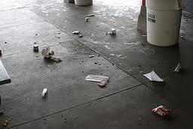
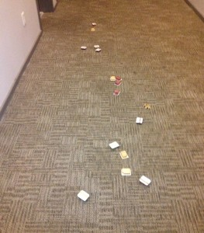
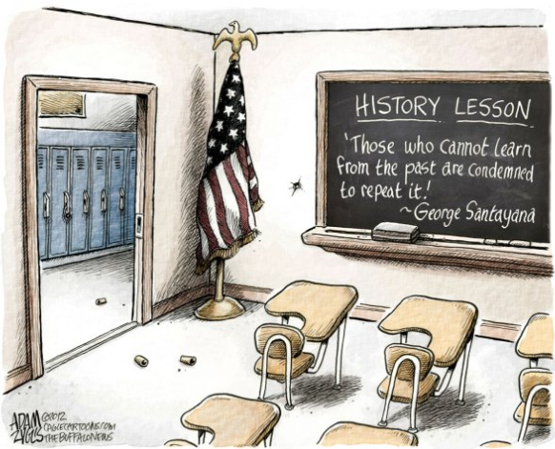
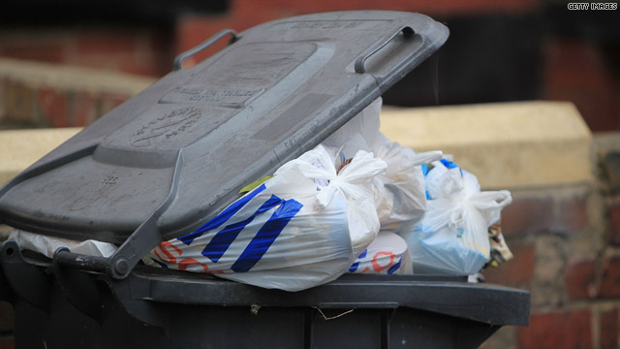
Or this…?

Slide 4
Do you think we have a lower school that looks like…
This one…?
This one…?
Or maybe something in between?

Slide 5
Step 1: Define the problem!
Garbage is accumulating in the classrooms, hallways and lower school.
Think-Pair-Share :
List the kind of waste products (trash) that are produced in the school.

Slide 6
In a small group, discuss…
What kind of trash do you see in our classroom, in our school, in the cafeteria, in the hallways, and outside on the schoolyard?
Choose a secretary to write your answers on the worksheet.

Slide 7
Step 2: Gather the Evidence!
In your group present evidence that a problem exists. Be as specific as possible and cite at least one source of data.
Use this worksheet as a guide

Slide 8
What did we come up with?

Slide 9
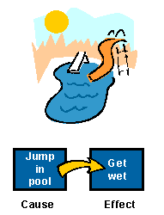
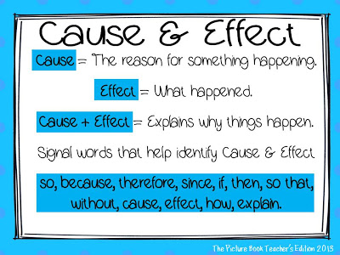
If you can identify the causes of the problem, then you can come up with a plan to lessen or even eliminate those causes.

Slide 10
Step 3: Identify the Cause
Use this worksheet to help you determine what the causes of our trash problems might be

Slide 11
Report your findings

Slide 12
Step 4: Evaluate an existing policy!
What do we already do here at SFA to keep trash from piling up? Use this worksheet to help you analyze what policies are in place to deal with our problem.

Slide 13
What stays?
What’s got to go?
What has to be changed?

Slide 14
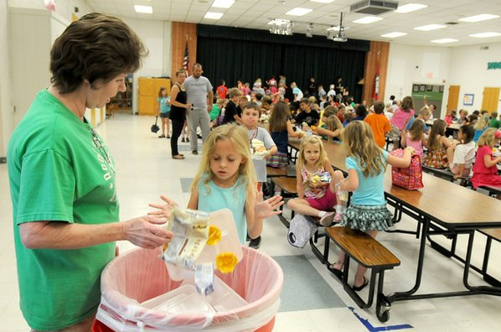
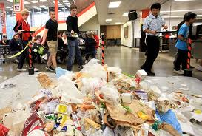
To be clear…which one do we want?
This one? OR This one?

Slide 15
Step 5: Develop Solutions
Develop some new policy solutions.
Can the disadvantages be eliminated with a new policy?
Can the advantages be strengthened?
Examples include tougher penalties, more education about the problem, clearer guidelines, etc.
New policies should include the action, such as hiring more custodians.
Use this worksheet to organize your thoughts.

Slide 16
Step 6: Select the Best Solution!
Which way should we go?
Which solution is most likely to be approved by school administration (feasibility)?
Which is most likely to produce results (effectiveness)?
Does it have to be both? Read this first…
Now use this worksheet to help you sort it out

Slide 17
How we can set our policy into place?

Slide 18
Congratulations! We just made some policy!

