Slide 1
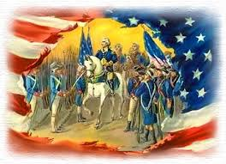
Using the AHPPA to Evaluate the American Revolution
Anastasia Korfiatis 126Q

Slide 2
The American History Public Policy Analyst (AHPPA) Has Four Steps
Identify the Problem
Gather Evidence
Determine the Cause
Evaluate Policy

Slide 3
Background of the Problem
Following the French and Indian War, Britain wanted to control expansion into the western territories. King George III issued the Proclamation of 1763 prohibiting settlements beyond the Appalachian Mountains.

Slide 4
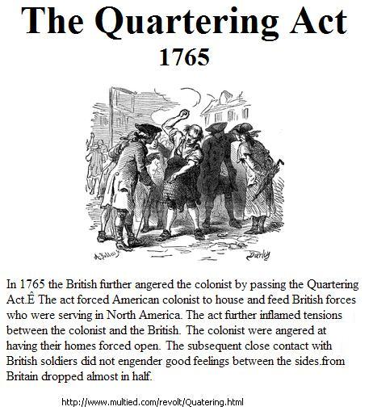
Background of the Problem
In 1765, Parliament passed the Quartering Act that forced the colonists lodge British soldiers stationed in America.

Slide 5
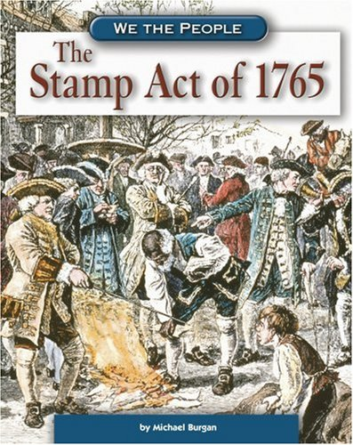
Background of the Problem: The Stamp Act of 1765 was a high tax on paper products imposed on the colonists.
These laws were all passed with no representation by the colonists.

Slide 6
Use the last 3 slides to Complete Define the Problem Worksheet Gather the Evidence Worksheet

Slide 7
AHPPA Step3: Causes of the Problem
Review Worksheets 1 & 2
Why did George III and Parliament enact such harsh laws on the colonists?

Slide 8
AHPPA Step 4: Evaluate the Policy
Ultimately the policy the colonists chose to deal with their problem became known as the American Revolution.
Evaluate that policy using AHPPA Worksheet 4

