Slide 1

Problem: Segregation Still Exists in U.S. Schools
Ms. Chang
I.S. 126Q
Vchang4@schools.nyc.gov
Objective: Use PPA steps to find possible solutions to reduce segregation in public schools.

Slide 2
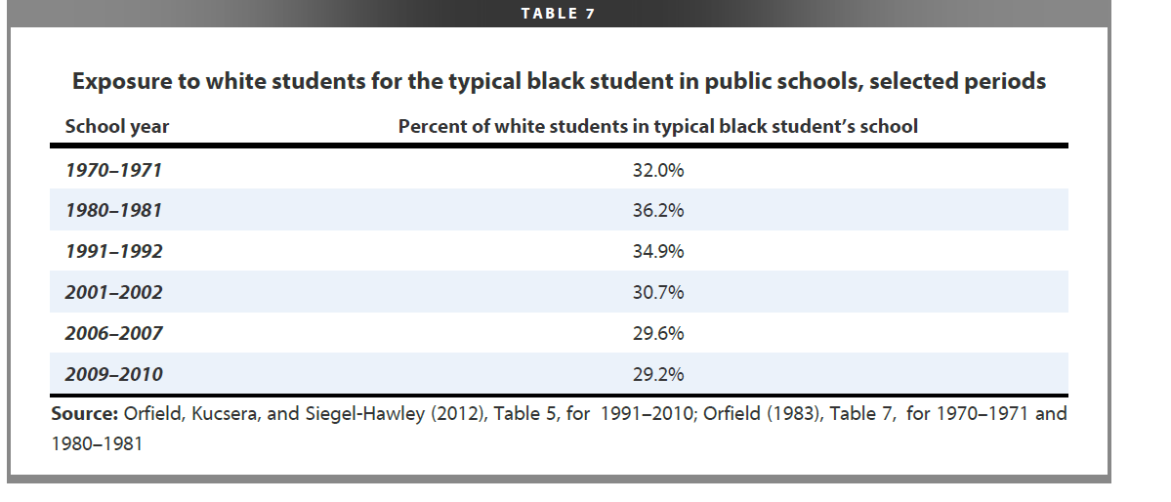
Step 1. In your groups, answer the question: What is the social problem?
*Based on the table, we can tell the social problem is: An increase in the separation of whites and blacks in public schools

Slide 3
Step 2. Where is the evidence?
In your groups:
a) Read the segregation report from the Washington Post
Read the article on Segregated Prom in Wilcox County, GA
Complete the provided worksheet. An example of a completed worksheet can be found here: Example.

Slide 4
Step 3. What are some causes of the problem?
Article to help you out:
ABC News
1. Differential funding for schools
2. Family’s economic hardships
3. Legal loopholes

Slide 5
Step 4. Let’s evaluate existing public policies
Article to help you out:
High Court Bans School Segregation
* There are federal court decisions which ban segregation in public schools

Slide 6
Step 5. What policies can you create to correct the problem?
Congress should:
*Set up a review board to ensure that laws are being followed.
*Investigate cases where there are high levels of segregation.
*Fund states to teach the values of diversity and integration to all school members and students.

Slide 7
Step 6. What is the best policy to correct the problem?
Use the hand-out to figure out the best (both feasible and effective) policy
Here is an example of a completed hand-out: Worksheet 6

