Slide 1
POST TRAUMATIC STRESS DISORDER
PHILLIP BARONE
I.S.126Q
PBarone2@schools.nyc.gov

Slide 2
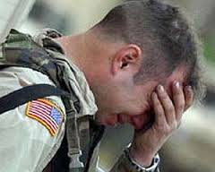
P.T.S.D
POST TRAUMATIC STRESS DISORDER

Slide 3
Use these to help you with some of the tasks in this slide show
http://www.pacaf.af.mil/news/story.asp?id=123328079
http://www.fas.org/sgp/crs/natsec/RS22452.pdf
http://www.mcclatchydc.com/2009/09/04/74886/defense-dept-funding-study-pairing.html#.UipqkBa3C0u
http://www.helpguide.org/mental/post_traumatic_stress_disorder_symptoms_treatment.htm
http://explore.org/about/dog-bless-you/

Slide 4
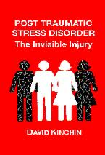
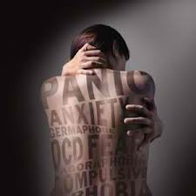
Define the Problem POST TRAUMATIC STRESS DISORDER
Post-traumatic stress disorder (PTSD) is a mental health condition that's triggered by a terrifying event. Symptoms may include flashbacks, nightmares and severe anxiety, as well as uncontrollable thoughts about the event.

Slide 5
DIAGNOSES IN ALL SERVICES (as of 12/7/12)

Slide 6
Gather the Evidence
Use the link above to begin gathering evidence on how extensive the social problem of PTSD is currently in the U.S.
Hint: Google “PTSD + Evidence”

Slide 7
Gather the Evidence
YEAR | NOT DEPLOYED | DEPLOYED
2000 | 1610 | 0
2001 | 1694 | 0
2002 | 1697 | 133
2003 | 1609 | 1100
2004 | 1777 | 3095
2005 | 1912 | 7015
2006 | 1893 | 7745
2007 | 2272 | 11763
2008 | 2589 | 14405
2009 | 2676 | 13975
2010 | 2638 | 14828
2011 | 2806 | 15702
2012 (TO 12/3/12) | 2376 | 14031
TOTAL | 27549 | 103792

Slide 8
POST TRAUMATIC STRESS DISORDER IN NON DEPLOYED MILITARY

Slide 9
What Are the Causes?
Use the link above to begin developing some of the causes of PTSD
Then, we will compare your list to those on the next slides
.

Slide 10
What Are the Causes?
research shows that it's possible to develop PTSD by watching videos, such as Predator reconnaissance and combat feeds, seeing photos, hearing or reading stories of traumatic events from downrange
Bottom line: someone could be half way around the world when they're exposed to a combat situation and still develop PTSD symptoms.
.

Slide 11
TREATMENT POLICIES

Slide 12
Develop Solutions
PTSD is a National Social Problem
Click the link above to help you devise a Treatment policy.
Then, look at the treatment polices on the next slides and select the best one

Slide 13
Treatment Policy #1
Trauma-focused cognitive-behavioral therapy:
Takes the sufferer and gradually exposes them to thoughts, feelings and situations that remind them of the trauma they experienced.

Slide 14
Treatment Policy #2
Family therapy:
Helps the family and loved ones close to the sufferer what they have gone through and communicate better.

Slide 15
Treatment Policy #3
Medication:
Sometimes given to sufferers to relieve secondary symptoms of depression or anxiety

Slide 16
Treatment Policy #4
Service canines for PTSD sufferers:
The Defense Department is financing a $300,000 study that will pair troops returning from Iraq and Afghanistan with dogs trained to sense when their masters are about to have a panic attack and give them a calming nudge or nuzzle.

Slide 17
What Is the Best Treatment Policy?
The best treatment policy is effective and feasible.
Read the above link and discuss what is an effective policy.

Slide 18
What Is the Best Treatment Policy?
The best treatment policy is effective and feasible.
Read the above link and discuss what is a feasible policy.

Slide 19
What Is the Best Treatment Policy? Use effectiveness and feasibility
Trauma-focused cognitive-behavioral therapy
Family therapy
Medication
Service canines for PTSD sufferers

