Slide 1
The Public Policy Analysis: Creating solutions against BULLYING
Lydia Tsiforas
Assistant Principal
I.S. 126
February 28, 2013

Slide 2
GOALS
Identify and understand various bullying behaviors.
Enhance or create a culture of respect.
Empower members of the school community to challenge all forms of bullying.

Slide 3
Define the problem…
Public Policy Analysis: Defining the social problem
What is Bullying?
Bullying is a form of youth violence. Bullying includes:
Attack or intimidation with the intention to cause fear, distress, or harm.
A real or perceived imbalance of power between the bully and the victim.
Repeated attacks or intimidation between the same children over time.1

Slide 4
Bullying can be:
DIRECT
Face to face
Verbal
Insults, name calling, teasing, harassment
Physical
Shoves, pushes, tripping, hitting, assault
Psychological
Rolling eyes, dirty looks, uttering threats, extortion

Slide 5
Bullying can be:
INDIRECT
Behind someone’s back
Exclusion
Leaving out, Shunning
Relational Aggression
Telling people not to be friends with a victim
Gossip
Spreading rumors, lowering people’s opinion about the victim

Slide 6
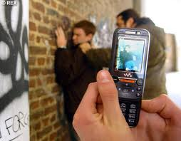
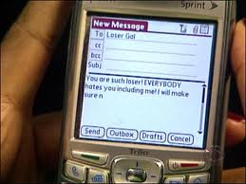
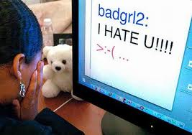
Cyber-Bullying
Bullying can also occur through technology and is called cyber-bullying. Electronic aggression is bullying that occurs through e-mail, a chat room, instant messaging, a website, text messaging, or videos or pictures posted on websites or sent through cell phones.2

Slide 7
Gather the Evidence…
Public Policy Analysis: Gathering evidence of the problem
Why is bullying a public health problem?
Bullying is widespread in the United States.
In a 2011 nationwide survey, 20% of high school students reported being bullied on school property in the 12 months preceding the survey.3
An estimated 16% of high school students reported in 2011 that they were bullied electronically in the 12 months before the survey.3
During the 2009-2010 school year, 23% of public schools reported that bullying occurred among students on a daily or weekly basis. A higher percentage of middle school students reported being bullying than high school students.4

Slide 8
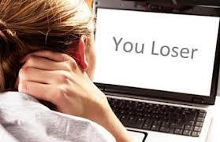
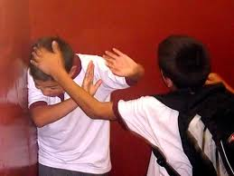
Have you ever been a victim of bulling?

Slide 9
Identify the causes…
Bully: They start the bully cycle
Public Policy Analysis: Identifying the cause of the problem
Defenders of the Victim: Dislike the action and do something to help stop it
Followers: Take active role in bullying but do not initiate
Cycle of Bullying
Supporters: Support the bullying but do not take active role
Possible Defenders: Dislike the action and think about helping
Passive Supporters: They like the bullying but do not display open support
Disengaged onlookers: Often say “It’s not my problem”.

Slide 10
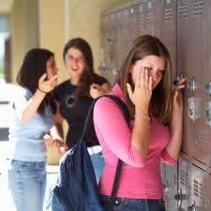
Who is the bully? Who is the victim?
Scenario
Mary recently broke up with her boyfriend John. John is now dating Lisa. Mary convinces all of her friends not to speak or hang out with Lisa anymore.

Slide 11
Characteristics of a bully…
Children who bully:
Want power
View violence in a positive way
May be impulsive, have quick tempers or poor self control
Have difficulty conforming to rules
Gain satisfaction from inflicting injury and perceive “rewards” (prestige, material goods) from their behavior
Have positive self images
Lack empathy
Show little or no concern for the feelings of others
Find it difficult to see things from someone else’s perspective
Are willing to use others to get what they want
Easily frustrated

Slide 12
Who is at risk for bullying?
Children who are bullied tend to:
Be sensitive
Be socially withdrawn
Are either smaller or bigger than most kids their age
Get anxious or upset easily
Have friendship difficulties
Have poor self-esteem
Are quiet, passive manner with lack of assertiveness
Get depressed

Slide 13
How Can You Prevent Bullying or Be a Cause to the Solution?
Develop solutions…
Public Policy Analysis: Developing public policy solutions
Respond as calmly and assertively as you can (anger ignites the situation and tears reinforce the bully’s behavior).
Speak up or offer support when someone is being bullied.
Seek immediate help from an adult.
Report bullying or harassment incidents to your teacher, dean, guidance counselor or principal.
Privately support those being hurt with kind words.
Express disapproval of bullying by not joining in the laughter, teasing or gossip.
Speak out in support of respect for all people no matter how “different” their interests, skin color, religion, origin, income, physical appearance or abilities are.
Defuse a situation by taking the bully aside and asking him or her to stop.

Slide 14
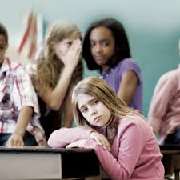
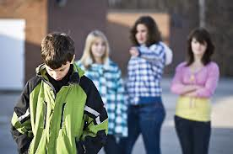
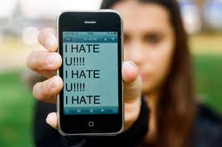
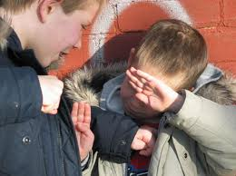
If you are ever the victim of bullying…
Go somewhere that an adult is present
Ignore them
Don’t get angry
Don’t cry
Pretend you didn’t hear them
Respond to the Bully evenly and firmly
Don’t show them that you are upset
Turn the comment into a joke
Don’t look at them
Turn and walk away
Talk about it to someone else
Remove yourself from the situation
Talk to an adult!

Slide 15
Where can I learn more?
Centers for Disease Control and Prevention
www.cdc.gov/violenceprevention
STRYVE
www.safeyouth.gov
Stop Bullying
www.stopbullying.gov
Surgeon General’s Report on Youth Violence
www.surgeongeneral.gov/library/youthviolence

Slide 16
References
1. Farrington, D. P. & Ttofi, M. M. School-based programs to reduce bullying and victimization. Systematic review for The Campbell Collaboration Crime and Justice Group; 2010. Available from URL: http://www.ncjrs.gov/pdffiles1/nij/ grants/229377.pdf
2. David-Ferdon, C., Hertz, M. F. Electronic media and youth violence: A CDC issue brief for researchers. Atlanta, GA: Centers for Disease Control and Prevention; 2009. Available from URL: http://www.cdc.gov/violenceprevention/pdf/ Electronic_Aggression_Researcher_Brief-a.pdf
3. Eaton, D. K. et al. (2010). Youth risk behavior surveillance – United States 2009. Morbidity and Mortality Weekly Report, 59 (SS-5), 1-142. Available from URL: http://www.cdc.gov/ mmwr/pdf/ss/ss5905.pdf
4. Robers, S., Zhang, J., & Truman, J. Indicators of School Crime and Safety, 2010 (NCES 2011-002/NCJ 230812). National Center for Education Statistics, U.S. Department of Education, and Bureau of Justice Statistics, Office of Justice Programs, U.S. Department of Justice. Washington, DC; 2010. Available from URL: http://nces.ed.gov/pubs2011/2011002.pdf

