Slide 1
Bullying in “All Summer in a Day” by Ray Bradbury
David Parente
I.S. 126-Albert Shanker School Visual & Performing Arts
Dparente2@schools.nyc.gov

Slide 2
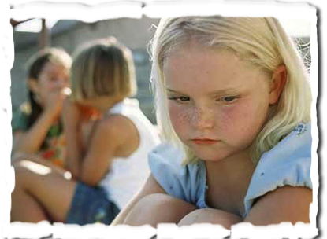
How do we define bullying?
(Elicit Student Responses)
http://www2.maxwell.syr.edu/plegal/TIPS/worksheet1.doc

Slide 3
PPA-Define the Problem: Why is bullying an issue in schools?
(Elicit Student Responses)

Slide 4
PPA-Identify the Causes: What caused the other children to bully Margot?
Utilize the excerpt below to answer the question above:
“It had been raining for seven years; thousands upon thousands of days compounded and filled from one end to the other with rain, with the drum and gush of water, with the sweet crystal fall of showers and the concussion of storms so heavy they were tidal waves come over the islands. A thousand forests had been crushed under the rain and grown up a thousand times to be crushed again. And this was the way life was forever on the planet Venus, and this was the schoolroom of the children of the rocket men and women who had come to a raining world to set up civilization and live out their lives.

Slide 5
PPA-Identify the Causes: What caused the other children to bully Margot?
Utilize the images below to write a paragraph about the question above:

Slide 6
How would you have felt if you were Margot?
Review the excerpt below to determine your response:
"Get away!" The boy gave her another push. "What're you waiting for?"
Then, for the first time, she turned and looked at him. And what she was waiting for was in her eyes.
"Well, don't wait around here!" cried the boy savagely: "You won't see nothing!"
Her lips moved.
"Nothing!" he cried. "It was all a joke, wasn't it?" He turned to the other children. "Nothing's happening today: Is it?"
They all blinked at him and then, understanding, laughed and shook their heads. "Nothing, nothing!"
"Oh, but," Margot whispered, her eyes helpless. "But this is the day, the scientists predict, they say, they know, the sun. . ."
"All a joke!" said the boy, and seized her roughly. "Hey, everyone, let's put her in a closet before teacher comes!"
"No," said Margot, falling back.

Slide 7
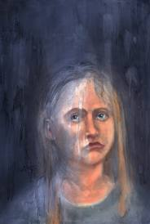
Film Adaptation
View the film adaptation by clicking on the link below:
All Summer in a Day Short Film
How does the film compare to the short story?
Do you think that the film or the short story better emphasize the negative effects of bullying? Explain your answer by citing evidence from both pieces.

Slide 8
PPA-Develop Solutions: What solutions would you develop? http://www2.maxwell.syr.edu/plegal/TIPS/worksheet5.doc
What would you do?
What would you say?

