Slide 1
Trouble with Trash at Saint Francis of Assisi School, Astoria, NY
Garbage is accumulating in the cafeteria and classrooms.
Created by Donna McLaughlin-
February 18th, 2013

Slide 2
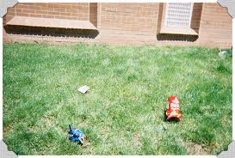
Trash…
Have you ever seen the school property look like this?

Slide 3
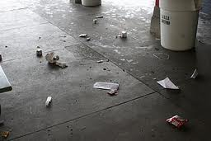
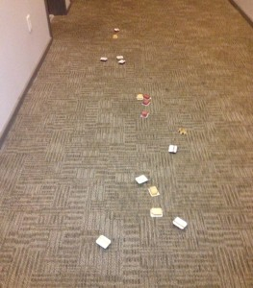
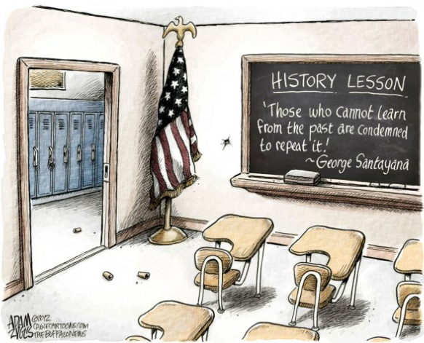
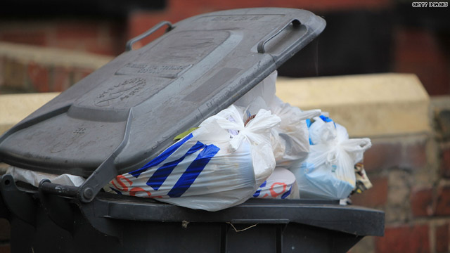
Or this…?

Slide 4
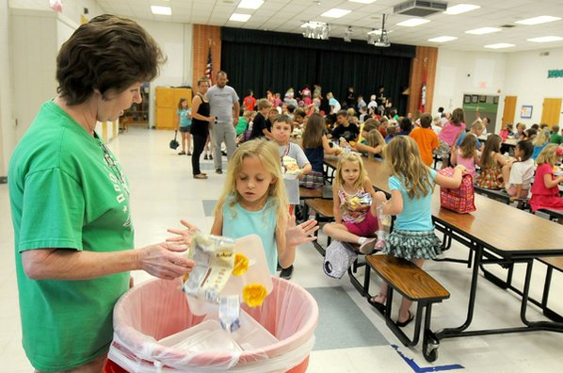
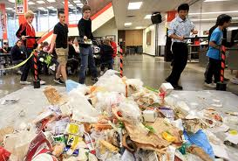
Do you think we have a lower school that looks like…
This one…?
This one…?
Or maybe something in between?

Slide 5
Step 1: Define the problem!
Garbage is accumulating in the classrooms, hallways and lower school.
Think-Pair-Share :
List the kind of waste products (trash) that are produced in the school.

Slide 6
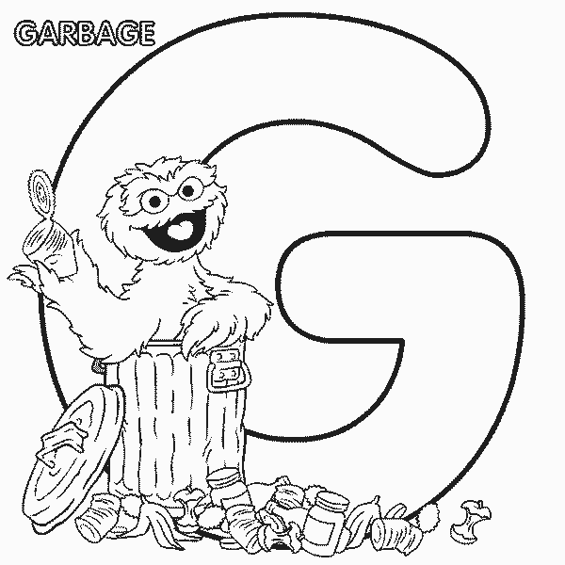
In a small group, discuss…
What kind of trash do you see in our classroom, in our school, in the cafeteria, in the hallways, and outside on the schoolyard?
Choose a secretary to write your answers on the worksheet.

Slide 7
Step 2: Gather the Evidence!
In your group present evidence that a problem exists. Be as specific as possible and cite at least one source of data.
Use this worksheet as a guide

Slide 8
What did we come up with?

